Slide 1
AGRA Tanzania Operational Plan
Revised, June 2019

Slide 2
Table of contents
 | Section | Page Number
1 | Acronyms | 3
2 | Executive Summary | 4
3 | AGRA Strategy Overview | 7
4 | Tanzania Agricultural Context | 11
5 | AGRA Tanzania Strategy | 17
6 | Our delivery – Portfolio to date, emerging context, lessons learned, emerging priorities | 27
7 | The Team | 35
8 | Annexes | 37

Slide 3
ACRONYMS
AGRF | The African Green Revolution Forum
ASDP | Agricultural Strategy And Agricultural Development Plan
BDS | Business Development Services
CAADP | Comprehensive Africa Agriculture Development Program
CARI | Competitive African Rice Initiative
EA | East African
EAC | East African Community
EFSETT | Food Security And Export Trade For Tanzania
GDP | Gross Domestic Product (
ICT | Information And Communications Technology
LGA | Local Government Authority (Lga) Level
MSME | Micro, Small And Medium Sized Enterprises
PPP | Public Private Partnership
SADC | Southern African Development Community
SIDP | The Sustainable Industrial Development Policy
SME | Small And Medium-sized Enterprises
SSA | Sub-Saharan Africa
TA | Technical Assistance
TPSI | Tanzania Potato Seed Systems Improvement
VBA | Village Based Advisor

Slide 4
Executive Summary

Slide 5
Executive Summary
Agriculture is undoubtedly the largest and most important sector of the Tanzanian economy, with the country benefitting from a diverse production base that includes livestock, staple food crops and a variety of cash crops. Macroeconomic performance including GDP growth at an average rate of 6.9 percent for the last three years (2016-2018), growth of agriculture sector at an average rate of 5.3 percent, containing inflation rate at a single digit at an average of 4.7 percent for the period, stability of the shilling against other currencies and reduction of poverty incidence from 28.2 percent to 26.4%. Food related imports are estimated to be about $818 million. Agriculture and related activities provide employment to an estimated 67% of the population^{2.}
Tanzania's Agricultural sector is a sector of contrasts; despite having a relatively rich base of land and water resources and a favorable climate in many areas for the majority of years, it is hampered by low productivity and persistent poverty. Crop diversity is high, but the majority of households engaged in the sector grow a limited number of food crops for subsistence, and despite the resource endowments these households are vulnerable to food security and economic shocks³.
The Agriculture sector in Tanzania, like her EA counterparts, faces many challenges. There is limited access to input/fertilizer with average fertilizer usage at 8-9 kg/ha of fertilizer compared to 16kg/ha used in SADC countries. About 4.7 M ha or 14% of the total crop land (32.7 M ha) in Tanzania are affected by soil acidity (pH<5.65). The area affected and the impact on agriculture in Tanzania is large and its economic impact significant with an estimated $470 Million in annual losses due to yield impediment on major cropped areas.
Only about 20% of smallholders use improved seeds, the cost of finance is high (18% - 24%) with <10% of commercial lending to Agriculture. There is inadequate delivery of extension services due to limited resources, input distribution systems operate at sub-optimal level and the costs of farm inputs are generally high. The quality of rural infrastructure (e.g. irrigation, rural roads, storage facilities, market infrastructure) remain low leading to high transaction costs and post-harvest losses estimated to be 25%-35%. Other challenges in the sector include low levels of mechanization that limits production capacity; for instance, 64% of smallholder farmers cultivate using the hand hoe, 24% by draught animal power and only 12% by tractors.
Areas of improvement at national level include (1) sector coordination and evidence-based planning, (2) access to major grain markets and reduction of post-harvest losses, (3) coordinated supply chains to match demand and supply of grains and legumes, and (4) development of input systems in some agro-ecological zones. Other underlying challenges include implementation capacity gaps, resource constraints to fund the interventions and under-developed sector coordination. System level underlying challenges include limited access to fertilizers of appropriate blends as well as other technologies, limited access to credit and an ineffectual extension services network that results in poor adoption rates for fertilizer, seeds of improved crop varieties and other new productivity enhancing technologies.
Sources: 1. https://datacatalog.worldbank.org | 2. Tanzania 2019/20 Budget Speech. 3.http://www.tzdpg.or.tz/fileadmin/documents/external/national_development_frameworks/ASDP2_Final_Document_20_May._2016__after_edit__1_.pdf | 4 Agriculture Climate Resilience Plan 2014-2019

Slide 6
Executive Summary
There are also policy gaps that hinder transformation of the sector. The government needs support towards ASDPII implementation at the Local Government Authority (LGA) Level, Improvement in the CAADP country process with the focus of improving Tanzania’s performance in the biennial review process, and strengthening policy analysis and reforms for an enhanced enabling policy environment.
AGRA’s 2017 – 2021 strategy seeks to catalyze and sustain an inclusive agriculture transformation in 11 priority countries including Tanzania. Our theory of change is that unlocking sustainable transformation will required a combination of {i} Policy and State Capability: working with government to strengthen execution capacity while enhancing the transparency, accountability systems and policy environment for increased public and private sector investment in agriculture; {ii} Systems Development: investments to build downstream delivery systems closer to smallholder farmers while providing support to local private sector to scale technologies and services which deliver better productivity and incomes; and Partnerships: investments to facilitate the alignment between government priorities and private sector interests; improving integration and coordination which lead to investments beneficial to smallholder farmers
In Tanzania, AGRA’s focus will be on:
Support government in the implementation of the ASDPII at the LGA level focusing on activities that strengthen planning and implementation of the DADPs and crowding-in investments. Development of flagship programme to catalyze the implementation of ASDPII will also be an important areas of focus. In Policy, AGRA will focus on micro-reforms of problem policies and regulations, political economy assessments, with a focus on trade, the seed sector and fiscal policies touching on agribusinesses. AGRA will also support government in the review of Agriculture Policy 2013.
Successful implementation of the consortia program. Embedded and complementing consortia program are the YieldWise project and inclusive finance. Specific activities will focus on the roll out of VBA operations, mechanization, equipment finance model, Competitive African Rice Initiative (CARI) for EAC countries, input authentication operationalization, input-output structuring and systems development and agro dealer development for efficient and robust down-stream delivery of inputs
Build partnerships that will help bring to scale innovations and products developed and tested at the consortia program and other AGRA investments. Specific partnerships Mechanization options, potato partnership, cassava commercialization, expanding maize markets and CARI-EA
AGRA has prioritized three regions with the highest potential for impact: Western, Southern and Northern Highlands targeting three primary crops (maize, rice and beans) and two secondary crops (cassava and potatoes). By executing this strategy, an inclusive agricultural transformation will be catalyzed and sustained resulting in increased income, food security and nutrition for at least 627,000 smallholder households directly and a further 2.5 million indirectly.

Slide 7
AGRA’s Current Tanzania Portfolio Summary (2017 - 2019)
Policy and State Capability
Farmer and Systems
Strategic Partnerships
Supported; Successful roll out of ASDP II socialization among the LGAs
Supported; MoA and ESRF to develop a project to strengthen export trade and food security.
Obtained; Minister’s approval of the Contract Farming Bill
Supported; MoA to successful develop and execute a communication strategy during ASDP II launch
Collaborated; with PO-RALG to develop a project to strengthen coordination of ASDPII implementation at the LGA level
Supported; MoA’s stakeholders meetings for mechanization and contract farming bills
Currently; Supporting ASLMs to develop agro-industrialization flagship program
Currently; Supporting MoA to review the relevance and updates to the agric policy of 2013, ultimately leading to the Agric Act.
Supported; Execution of Lake Tanganganyika Business Summit, meant to improve cross-border food trade across the Great Lakes regions
Ihemi (Iringa and Njombe regions) Targeting 100K SHFs
SHFs inclusive productivity & market access for maize, beans and & soybeans value chains
SUKA (Rukwa and Katavi regions) Targeting 120K SHFs
SHFs inclusive productivity & market access for maize, Rice and beans value chains
Kagera region; Targeting 220K SHFs
SHFs inclusive productivity & market access for maize, Cassava and beans value chains
Kigoma region; Targeting 170K SHFs
SHs inclusive productivity & market access for maize, Cassava and beans value chains
Seed; Targeting smallholder farmers engaged by AGRA under our PIATA program in Tanzania
Agro-dealers Dev; Targeting 590K farmers under consortium intervention
YWS is a specialist intervention in the postharvest and loss reduction for the entire set of smallholder farmers engaged by AGRA under our PIATA program in Tanzania.
Inclusive Finance; Financial inclusion for SHFs engaged by AGRA under our PIATA program in Tanzania and SME Financing through revolving funds and blended finance.
Coordinating with Enabel in Western Tanzania for input-output marketing systems in beans and cassava value chains
CARI-EA
Provide matching grants to SMEs along the rice value chain in order to increase their competitiveness of locally available rice within EA region
Expanding Maize Markets Through Agro processing
(EMMA)
Partnering with a wide range of large companies and SMEs for expanding maize markets options through transitional markets which goes along with complementary inputs like soybeans
Northern Tanzania Potato Systems Improvements (NTPSI)
Partnering with a wide range of large companies and SMEs for extending improved potato production and marketing technologies to farmers and SMEs in Northern Tanzania
Mobilize multiple stakeholders along the maize value chain to increase production and structured trade. This is complementing the YWS initiative geared to reduction of PHLs

Slide 8
AGRA’s Strategy continues to build on past work done in Tanzania to drive for scale and sustainability
In the first ten years (2006 – 2016), AGRA’s work in Tanzania was in the following programs: Seed systems, Soil Health, Policy, Market access and inclusive finance. Through these investments, AGRA made progress that we continue to build on in the new strategy:
11 PhDs funded in Plant Breeding, 3 PhDs funded in Agronomy, 16 MScs funded in crop science and 11 MScs funded in soil science
15 seed companies supported, 35,046 MT of seed produced, and 762,761 MT inorganic fertilizer sold by agro dealers
AGRA supported training of 6,748 agro-dealers; distances the farmer has to travel to access inputs has reduced from above 20 km to less than 10 km
227,752 farmers using ISFM technologies and 149,895 ha cropped with ISFM technologies
Innovative finance
AGRA/Kilimo Trust/Stabic Tanzania Lending Scheme worth US$2.5 million that leveraged US$25 million benefiting 52,465 smallholder farmers and 20 agribusinesses.
AGRA/FSDT/NMB Bank Lending Scheme worth US$2.1 million that leveraged US$10 million benefiting 1,055 agro-dealers.
ARI-Uyole ISFM project Revolving Fund worth USD50,000 that leveraged US$100,000 benefiting 2,000 farmers
Supported various evidence generation and advocacy for various agribusiness related reforms which creates conducive environment for the private sector investments and full participation in the agric value chain

Slide 9
AGRA Strategy Overview

Slide 10
AGRA’s Vision and Headline Goals 2017 - 2021
AGRA’s vision
To catalyze and sustain inclusive agriculture transformation in Africa by increasing incomes and improving food security for 30 million smallholder households in Africa and to support countries on a pathway to attain and sustain an agriculture transformation.
AGRA’s headline goals
Increase the incomes and improve food security for 9 million farm households through the direct result of activities of AGRA, grantees, and partners to increase productivity and access to markets and finance
Contribute to increasing the incomes and improving food security of another 21 million farm households through support to strengthening capacities of governments and private sector and through the contributions of AGRA, grantees, and partners to policies, programs, and partnerships that increase productivity and access to markets and finance
Support 11 focus countries on a pathway to attain and sustain an agricultural transformation

Slide 11
AGRA’s 2017 – 2021 Strategy
AGRA’s strategy is to increase the incomes and improve food security for 9 million farm households directly and 21 million indirectly; and support 11 focus countries on a pathway to attain and sustain an agricultural transformation through its three areas of work: Policy and State Capability, Systems Development and Partnerships
Headlines goals and objectives
the incomes and food security for 9 M households reached directly and for 21 M reached indirectly through AGRA activities; support 11 countries on a path to sustained agriculture transformation
Policy and State Capability
Systems Development
Partnerships
Improved staple crop productivity
Expanded access to markets
Better resilience
Improved government coordination and accountability capability
Theory of Action
Outcomes
Improved Input Markets
Increased tech adoption
Reduced Post Harvest losses
Increased Employment
Increase Market access
Increase access to Finance + BDS
Reduced Volatility
Improve Institutional capacity
Theory of Change
Cross Cutting Outcomes
Enabling environment, Gender and Youth empowerment
Capacity development (SMEs, SHFs, Governments, Improved access to and update of financial services, Improved private sector investment in Agriculture.
*Source: AGRA Strategy and Business Plan 2017- 2021

Slide 12
Summary of AGRA’s Strategic Approach
State Capability
Systems Development
Partnerships
Objective
Working with government to strengthen execution capacity while enhancing the transparency, accountability systems and policy environment for increased public and private sector investment in agriculture
Activity focus areas
Develop and operationalize national agriculture investments plans
Micro and macro policy and regulatory reform
Implementation of national sector strategies and investment plans
Intra and inter-ministerial coordination
Mutual accountability mechanisms
Investment vehicles
Staff time, Grants, TA, Consultancies, Convenings / Meetings, AGRF
Objective
Building downstream delivery systems closer to smallholder farmers while providing support to local private sector to scale technologies and services which deliver better productivity and incomes
Activity focus areas
Seed systems
Soil health and Fertilizer systems
Input distribution systems
Extension systems
Market systems
Financial services
Cross cutting: Gender and ICT4Ag
Investment vehicles
Consortia grants, Staff time, Grants (standalone), TA, Consultancies, Convenings / Meetings
Objective
Facilitating the alignment between government priorities and private sector interests; improving integration and coordination which lead to investments beneficial to smallholder farmers
Activity focus areas
Mobilizing inclusive investments in Agriculture
Creating a private-sector led leadership agenda
Build partnerships with leading private sector champions to leverage entire ecosystem and build partnerships around knowledge and intelligence sharing
Investment vehicles
Staff time, Grants, TA, Consultancies, Convenings / Meetings, AGRF
Overarching Principles
Approach to scale and sustainability
Partnerships and private sector engagement
Active big plays and technologies, models etc. identification for development and scale

Slide 13
Tanzania Agricultural Context

Slide 14
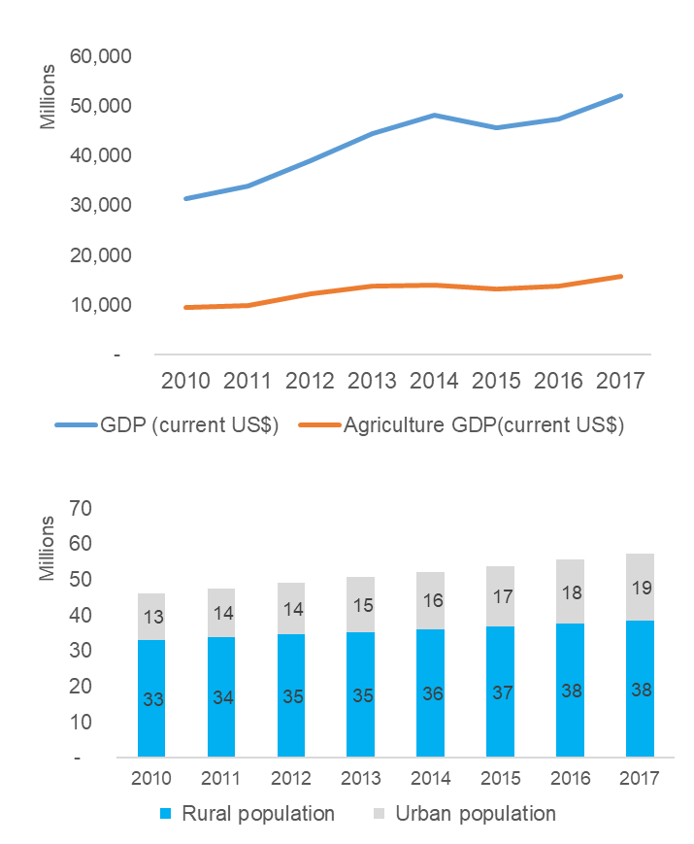
Tanzania’s Agricultural Agenda is Shaped by a Few Macroeconomic Trends and Contextual Factors (1/3)
1. Agriculture and the Economy
Tanzania registered an average economic growth of 7% in the past decade, which was well above the 6% average for Sub-Saharan Africa (SSA) and East African Community (EAC) members and the global average of 4%^{3.} The Agricultural sector also grew at an average of 2.9% per year over the same period implying that the performance of the agricultural sector may have a relation with overall economic performance^{1.}
Agriculture accounts for 26.7% of Tanzania's GDP and provides employment for majority of the nation’s population. Opportunities exist for agriculture businesses across domestic, regional and international markets, for both traditional and new products. However, productivity is low with modest progress over the past two decades. It is dominated by smallholder farmers dependent on rain-fed production, limited use of improved seeds and fertilizers, and the low share of cultivated over arable land³.
The country population is growing at an average rate of 3.1% per annum. This implies a growth in human labour force, but also increased food demand¹ . Over 67% of the population lives in rural areas and mostly depend on agriculture for livelihoods. The national poverty headcount stands at 28% with the situation even worse in rural areas at 33%¹
The country is a net food exporter with food imports constituting 9% of merchandised imports and food exports about 55% of merchandised exports²
Tobacco, cashew nuts, and coffee among top agricultural based foreign exchange earners - exports total earning estimated to be $1,579 million, while palm oil, wheat, and sugar are the main imports - estimated cost of food imports about $818 million as per 2016 figures²
3.1%
2.9%
Sources: 1. https://datacatalog.worldbank.org | 2. www.fao.org/faostat | 3. http://www.fao.org/tanzania/fao-in-tanzania/tanzania-at-a-glance/en/

Slide 15
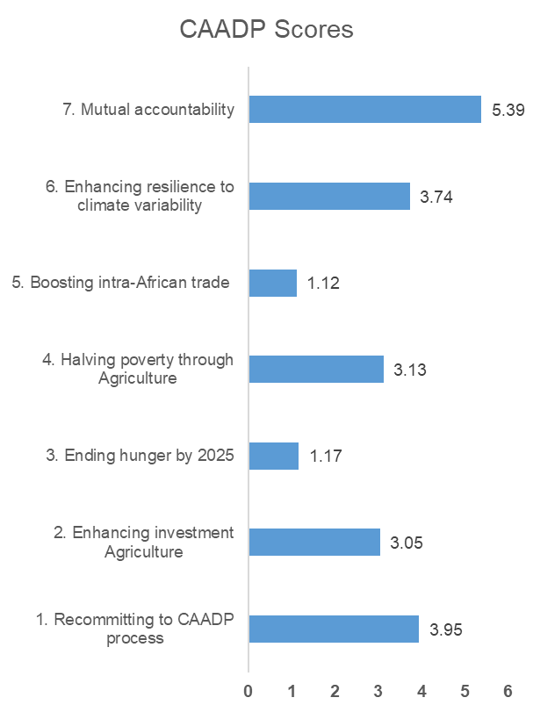
Tanzania’s Agricultural Agenda is Shaped by a Few Macroeconomic Trends and Contextual Factors (1/3)
2. Government Priorities and Key Challenges in the Sector
The Tanzania Ag. Sector faces a myriad of challenges. The key constraints in the sector include poor implementation of existing policies, inadequate sector coordination, inadequate infrastructure, weak linkages between the public and private sectors, inadequate extension services and low use of productivity enhancing inputs. Tanzania's dependence on rain fed agriculture in all agro ecological zones puts farmers at risk of crop failure and losses due to the unpredictable weather patterns. Majority of smallholder farmers see weather-related shocks as the greatest risk to their agricultural activities.
Downstream constraints include post-harvest losses (though recent trends showing reduction in trends from max of 30% to 20%⁴) and inadequate market information. With less than 10% of commercial lending going to Agriculture, there is limited access to credit/finance and insurance for most players in the sector. Other challenges in the sector include low levels of mechanization that limits production capacity; for instance, 64% of smallholder farmers cultivate using the hand hoe, 24% by draught animal power and only 12% by tractors. There are also soil fertility challenges (acidity & salinity) in pockets of areas in the republic. These challenges could have contributed to the poor CAADP scores by Tanzania.
The government priorities in order to address some of these challenges include: Promoting the effective consultative formulation and implementation of key policy and regulatory reforms, increasing sustainable agricultural productivity of crop, livestock/fish and export commodities, stimulating expanded and inclusive private sector-driven development and integration and strengthening institutional development and effectiveness^{1.} These are articulated in the Agricultural Sector Development Strategy II.
Sources: 1: http://www.tzdpg.or.tz/fileadmin/documents/external/national_development_frameworks/ASDP2_Final_Document_20_May._2016__after_edit__1_.pdf

Slide 16
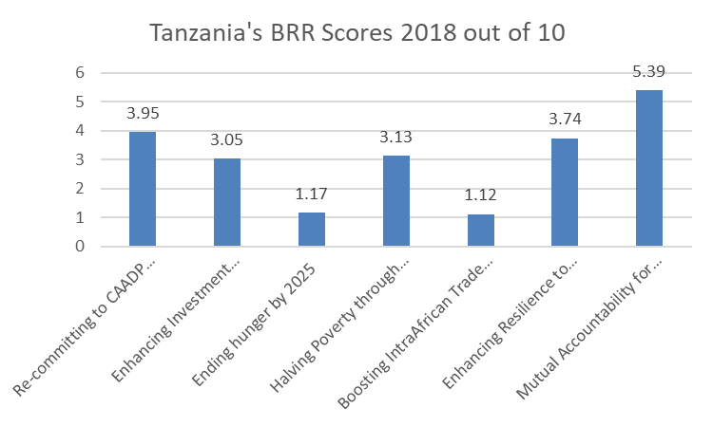
CAADP biennial review shows that the country is not on-track and should emphasize ending hunger and boosting trade
Government Priorities from BRR Review
The AU, through the CAADP process using the Biennial Review Rating (BRR), is tracking countries’ progress towards the 7 (seven) commitments. The first review conducted in 2017 and launched in 2018 rated Tanzania at 3.1 against a benchmark of 3.9 in 2017 - the average rating a country should score to show positive progress towards achievement of its 2025 targets. This rating means that Tanzania’s performance is not on track and it is hoped this performance will be improved and surpassed during the next review scheduled for 2020⁹.
Coming out of the Biennial review process in 2018, Tanzania had recommendations and priorities for the next 2 years:
Recommendations
Tanzania should increase its spending in agriculture sector to meet the CAADP Malabo target of 10%, and increase funding to research and development activities in order to enhance productivity.
The country should establish evidence-based policies, supportive institutions and corresponding human resources that support planning and implementation to deliver on the Malabo commitments.
The country should put in place policies that would facilitate and promote intra-regional African trade in agricultural commodities and services.
Priorities for the next two years:
Sustainable food and nutrition security
Increasing production and productivity
Improving agro processing and market access
Promote post-harvest loss management
Increase investments in agriculture
Intensify resource mobilization and allocation of public budget to agriculture
Improve national statistics system for capturing data in the agricultural sector

Slide 17
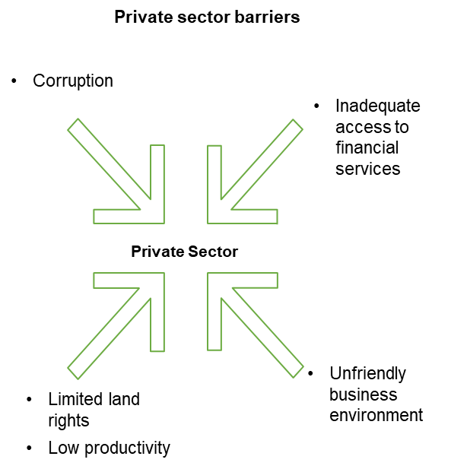
Tanzania’s Agricultural Agenda is Shaped by a Few Macroeconomic Trends and Contextual Factors (3/4)
3. The Private Sector Landscape
The World Bank interviewed a representative sample of the private sector in five of the most active economic regions in Tanzania. The sample consisted of 813 business establishments surveyed from January 2013 through August 2014. According to the survey, access to finance and electricity continue to be the biggest obstacles to private firms’ operations^{1.}
Tanzania ranks 116 out of 176 countries in Transparency International’s Corruption Perceptions Index 2016. the World Bank Enterprise Survey noted that approximately 65% of firms expected to give gifts to secure a government contract¹
The majority of micro enterprises in Tanzania operate in the informal sector². The Sustainable Industrial Development Policy - SIDP (1996 - 2020)¹ places specific emphasis on the promotion of SMEs through: supporting existing and new promotion institutions, simplifying taxation, licensing and registering SMEs, and improving access to financial services. In addition, SIDP encourages informal sector businesses to grow and become formalized, and identifies measures that would enable indigenous entrepreneurs, women, youth and people with disabilities to take part in economic activities²
The private sector, especially the informal sector, is the main creator of employment opportunities in Tanzania. It is estimated that there are 3.1 million micro, small and medium sized enterprises (MSMEs) in Tanzania. The jobs created, are however insufficient to move people out of poverty. 65 to 70% of the labor force is active in agriculture sector, yet agriculture only contributes to about 1/3 of Tanzania's GDP. Barriers that prevent growth in Tanzania include: access to financial services, extensive trade barriers, limited land rights, low productivity in the agricultural sector and a non-conducive business environment³.
Engagement of private sector with Government and its constituent bodies must continue to be deepened to ensure that there is a conducive business environment for the private sector in agriculture because the private sector holds the key to sustainable scaling of transformative interventions.
Sources: 1. Tanzania Ministry of Industry and Trade. Small and Medium Enterprise Policy. 2003.| 2. World Bank Enterprise Surveys. Tanzania Country Profile 2013 | 3. https://www.swedenabroad.se/en/about-sweden-non-swedish-citizens/tanzania/development-cooperation-with-Tanzania/private-sector-development-and-agricultural-markets/

Slide 18
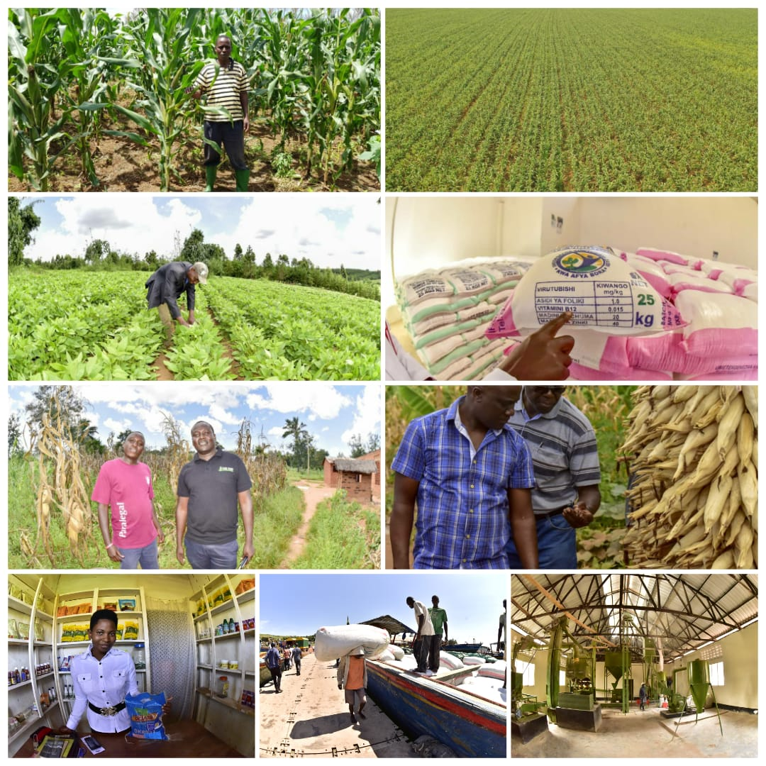
Tanzania’s Agricultural Agenda is Shaped by a Few Macroeconomic Trends and Contextual Factors (4/4)
4. The Smallholder Farmer Landscape
There are about 3.7 million smallholdings in Tanzania (those smaller than the middle size farm threshold of 2.2 hectares), which make up for 80 percent of total farms^{1.} These Tanzanian small farmers produce 69 percent of the food in the country^{1.}
Low incomes mean that small farmers spend less on education and health. Books and fees are the most important items of household expenditure on education. Smallholder families, in Tanzania, only allocate 2-3 % of their budget to education translating to an average smallholder farm head attaining just 4.6 years of school. Most of smallholders’ income is allocated to food. For example, an average smallholder family of five persons - living on $1.9 a day each spends 81 percent of this budget on food¹.
Smallholder families in Tanzania primarily grow food and staple crops (as opposed to cash crops). 63% of smallholders grow only staple crops, while only 1% grow only cash crops. 37% of smallholders grow both types. Maize is the most commonly grown staple crop, followed distantly by beans, cassava, sweet potatoes, and rice. Only a few grow cash crops, which tend to be sunflower, sesame, coffee, cotton, cashew nut, and sugar cane².
SHFs in Tanzania continue to face a range of challenges, including obtaining and paying for quality seeds, fertilizer, and pesticide, and transporting goods to market. Compounding this is a lack of post-harvest storage facilities for crops and, if available, their prohibitive cost³. This is in addition to limited access to credit with only 17% receiving credit¹, insurance, and payments facilities despite significant investments in the country’s financial infrastructure in recent years. Further, only 17% of smallholders have access to seeds of improved crop varieties according to an analysis by FAO^{1.}
Photo Credit: AGRA Communications
Sources: 1. The economic lives of smallholder farmers: http://www.fao.org/3/a-i5251e.pdf
| 2. National Survey and Segmentation of Smallholder Households in Tanzania:https://www.cgap.org/sites/default/files/Working-Paper-Smallholder-Survey-Tanzania-May-2016.pdf |

Slide 19
Changes in assumptions/ New developments
Issue | Proposed Mitigation
Capacity for LGAs to plan, coordinate and implement agricultural transformation activities | Strengthen Coordination of ASDPII, planning and resource mobilization at at the Local Government Level is important for scaling and sustaining AGRA models
Donor resources not well coordinated at implementing partners’ level | Country Advisory Committee (CAC) and active engagements in Agric Sector Working Group (ASWG) is essential for improving efficiency and effectiveness of interventions
Limited Private sector service delivery models to enhance access to mechanization services to smallholder farmers | Develop strategy and plan for mechanization and irrigation systems for smallholders (MISS) in Africa
Achieving results in market led interventions requires maximum and constant engagement with private sector partners (market actors) | Identify and engage prime movers of crop produce volumes in order to sustain off-take of excess production thus sustaining improved productivity and adoption levels
Reform impact analysis (RIA) and political economy assessment for policy options required to enhance policy and regulatory environment for inclusive agricultural transformation. | Evidence building: Undertaking political economy analysis, economic and legal analyses to generate evidence is required to support and justify policy reforms required to enhance policy and regulatory environment for inclusive agricultural transformation.

Slide 20
A number of major donors and private sector companies are focused on Southern and Northern Highlands
Seed supply & research
Fertilizer supply & research
Other ag. inputs
Infrastructure
Farmer organization
Agrodealers
Market linkages
Post-harvest management, quality and standards
Extension
Southern Highlands
Local Seed Companies; previously supported by AGRA
Yara, ETG, TFC
Northern Highlands
Local Seed Companies; previously supported by AGRA
Yara, ETG, TFC
Western Highlands
National & regional policy
n/a
Agri-cultural finance
n/a
Private Sector
Seed companies

Slide 21
In addition to Macro-economic analysis, AGRA also carried out analysis of specific systems to inform the strategy
Seed systems
Status
Breeding and variety release | EGS supply | Certified seed production | Awareness by farmers | Marketing and distribution | Regulation
Maize, rice, beans, cassava and sweet potato breeding programs supported resulting in the release of 42 varieties Out of 42 varieties released 23 commercialized 28 research scientists trained in breeding and seed technology | Public institutions ASA and TARI are key producers of EGS public varieties particularly for other crops in addition to maize Private seed companies with their own varieties are in-charge of their own EGS production. | 15 seed companies supported and out of these 13 are still active and operational 2 public institutions supported to produce seed of vegetatively propagated crops (cassava and sweet potatoes) In 2016 supported seed companies produced 4,226 MT of seed which benefited 169,040 smallholder farmers Multinational seed companies (Monsanto, Syngenta & Pioneer) regional seed companies (Seed Co, Pannar & Kenya) are also active but with focus on maize | Uptake and adoption of improved varieties still low. Seed companies and agro-dealers were key players in creation of awareness | By 2016 about 2,800 agro-dealers had been trained and actively selling inputs. The hub-agro-dealer model was just starting and only a few regions (Southern and Northern) had some and had been established in partnership with AFAP | Circular 2011 allowed private seed companies to access and produce public varieties. 4 seed companies successfully applied and only focused on maize Seed harmonization in line with SADC protocols was beginning to take root Seed law in place
Plant breeders rights still not fully operational | Breeder seed still in shortage for public varieties since TARI is underfunded and this has implications on foundation and certified seed | Kigoma and Kagera region still underserved with no seed companies producing seed there Improved seed of other crops beans, rice, sorghum still insufficient | Farmer awareness still low partly because of few extension agents. VBA model likely to help improve the situation Input supplies (seed and fertilizer companies) have to do more demos | More agro-dealers and hub agro-dealers still required because distance travelled by farmers is still more than 8 km | Seed quality still an issue and may require utilization of ICT e.g. e-tags (scratch coin technology) Number of seed inspectors still low. Consider allowing private inspectors as is the case in Zambia
Gaps

Slide 22
In addition to Macro-economic analysis, AGRA also carried out analysis of specific systems to inform the strategy
Soil health and fertilizer systems
Soil Mapping and Testing | Product development | Importation | Blending | Distribution | Awareness Creation
There exist substantial source of complete soil nutrient and soil acidity information from the AfSIS/TANSIS assessment AGRA trained 227,752 farmers on ISFM technologies 149,895 cropped with ISFM technologies;19 lab technicians trained in plant and soil analysis AGRA has Supported best-bet trials on AGRA priority crops using blended fertilizers, with Yara and Minjingu fertilizers serving as benchmarks AGRA supported a study on soil acidity to determine the interventions | Both Yara and Minjingu are selling balanced fertilizer either as blends or compounds; OCP and ETG mainly sell NPKs; Tanzania Fertilizer Regulatory Authority is the sole regulatory body responsible for all aspects pertaining to fertilizer, including management of the BPS. | Importation through Bulk Procurement System (BPS)→ This limit many importers appetite to invest in development. | There are several crop-specific fertilizer blends from different companies (Yara and Minjingu); The blending industry is not well-established in Tanzania, though interest exists; Changes to regulations in 2017 that allowed a more market-responsive approach to blend formulations | The distribution channel severely disrupted by BPS; The role of both Hubs and agro-dealers have been impacted by decisions of the government in payment of subsidy arrears and BPS; village and cooperative actors playing an active role in the distribution. | Fertilizer use still low and predominantly used DAP and urea Estimates of fertilizer use could be a low as 17 kg/ha- compared to 50kg/ha Malabo target Fertilizer price relatively high- one of the factor hindering fertilizer use
Still there is not comprehensive soils map for the whole country; Soil information needs to be translated into fertilizer formulations and links with fertilizer companies established to develop blends; Soil Acidity affects 4.7 million ha of arable land | A number of importers and manufacturers have placed on hold development plans until a clear direction is understood with BPS Lime availability is a challenge because of distance | A number of importers and manufacturers have placed on hold development plans until a clear direction is understood with BPS TFRA is both the importer and the quality control institution- likely conflict of interest that need to be addressed | The amended Fertilizer Regulations of 2017 ease the requirements to make blends, but will require significant strengthening of the capacity of public sector individuals involved in formulation approval There is need to facilitate TANSIS and Fertilizer companies to develop blends | Role under BPS is unclear because of financial constraint Poor infrastructure exists in some areas e.g distribution Kigoma and Kagera, and poor roads in many areas. Distribution channels under government fixed pricing models needs careful evaluation | Significant market disruptors and public sector controls over the SHF sector exist; Limited awareness of fertilizer blends; Soil acidity is a challenge and limited information about the same; Regarding acidity correction, a scoping study identifying the severity of acidity completed
AGRA & BMGF are jointly engaging government in investing in awareness creation, research and development of a business case for a comprehensive liming program |  |  |  | AGRA is partnering with AFAP and also investing in agro-dealers to improve the delivery of the fertilizers | AGRA has invested in consortia which has awareness components on fertilizer and ISFM technologies
Status
Gaps
Interventions

Slide 23
In addition to Macro-economic analysis, AGRA also carried out analysis of specific systems to inform the strategy
Extension
Agro-dealer networks
Current state of play | District Councils do not have enough Extension Agents to teach farmers (Extension Agent: Farmer ratio > 1:3,000+) Extension Agents do not have sufficient resources to visit and train farmers Private sector Extension poorly developed
Opportunities | Reduce Extension worker: farmer ratio by creating self-employment opportunities for Extension workers (Village-based Advisors (VBAs)) including women and youth to rapidly create demand for yield-enhancing inputs whilst teaching farmers good agricultural practices; Seed and fertilizer companies supply inputs to VBAs for demonstration and sale to farmers at the Village level; Enhance Extension Service delivery policies at regional and district levels
Enablers | District Council Extension Agents Village-based Advisors (VBAs) Small seed and fertilizer packs for Mother and Baby demos Smartphones for VBAs
Key Partners | Local Governments Seed and Fertilizer Companies Agro-dealers and Offtakers Local NGOs
Current state of play | Few large agro-dealers (hubs) in major towns Some small agro-dealers in rural towns, who often lack the full range of inputs Poor linkages between input suppliers, hubs & retail agro-dealers Existing agro-dealers financially constrained and lack technical capacity to provide extension support Many rural areas still lack agro-dealers
Opportunities | Tailored SME financial & capacity building support to strengthen existing agro-dealers Work with hubs & input Companies to expand AD networks into remote rural areas Provide startup grants to new rural ADs Formalize & map the linkages along the distribution chain Support hubs to engage in commodity aggregation & extension provision ICT Platforms to strengthen businesses
Enablers | ICT Apps Extension Agents & VBAs Government programs & policies
Key Partners | Input supply Companies Commodity Off-takers LGs & NGOs

Slide 24
In addition to Macro-economic analysis, AGRA also carried out analysis of specific systems to inform the strategy
Output Markets
Access to Finance
Current state of play | Total food production in 2018 was 16.89 million MT (9.53 million of cereals and 7.35 million of non-cereals) Domestic consumption of cereals and non-cereal crop is 13.56 million MT Surplus for export is 3.32 million MT Local processors (mostly SMEs) offer immediate market opportunity to farmers The Food reserve (NFRA) is buying less than 50,000 MT and sells to WFP Grain traders are exporting to neighboring countries Increased uptake of harvesting and post-harvest management technologies (combine harvesters, threshing machines, hermetic storage bags)
Opportunities | Increase export of grain and flour along the southern corridor: DRC (Katanga, and Tanganyika provinces), Malawi, Zambia, and Zambabwe Increase export of grain and flour along central corridor: Rwanda, Burundi, Eastern DRC Partner with the government and other development partners to support value addition initiatives (agro-processing flagships) +mobilize private investments for underutilized processing facilities throughout the country
Enablers | Food trade enabling environment is improving and TANTRADE became active in securing export markets Government commitment to supply the export markets
Key Partners | TANTRADE MIT TCCIA TradeMark East Africa
Commercial banks focus on tight value chains (cash crops) and formalized farmer groups
Government agricultural bank lacks quality pipeline
Low (digital) financial literacy, uneven distribution of touchpoints and poor networks in rural areas
Current state of play
Opportunities | Enhance access to finance for agri SMEs by strengthening their capacity (Fin. Management) and by providing TA to agri-friendly banks (ECAF) Partnership with SME focused non-bank financial institutions like Equity for Tanzania and SME impact fund to increase capital investments in agriculture Scaling digital finance (FISFAP) partnerships to more regions and farmers
Enablers | Existence of guarantee funds to de-risk agriculture (PASS Trust, Rabobank, AGF, DCA, GAFSP) Specialized government owned agricultural development bank: TABD serves SMEs Proliferation of mobile phones and interoperability enables digital finance
Key Partners | PASS Trust, NMB, TPB, Equity Bank for value chain finance TADB for blended finance SELF, MuCoBa, ECLOF, SACCOS for digital finance Reliance and ACRE Africa for insurance

Slide 25
Partnerships Mapping
Intervention area | Name of implementing partner | Type of project (Public, Private, NGO, SME) | Current engagement (grantee, partner, government, other partner) | Operational level (National, Regional, International) | Location of HQ in Tanzania | Type of engagement ( National Authority, Input supplier, capacity building, research, academic, policy, farmer organization, financial instituion, ICT4AG)
Systems development | Agricultural Reserch Institute-Ukiriguru | Public | Grantee | National | Mwanza | Research
 | Tanzania Association of Professional BDS Providers Company Limited | Private | Grantee | National | Dar es salaam | Capacity building
 | Agricultural Council of Tanzania | Private | Grantee | National | Dar es salaam | Markets development
 | Ruvuma Commercialization and Diversification of Agriculture | Private | Grantee | National | Songea | Input supplier
 | Ruvuma Commercialization and Diversification of Agriculture | Private | Grantee | National | Songea | Input supplier
 | ETC Agro Tractors & Implements Ltd | Private | Grantee | National | Dar es salaam | Mechanization Services Provider
 | NMB Foundation For Agriculture Development | Private | Grantee | National | Dar es salaam | Financial Service Provider
 | Tanzania Agricultural Development Bank | Private | Grantee | National | Dar es salaam | Financial Service Provider
 | TPB BANK PLC | Private | Grantee | National | Dar es salaam | Financial Service Provider
 | Equity Bank Tanzania | Private | Grantee | National | Dar es Salaam | Financial Service Provider
 | Faida Market Link Company | Private | Grantee | National | Arusha | Markets development
 | Farm Radio International | Private | Grantee | National | Arusha | Information services provider
 | Meru Agro-Tours and Consultants Co. Ltd. | Private | Grantee | National | Arusha | Markets development
 | Reliance Insurance Company | Private | Grantee | National | Dar es Salaam | Financial Services/Insurance
 | Nyakitonto Youth for Development Tanzania (NYDT) | Private | Grantee | National | Kigoma | Extension Services Provider
 | Suba Agro-Trading & Engineering Co. Ltd | Private | Grantee | National | Arusha | Input supplier
 | Actions for Development Programmes – Mbozi | Private | Grantee | National | Mlowo | Extension Services Provider
 | Building Rural Incomes Through Enterprise | Private | Grantee | National | Dar es salaam | Extension Services Provider and Markets Development
 | Karagwe Development and Relief Services (KADERES) | Private | Grantee | National | Karagwe | Extension Services Provider
 | Maruku Agricultural Research Institute | Public | Grantee | National | Arusha | Input supplier
 | Mbozi-Ileje-Isangati-Consortium(MIICO) | Private | Grantee | National | Arusha | Extension Services Provider
 | Division of Research and Training, Ministry of Agriculture, Food Security and Cooperatives | Private | Grantee | National | Arusha | Input services provider
 | Centre for Sustainable Development Initiatives | Private | Grantee | National | Dar es salaam | Markets development
 | Division of Research and Training, Ministry of Agriculture, Food Security and Cooperatives | Private | Grantee | National | Mbeya | Input services provider
Sate Capacity and Policy | Economic and Social Research Foundation | Private | Grantee | National | Dar es salaam | Policy development
 | Agricultural Non-State Actors Forum | Private | Grantee | National | Dar es salaam | Policy development
 | Tanzania Chamber of Commerce, Industry and Agriculture Limited, TCCIA Regional Chamber KIGOMA | Private | Grantee | National | Kigoma | Policy development

Slide 26
AGRA Tanzania Strategy

Slide 27
Tanzania Theory of Change
Country Goal: Increased incomes and improved food security for SHFs
Cross Cutting areas
State Capability and Policy
Strengthen national coordinating team’s (NACOTE) capacity for driving evidence based planning & implementation
Enhance planning and coordination between MOA, other ASLMs and external stakeholders
Support development of an enabling environment for private sector
Increased productivity
Increased accessibility to output markets
AGRA’s Strategic Country Goals
Outcomes
Farmers using
Improved production, management technologies & practices
Fertilizers & other improved technological management practices
Improved post harvest management technologies & practices
Structured trade to market their produce
Other value chain actors
Large, MSMEs producing and delivering inputs, extension, services to farmers in response to demand from farmers
Bank and non-bank institutions providing financial and credit services to MSMEs and farmers
Large, MSMEs providing off-taking, warehousing and processing services
Partnerships
Work with partners at all levels to:
Enhance supply chain efficiency through effective agribusiness deal-making platforms in the Northern Highlands
Expand market access through value addition, structured trade, quality enhancement and aggregation in the Southern Highlands
Strengthen input supply systems and linkages to output markets to facilitate the uptake of yield-enhancing agricultural technologies in the Western Highlands
Promote women empowerment in agriculture and active participation in decision making so they benefit more from the downstream portion of value chain activities such as marketing, processing and trade
So that the target population, institution or resource change
Farmers and other value chain actors have improved access to
Inputs (fertilizer, seeds); Extension services (knowledge and information); Credit and financial services, stable and remunerative markets
Country Investment areas
Strengthening agricultural input systems, technology development and supply chain
Developing and strengthening extension and advisory services
Developing and strengthening responsive agricultural finance and credit systems
Developing and strengthening stable reliable and remunerative output markets
Create sustainable platforms by supporting the digitization of value chain transparency and coordination system
What AGRA does

Slide 28
AGRA’s Strategy for Tanzania
AGRA’s approach in Tanzania is focused on state capability support and policy engagement and support to systems development to impact key value chains.
AGRA believes that in Tanzania there is room to drive scale through: a) a well-planned and coordinated approach to resources in the public domain including coordinated engagement at country level, b) working with private sector to build systems that improve access and drive sustainability
Policy and State Capability
Strengthen national coordinating ASDP II coordination, implementation and alignment between national, regional and local governments.
Partnerships and Systems development
Enhance supply chain efficiency through effective agribusiness deal-making platforms in the Northern Highlands
Enhance planning and coordination between MOA, other ASLMs and external stakeholders (donors, private sector, civil society etc.)
Support development of an enabling environment for private sector
Expand market access through value addition, structured trade, quality enhancement and aggregation in the Southern Highlands
Strengthen input supply systems and linkages to output markets to facilitate the uptake of yield-enhancing agricultural technologies in the Western Highlands
Promote women empowerment in agriculture and active participation in decision making and benefit more from the downstream portion of value chain activities such as marketing, processing and trade
Support ASLMs in development of agro-industrialization flagship as part of ASDP II realization

Slide 29
State Capability Support and Policy Engagement
AGRA’s State Capability Support and Policy Engagement approach comprises 5 components:
Country Vision, Strategy, Prioritized Plans and flagships
AGRA works with governments, & others to ensure a country has a sector strategy aligned to its vision that has a prioritized and costed investment plan, and flagship programs to drive the sector growth
2
Enabling Policy Environment
AGRA supports governments to articulate alternative policy options through analyzing cost & benefits of reform thus better placed to assess and approve policy changes based on reliable and relevant evidence.
Implementation Capacity & Delivery
AGRA works with governments to strengthen their capacity and capability to increase service delivery & execute on commitments made in national sector strategies and investment plans.
Stronger Sector Coordination
AGRA works with development partners & other sector stakeholders to strengthen intra- and inter-ministerial coordination as well as, strengthen key coordination platforms such as the donor working groups and the agriculture sector working groups
Accountability Mechanisms in place
AGRA works to support governments put in place mechanisms and system to recognize & appreciate performance of their agricultural sector against key commitments agreed upon especially the Malabo Declaration.

Slide 30
To deliver system and farmer level interventions, AGRA prioritized regions with high potential for impact
Western Highlands
Kagera
Northern Highlands
Underdeveloped due to poor infrastructure and a lack of deliberate Ag development
Needs the basic building blocks for a transformation: seed supply, fertilizer supply, distribution network, and marketing system
Access to export markets in DRC, Burundi, and Rwanda for maize and beans
Includes 2 regions, Kagera and Kigoma*
Target direct farmer reach: 509,080
Crops of focus: maize, beans & cassava; Legumes secondary
High farmer density and sophisticated value chains, but lack of feedback loops and information transparency across VCAs
Efficient access to Tanzania’s largest grain export market (Kenya)
~491K MT marketable surplus in maize
Highly affected by periodic grain export bans/quota
Includes 3 regions: Arusha, Manyara and Kilimanjaro
Target direct farmer reach: 510,084
Crops of focus: maize & beans
Secondary crops: Pulses (pigeon pea)
Arusha & Manyara
Kilimanjaro
Kigoma
Rukwa & Katavi
Iringa & Njombe
Morogoro
Mbeya
Southern Highlands
Excellent agronomic conditions, heavy investment through SAGCOT, but poor market linkages
Presence of several key stakeholders, including AGRA grantees and off-farm infrastructure projects
Could be national & regional breadbasket, has the potential of increasing exports to neighboring countries; but has poor infrastructure linkages to other markets
Already experiencing 1M MT marketable surplus in maize
Includes 7 regions: Rukwa, Katavi, Mbeya (Mbeya and Songwe), Iringa, Njombe, Morogoro and Ruvuma
Target direct farmer reach: 974,085
Crops of focus: maize, beans & rice; soybeans and potato as secondary focus
Ruvuma
Total number of farmers targeted for reach by AGRA interventions in 3 regions – 1,993,249.
Tanzania will also reach an additional estimate of 2,500,000 farmers through government engagement and other national level interventions
ASDP II classifies Kagera and Kigoma regions differently as Lake and Central Zones respectively

Slide 31
Within these regions, AGRA is focused on three primary crops and two secondary crops
Prioritization of crops
Maize
Impact potential: Accounts for 20% of total agricultural GDP; Produced by 60% of farming households; SHFs produce 95% of maize
Ease of delivery: AGRA has investments in maize, Rice and Bean seed varieties releases
Impact potential: Second most common cereal in terms of area under cultivation and tonnage. Local and export demand expected to rise
Ease of delivery: Similar to maize, rice is a focus crop for the government through SAGCOT, and NRDS¹
The use of maize-soybean blends as animal feed should open up new markets in the animal feeds industry
Beans
Impact potential: Commonly intercropped with maize for nitrogen fixation; Important for nutrition; High potential to reduce yield gap and high market demand for beans, thus potential to increase farmer income
Ease of delivery: Potential to package interventions in maize and beans. Strong AGRA assets - released several new varieties
Maize
Impact potential
Millet
Cassava
Sorghum
Potato
Beans
Pigeon peas
Rice
Key
Primary crops
Secondary crops
Ease of delivery
Scoring criteria (equally weighted)
Impact potential - Number of farmers; Yield gap (%); Expected future demand (High/ Medium/ Low)
Ease of delivery - Focus from the government, donors and private sector (High/ Medium/ Low); AGRA capabilities and past investments (High/ Medium/ Low)
1: National Rice Development Strategy
Source: AGRA; FAOStat

Slide 32
AGRA’s 2019 Priorities for Tanzania
AGRA’s overall goal in Tanzania is to catalyze and sustain an inclusive agricultural transformation to increase incomes and improve food security by directly reaching 1.99 million smallholder farming households and indirectly impacting a further 2.5 milllion farm households, through strategic country support and government engagement coupled with a set of targeted catalytic downstream and systemic investments. To achieve this, AGRA has prioritized three regions with the highest potential for impact: Western, Southern and Northern Highlands targeting three primary crops (maize, rice and beans) and two secondary crops (cassava and potatoes).This will be delivered through AGRA’s three areas of work:
Policy and State Capability
Systems Development
Partnerships
Coordination of the implementation of ASDPII at LGA level,
Support strengthening food security and export trade for Tanzania (EFSETT),
Support review of relevance of agric policy of 2013 and subsequent enactment of agric act
Study to assess cost of seed production in Tanzania to inform debate on seed price capping
Development of comprehensive agro-industrialization flagship program out of ASDP II framework
Roll out VBA operations, mechanization, SME financing, equipment and input finance model,
CARI-EA-AGRA/GiZ joint Competitive African Rice Initiative for EAC countries,
Input Authentication Operationalization,
Input-output Systems Development,
Market Development
Agro Dealer Development initiatives
Regional food trade and resilience program
Roll out Northern Tanzania Potato Seed Systems Improvement (NTPSI), Expanding Markets through Agro-processing and CARI-EA
Conduct Meetings of SC and JRRC for annual results of 2018 – to further enhance integration within consortia and among the consortia
Finalize mapping the partnership portfolio within the public and private sector agribusiness ecosystem
Finalize the agribusiness investment programs alongside rolling out potato and mechanization partnership
Move our partnership with ENABEL to a next level by signing teaming up agreement
Scale out YWS beyond maize and beyond Tanzania
Enhanced Large Scale Production, Smallholder Productivity, Reduced Cost Of Food

Slide 33
Mapping the Strategy to outcomes in the theory of change
Northern Highlands
Change area (outcomes) | Activities | Current investments | Gaps for future investments | Potential partners
Market System Development | Facilitate delivery labs that bring together pertinent stakeholders in each of the Northern Highland regions to develop plan and to put in place mechanisms to enhance agricultural value chain coordination and transparency | NONE | Lack of a mechanism for agricultural value chain coordination and transparency | Local Gvt, TCCIA, EAGC, Food Trade, Trademark EA
 | Enhance market transparency by supporting the development of a deal making platform | NONE | pre-harvest networking session to connect value chain actors | Food Trade, EAGC, TCCIA, Trademark EA
 | Create sustainable platforms by supporting the digitization of value chain transparency and coordination system; includes forward contracting, pricing, quantity projections, transportation costs, digital extension (linked to stakeholder) | NONE | Digitized value chain transparency system linked to stakeholder | G-Soko/ Food trade/EAGC and ICT Partners

Slide 34
Mapping the Strategy to outcomes in the theory of change
Northern Highlands
Change area (outcomes) | Activities | Current investments | Gaps for future investments | Potential partners
Input System Development | Leverage the deal-making platform to support the introduction of new agricultural technologies through field days and demo plots; scale up ICT, video and radio based extension messaging, support ward resource centers and BDS to FOs | NONE | Platforms that link farmers to sources of inputs, credit, extension service providers, and off-takers | Digital Green, farm radio international, regional and district authorities, agribusinesses
 | Support seed companies to transition from start-up stage to growth state e.g., by facilitating the adoption of improved seed business practices | NONE | Capital investments in seed companies up to the point of ‘bankability’ then facilitate access to appropriate financial products as needed | Research institutions, high performing seed companies (local and MNC)
 | Support the production of breeder and foundation seed by partnering with 5 existing specialized seed companies in Northern Highlands | NONE | No production of breeder nor foundation seed for the Northern Region | Research institutions, breeders, and seed companies

Slide 35
Mapping the Strategy to outcomes in the theory of change
Southern Highlands
Change area (outcomes) | Activities | Current investments | Gaps for future investments | Potential partners
Market System Development | Support traders & processors in the Southern Highlands to increase trading and processing capacity through the provision of business development services (BDS | Partnerships established with with YWS, EAGC, BRITEN , ACT & MIICO for increased access to structured markets by SHF. | Access to major grain markets (e.g., Dar, Nairobi) | PASS TRUST, SAGCOT, TCCIA,
 | Value chain financing: grain handlers/processors; grant matching for early stage companies (covers 1st year working capital + initial capex, including grain handling equipment and seasonal storage) | NONE | Support grain handlers to build assets that can be used as collateral to access credit from commercial banks (CAPEX and WC for business expansion) | EACF, other business plan competition agencies, banks and non-banking financial institutions, CARI project
 | Support newly designed agro-processing clusters by generating proof-of-concept for the transition towards lucrative markets such as animal feed | Ongoing with EMMA | Provision of funding for equipment acquisition (maize milling) & crowding in funding and specific financial products to scale | Traders and milling/processing enterprises organizations, Silverlands

Slide 36
Mapping the Strategy to outcomes in the theory of change
Southern Highlands
Change area (outcomes) | Activities | Current investments | Gaps for future investments | Potential partners
Market System Development | Support the adoption of post-harvest management technologies and other mechanization equipment by partnering with providers of lease finance products and by facilitating joint agro-dealer orders for storage and post-harvest management solutions to reduce wholesale/transportation costs as well as local manufacturing | Partnerships established with YWS, EAGC, BRITEN , ACT & MIICO for increased Adoption of post-harvest management technologies and other mechanization equipment. | Lease financing products for large mechanization equipment | PICS bag project, Intermech Engineering Ltd
 | Support initiatives to upgrade near farm aggregation centers by facilitating access to PHH training, basic commodity handling equipment, enhanced management and linkages to output off-takers and input dealers | Partnerships established with YWS, EAGC, BRITEN , ACT & MIICO for increased Adoption of post-harvest management technologies and other mechanization equipment. |  | EMA private sector alliance partners
 | Facilitate the development and operationalization of business models for government-owned, refurbished aggregation centers operationalize = link partners and provide marketing support | NONE | Private sector incentivized to use these aggregation centers for temporary storage and service centers (drying, shelling/threshing, input | Local governments, and agribusinesses

Slide 37
Mapping the Strategy to outcomes in the theory of change
Southern Highlands
Change area (outcomes) | Activities | Current investments | Gaps for future investments | Potential partners
Input System Development | Support seed companies to transition from start-up stage to growth state by facilitating the adoption of improved seed business practices[ | Partnership with TARI UYOLE, . | More support for start-up stage to growth state | Research institutions, high performing seed companies (local and MNC), TAPBDS
 | Support the increased production of breeder and foundation seed by partnering with 5 existing specialized seed companies in Southern Highlands | Partnership established with one seed company for increased production of breeder and foundation seed through grants | More partnerships needed with seed companies | Research institutions, breeders
 | Leverage the deal-making platform to support the introduction of new agricultural technologies through field days and demo plots; scale up ICT, video and radio based extension messaging, support ward resource centers and BDS to FOs | BRITEN, ADP Mbozi supported to accelerate adoption of GAP | Platforms that link farmers to sources of inputs, credit, extension service providers, and off-takers | Digital Green, farm radio international, regional and district authorities, MVIWATA, ACT
 | Support the growth of hub agro-dealers (including youth and women) in the Southern Highlands through the provision of BDS and improved linkages to input manufacturers or distribution centers | Partnership with TAPBDS, ACT & BRITEN for provision of BDS and linkages with input markets | Strengthened relationship with Financial Service Providers | AFAP, LMA, Positive International
 | Support the institutionalization of business relationship between agro-dealers and input companies by strengthening the institutional capacity of the Tanzania National Agro-dealers Development Associations (TANADA) | NONE | Structured institutional capacity building for agro-dealers | USAID NAFAKA project project

Slide 38
Mapping the Strategy to outcomes in the theory of change
Western Highlands
Change area (outcomes) | Activities | Current investments | Gaps for future investments | Potential partners
Input System Development | Facilitate increased availability of improved seed in Kigoma and Kagera regions e.g., by supporting at least 4 existing seed companies to expand their operations in the two regions | 2 seed companies (Meru and Suba Agro) supported to expand their operations to Kagera and Kigoma.regions | More seed companies need to be supported to meet the demand | Local seed companies
 | Facilitate increased availability of breeder and foundation seed by supporting 1 existing specialized seed company | TARI Maruku supported to produce bean breeder and foundation seed |  | Research institutions, breeders
 | Support the development of new agro-dealers and hub agro-dealers (including youth and women) in the Western Highlands in partnership with Last Mile Alliance, AFAP, Positive International Limited (PIL) | Partnerships with RUCODIA for agrodealer development done. |  | AFAP, LMA, RUCODIA
 | Support the introduction of new agricultural technologies through field days and demo plots; scale up ICT, video and radio based extension messaging, support ward resource centers and BDS to FOs | FRI, NYDT, KADERES all promote the adoption of modern agricultural technologies. | Strengthened platforms that link farmers to source of inputs, credit, extension service providers, and off-takers). | Input companies, BTC Digital Green, Farm Radio International, regional and district authorities

Slide 39
Mapping the Strategy to outcomes in the theory of change
Western Highlands
Change area (outcomes) | Activities | Current investments | Gaps for future investments | Potential partners
Market System Development | Support traders & processors in the Western Highlands to increase trading and processing capacity through the provision of business development services (BDS | Partnerships established with Faida Mali, KADERES and RUCODIA for increased access to structured markets by SHF. | Access to major grain markets (e.g., Dar, Nairobi) Improve capacity of SMEs for sustainable offtake and processing of produces | TCCIA, KADERES
 | Value chain financing: grain handlers/processors; grant matching for early stage companies (covers 1st year working capital + initial capex, including grain handling equipment and seasonal storage) | NONE | Support grain handlers to build assets that can be used as collateral to access credit from commercial banks (CAPEX and WC for business expansion) | EACF, other business plan competition agencies, banks and non-banking financial institutions,
 | Support newly designed agro-processing clusters by generating proof-of-concept for the transition towards lucrative markets such as animal feed | Ongoing with EMMA | Provision of funding for equipment acquisition (maize milling) & crowding in funding and specific financial products to scale | Traders and milling/processing enterprises organizations,

Slide 40
Mapping the Strategy to outcomes in the theory of change
Western Highlands
Change area (outcomes) | Activities | Current investments | Gaps for future investments | Potential partners
Market System Development | Enhance market transparency by supporting the development of a deal making platform | NONE | pre-harvest networking session to connect value chain actors Strengthening relationship between buyers/offtakers and farmers | Food Trade, EAGC, TCCIA, Trademark EA, KADERES
 | Create sustainable platforms by supporting the digitization of value chain transparency and coordination system; includes forward contracting, pricing, quantity projections, transportation costs, digital extension (linked to stakeholder) | NONE | Digitized value chain transparency system linked to stakeholder | RUCODIA

Slide 41
AGRA’s Approach in Tanzania is Aligned to the National Agriculture Strategy
Having worked in Tanzania over the last 10 years, AGRA and partners have built an assets base in technologies, partnerships and models that if scaled can lead to a competitive and inclusive agriculture in Tanzania. AGRA’s new strategy seeks to bring all of these elements together to support the Tanzania’s agricultural transformation agenda. In its 2017-2021 strategy, AGRA has prioritized three regions with the highest potential for impact: Western, Southern and Northern Highlands targeting three primary crops (maize, rice and beans) and two secondary crops (cassava and potatoes).
Tanzania’s Vision for Agriculture Development
Through the Agricultural Development Plan Second Sector Phase Two (ASDP II) the government of Tanzania is looking to transform the agricultural sector (crops, livestock & fisheries) towards higher productivity, commercialization level and smallholder farmer income for improved livelihood, food security and nutrition. The ASDP II has four pillars:
Sustainable Water and Land Use Management-
Enhanced agriculture productivity and Profitability
Commercialization and Value addition
Sector Enablers
AGRA’s Goals in Tanzania
We seek to catalyze and sustain an inclusive agricultural transformation to increase incomes and improve food security by directly reaching 1.99 million smallholder farming households and indirectly impacting a further 2.5 million farm households, through strategic country support and government engagement coupled with a set of targeted catalytic downstream and systemic investments made through its alliance of partners. Focus areas:
Input systems (seeds and fertilizers)
Markets and agro dealer development
Agro-industrialization Flagship
Mechanization
Access to finance
Extension services
Enabling environment
Maize, rice, beans, cassava and potatoes).
Tanzania Government Vison and AGRA Goal Alignment
Tanzania/AGRA Collaboration
Tanzania Agriculture Transformation
Improved Livelihoods for SHF’s

Slide 42
AGRA’s funds alone are insufficient to drive transformation in Tanzania
Proposed expenditure and investments¹
AGRA estimates it will spend <1% of total public funds to agriculture
AGRA’s strategic vision in Tanzania can only be achieved through strong partnerships with other players in Tanzania
AGRA will prioritize interventions that catalyze and complement funding committed by the Government and donors
AGRA is committed to:
Alignment with Government priorities and programs
Boosting government capacity for strategic planning and implementation
Participating in and supporting government coordinating mechanisms
Catalytic system investments to scale known models and technologies
Donors²
~$3,714 million
Government of Tanzania³
~$1,400 million
Private sector investment
(To be determined)⁴
AGRA
$28 million (annual avg.)
1: Figure not drawn to scale
2: Official Development Assistance (ODA) flows, Other Official Flows (OOFs) and Private Grant/Flows reported by donor countries, multinational organizations and private entities to OECD DAC Directorate for all purposes related to agriculture except forestry and general environment protection
3: FAOSTAT 2014 data flat-lined for 5 years
4: Exact estimates for private sector investment are unknown and therefore conceptual
SOURCE: FAOSTAT; ReSAKKS; AGRA analysis

Slide 43
AGRA’s Main Partners in Tanzania
System Development | Partnerships | Policy & State Capability
Agricultural Sector Led Ministries (ASLMs)
Manuals on entrepreneurship/farming as a business

Slide 44
Results Framework and Targets

Slide 45
Tanzania Country Results Framework
Expected outcome | Country Result area | Key interventions
Improved planning, coordination, execution and performance of government agriculture programs | Existence of a well-coordinated ag. sector | 36 LGAs supported to effectively manage and coordinate ASDP II programmes
 |  | Resource mobilization strategies devised for greater public and private sector investment in DADPs implementation in selected LGAs
 |  | All targeted 36 LGAs qualify for increased DADP funds through performance assessment by year 3
Strengthened regional and national agricultural enabling policy environment | Regional and national level agricultural regulatory environment improved | Ensure removal of export ban and export permits are codified into law
 |  | Design reliable food security monitoring system and implement (to provide accurate and reliable data and information to guide decision makers on food security and cross border trade)
Increased commercialization and availability of improved seed | Production of improved seeds supported | Support production of improved varieties of seeds of focus crops
 |  | Support sale of improved varieties of seeds of focus crops
Increased production of appropriate fertilizer blends and other soil management technologies/ practices | Production and accessibility to appropriate fertilizer blends and other soil management technologies/ practices scaled up | Develop balanced fertilizer blends through nutrient deficiency trials, soil mapping and development of crop & soil specific fertilizer blends
Increased access to focus agricultural value chain knowledge/information | Extension service events completed | Establish Mother and Baby demo plots
 |  | Conduct seed fairs
 |  | Conduct field days
 |  | Support airing of radio programs
 | Increased use of inputs and other improved technology innovations | Train SHF, VBAs and Agro dealers on GAP.

Slide 46
Tanzania Country Results Framework
Expected outcome | Country Result area | Key interventions
Reduced post-harvest losses | Access to improved crop storage infrastructure improved | Develop /refurbish storage space
 | Use of improved post-harvest technologies and practices by small holder farmers increased | Train farmers on good post-harvest handling practices, techniques, technologies and warehouse management
Increased use of structured markets | Linkage to structured markets for small holder farmers increased | Mobilize SHF to sell their produce through structured trading facilities/arrangements
 |  | Support local buyers and processors to access regional markets
 |  | Support aggregator SME’s with equipment
 |  | Train SHF on output marketing, PHH, grading & standards, and crop aggregation models
Strengthened Business development, financial and risk management services in agriculture value chain | Access to financial services increased | Value chain actors receiving financial services
 |  | Promote demand for financial services for FOs and other market actors in focus value chain
Reduced impact of agricultural volatility | Use at scale of climate smart agricultural technologies and practices promoted | Produce crop varieties with distinct resilience traits
 |  | Train farmers on stress/shock tolerant varieties and good agronomic practices in target areas
 |  | Widely share and disseminate information on EWS

Slide 47
Key Country Indicators and Targets
INDICATORS |  | Baseline | Year 1: 2017 | Year 2: 2018 | Year 3: 2019 | Year 4: 2020 | Year 5: 2021
Goal Level Impact Indicators
Agriculture GDP growth |  | 4.00% | x | x | x | _ | _
Average number of months of adequate household food provision |  | 8.58 | x | x | 9.2 | _ | 10.4
Household dietary diversity index |  | 5.8 | x | x | 7 | _ | 8.2
Percent of population living on less than $1.90/day |  | 44.00% | x | x | x | _ | _
Percent of population living below the national poverty line |  | 28.20% | x | x | x | _ | _
Wealth assets index score |  | 22% | x | x | 23% | _ | 27%
Objective Level Outcome Indicators
Average yield (MT/ha) of focus crops | Maize | 1.5 | 1.5 | 2 | 2.5 | 3 | 3.5
 | Rice | 3.2 | 3.2 | 3.4 | 3.6 | 3.8 | 4.2
 | Soybeans | 0.5 | 0.60 | 0.65 | 0.7 | 0.8 | 0.9
 | Cassava | 7 | 9 | 10 | 12 | 13 | 15
 | Beans | 0.42 | 0.42 | 0.45 | 0.55 | 1.2 | 1.5
% change in yield gap of focus crops | Maize | tbd | x | x | ↓by 10% | x | ↓by 20%
 | Rice | tbd | x | x | ↓by 5% | x | ↓by 15%
 | Soybeans | tbd | x | x | ↓by 5% | x | ↓by 10%
 | Cassava | tbd | x | x | ↓by 10% | x | ↓by 20%
 | Beans | tbd | x | x | ↓by 5% | x | ↓by 10%

Slide 48
Key Country Indicators and Targets
INDICATORS |  | Baseline | Year 1: 2017 | Year 2: 2018 | Year 3: 2019 | Year 4: 2020 | Year 5: 2021
Outcomes (PO: Primary Outcome, IO: Intermediate Outcome)
Average time (months) from seed variety release to variety commercialization |  | 36 | x | x | 28 | _ | 24
Rate of adoption of target improved productivity technologies or management practices at farmer level |  | tbd | x | x | ↑ to at least 40% of reach | x | ↑ to at least 67% of reach
% of post-harvest losses | Maize | 25% | 20% | 15% | 12% | 10% | 8%
 | Rice | 30% | 28% | 25% | 20% | 15% | 12%
 | Soy beans | 26% | 24% | 22% | 18% | 12% | 10%
 | Cassava | 36% | 32% | 28% | 20% | 15% | 12%
 | Beans | 26% | 24% | 22% | 18% | 15% | 12%
Number of new people employed by SMEs receiving AGRA support along the focus value chains | Total people employed | 0 | 20 | 640 | 470 | 225 | 75
 | Male | 0 | 12 | 384 | 282 | 135 | 45
 | Female | 0 | 8 | 256 | 188 | 120 | 30
% of total household produce sold through structured market facilities/arrangements |  | tbd | ↑by 0% | ↑by 5% | ↑by 10% | ↑15% | ↑20%
% value of financial services directed to agriculture sector |  | tbd | ↑by 0% | ↑by 5% | ↑by 10% | ↑15% | ↑20%
% yield difference of farming households using climate smart technologies in times of shocks/stresses |  | tbd | ↑by 0% | ↑by 2% | ↑by 5% | ↑by 12% | ↑by 15%
Number of countries with a functional multi-stakeholder coordination body that links with regional bodies |  | tbd | Tz has a functional multi-stakeholder coordination body | Tz has a functional multi-stakeholder coordination body | Tz has a functional multi-stakeholder coordination body |  | 1

Slide 49
Key Country Indicators and Targets
INDICATORS | Baseline | Year 1: 2017 | Year 2: 2018 | Year 3: 2019 | Year 4: 2020 | Year 5: 2021
Outcomes (PO: Primary Outcome, IO: Intermediate Outcome)
Supportive institutions/mechanisms to implement approved national agriculture policies as a result of AGRA support in place | 0 | Supportive institutions/mechanisms to implement approved policies set up | Supportive institutions/mechanisms to implement approved policies set up | Supportive institutions/mechanisms to implement approved policies set up | supportive institutions/mechanisms exist, and functioning | supportive institutions/mechanisms exist, and functioning
Women's Empowerment in Agriculture Index (WEAI) | tbd | x | x | ↑by 3% | ↑by 5% | ↑by 10%
% of youth in target areas engaged in agricultural activities for livelihood | tbd | ↑by 0% | ↑by 5% | ↑by 15% | ↑by 20% | ↑by 25%
% of farmers applying skills and knowledge as a result of AGRA capacity building interventions | 0 | At least 30% of those trained | At least 50% of those trained | At least 60% of those trained | 70% | 80%
Number of training events held to build capacity of farmers and other value chain actors along focus value chains | 0 | 68 | 1,399 | 1,679 | 130 | 50
Number of individuals who have received AGRA supported short-term agricultural sector training | 0 | 7,342 | 117,668 | 183,081 | 20,539 | 1,000
Number of farmers reached with promoted interventions | 0 | 39,865 | 597,975 | 996,624 | 358,785 | 0
% change in private sector investment in agriculture and agribusiness | 0% | ↑by 0% | ↑by 3% | ↑by 5% |  | 10%
Value (USD) of new public or private sector investment in the agriculture sector leveraged by AGRA implementation | 0 | 0 |  | 20,000,000 | 30,000,000 | 53,125,000

Slide 50
Our delivery – Portfolio to date, emerging context, lessons learned, emerging priorities

Slide 51
Approved Grants, Tanzania
30°0'0"E
35°0'0"E
40°0'0"E
Grant type: Consortium(Kagera)
Grant Title: Agricultural Transformation for increased income and improved food security and livelihood among smallholder farmers in Kagera Region. Coverage: Kagera
Grant type: Gap-filling grant
Grant Title: Agricultural sector development programme (ASDP I & II); Coverage: National
1
78
Kagera
Mara
Grant type: Gap-filling grant
Grant Title: Scaling up Local Seed Production and Distribution of Nitrogen Use Efficient and Drought Tolerant Maize Varieties; Coverage: North Western Zone Regions
Mwanza
Grant type: Gap-filling grant
Grant Title: Establishing a Mechanism to Monitor and Regulate Food Crop Commodity Exports; Coverage: National
2
9
Kigoma
Shinyanga
Grant type: Gap-filling grant
Grant Title: Policy Advocacy to Strengthen & Accelerate Agricultural Reforms in Tanzania; Coverage: National
Manyara
10
Grant type: Gap-filling grant
Grant Title: Production, promotion and distribution of improved seeds of maize, sunflower and beans varieties to smallholder farmers; Coverage: Kigoma and Kagera
3
Manyara
5°0'0"S
11
Grant type: Gap-filling grant
Grant Title: SAGCOT Integrated Knowledge and Information for Agriculture (SIKIA); Coverage: SAGCOT Region;
Dodoma
Grant type: Consortium (Kigoma)
Grant Title: Integrated Project to Increase Income and Improve Food Security and Livelihood among Smallholder Farmers in the Western Tanzania, Kigoma Region; Coverage: Kigoma
Rukwa
4
12
Grant type: Gap-filling grant
Grant Title: Start-up Grants to Rural Agro-Dealers in Sumbawanga and Katavi Regions
Mbeya
Morogoro
Grant type: Consortium (Sumbawanga)
Grant Title: Promoting Market led Approach to improve profitability of beans, Maize and Rice in Sumbawanga cluster; Coverage: Sumbawanga
Iringa
Grant type: Gap-filling grant
Grant Title: Empowering Smallholders through Mechanized Agriculture
5
13
Inclusive Finance
Grant type: Gap-filling grant
Grant Title: e-Verification system for Agricultural Inputs in Tanzania
Mechanization
14
Grant type: Consortium (Ihemi Ludewa)
Grant Title: Linking farmers to input and out markets to spur maize, beans and soybean productivity in Ihemi-Ludewa Cluster; Coverage: Ihemi-Ludewa Cluster
Policy & Partnership
State capability
6
Agro dealer
Ruvuma
Grant type: Gap-filling grant
Grant Title: SHF Seasonal Income Smoothening and Produce Market Access.
Grants
Extension
15
Seeds
AGRA Selected Regions
Other Regions
Notes
*Bigger Circles/Pie charts shows consortium grants
*Smaller circle shows stand alone/gap filling grants.
*Circles/Pie charts leaning on the county outline illustrate grants covering multiple locations

Slide 52
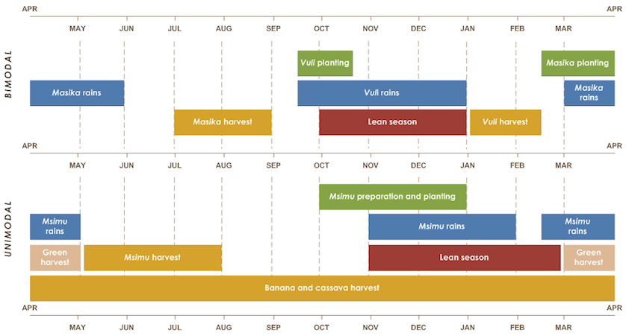
Tanzania Cropping Seasons

Slide 53
Details of Existing Portfolio of Investments in Tanzania
Area of work | Description | Partners | Crops/value chain
Tanzania | To support a follow up survey on adoption of SOPs and use of MLN rapid diagnostics kits (Agristrips) that were specifically piloted in 2018. | Agricultural Research Institute-Ukiriguru | Maize
Tanzania | e-Verification system for Agricultural Inputs in Tanzania | Quincewood | Inclusive Finance
Tanzania | Income smoothening for smallholder farmers and Produce market access. | SELF MF | Inclusive Finance
Tanzania | Improving Smallholder Farmers Resilience through crop insurance 'Wekeza Kwa Uhakika (WEKU)'. | Reliance Insurance Company and Tanzania Association of Professional BDS Providers Company Limited | Inclusive Finance
Tanzania | Tanzania Potato Systems Improvement. | Crop Bioscience Solutions Ltd. | Potatoes
Katavi Region | Upgrading and Strengthening Input Distribution Systems through Start-up Grants to Rural Agro-Dealers in Sumbawanga and Katavi Regions | Agricultural Council of Tanzania | Agro-dealers
Kagera | New Agro-dealers Development Support in the Kagera Region of Tanzania. | Ruvuma Commercialization and Diversification of Agriculture | Agro-dealers
Kigoma | Commercializing smallholder farmers through agro-dealer support project in western-Kigoma Tanzania. | Ruvuma Commercialization and Diversification of Agriculture | Agro-dealers
Southern Highlands | Mobile to Mechanization Leading to More Money for All | ETC Agro Tractors & Implements Ltd | Inclusive Finance
Tanzania | Policy Advocacy to Strengthen & Accelerate Agricultural Reforms in Tanzania (PASAAR-Tanzania) | Agricultural Non-State Actors Forum | Policy & advocacy
Tanzania | Establishing a Mechanism to Monitor and Regulate Food Crop Commodity Exports | Economic and Social Research Foundation | Policy & advocacy
Tanzania | Increased Financial Inclusion for Smallholder farmers through refurbishing of transactional and mobile accounts (Savings, Transactions and Credit). | Foundation For Agriculture Development | Inclusive finance
Tanzania | AGRA-TADB Matching Grants Portfolio | Tanzania Agricultural Development Bank | Inclusive finance
Tanzania | Agricultural lending scheme agreement. | TPB BANK PLC | Inclusive finance

Slide 54
Details of Existing Portfolio of Investments in Tanzania
Area of work | Description | Partners | Crops/value chain
Kigoma Region | Integrated Project to Increase Income and Improve Food Security and Livelihood among Smallholder Farmers in the Western Tanzania, Kigoma Region | Faida Market Link Company | Maize, cassava, beans
Kigoma | Integrated Project to Increase Income and Improve Food Security and Livelihood among Smallholder Farmers in the Western Tanzania, Kigoma Region | Farm Radio International | Maize, cassava, beans
Tanzania, North Western Zone Regions | Scaling up Local Seed Production and Distribution of Nitrogen Use Efficient and Drought Tolerant Maize Varieties in North Western Zone Regions of Tanzania | Meru Agro-Tours and Consultants Co. Ltd. | Maize, cassava, beans
Kigoma Region | Integrated Project to Increase Income and Improve Food Security and Livelihood among Smallholder Farmers in the Western Tanzania, Kigoma Region | Nyakitonto Youth for Development Tanzania (NYDT) | Maize, cassava, beans
Kigoma Region | Integrated Project to Increase Income and Improve Food Security and Livelihood among Smallholder Farmers in the Western Tanzania, Kigoma Region. | Ruvuma Commercialization and Diversification of Agriculture | Maize, cassava, beans
Kigoma and Kagera Region | Production, promotion and distribution of improved seeds of maize, sunflower and beans varieties to smallholder farmers in Kigoma and Kagera regions of Tanzania for enhanced productivity, accessibility and affordable prices. | Suba Agro-Trading & Engineering Co. Ltd | Maize, sunflower, beans
Kigoma Region | Integrated Project to Increase Income and Improve Food Security and Livelihood among Smallholder Farmers in the Western Tanzania, Kigoma Region. | Tanzania Chamber of Commerce, Industry and Agriculture Limited,TCCIA Regional Chamber KIGOMA | Maize, beans, cassava
Rukwa Region | Promoting Market led Approach to improve profitability of beans, Maize and Rice in Sumbawanga cluster | Actions for Development Programmes – Mbozi | Maize, beans, rice
Rukwa Region | Promoting Market led Approach to improve profitability of beans, Maize and Rice in Sumbawanga cluster | Agricultural Council of Tanzania | Maize, beans, rice

Slide 55
Details of Existing Portfolio of Investments in Tanzania
Area of work | Description | Partners | Crops/value chain
Rukwa Region | Promoting Market led Approach to improve profitability of beans, Maize and Rice in Sumbawanga cluster | Building Rural Incomes Through Enterprise | Maize, beans, rice
Kagera Region | Agricultural Transformation for increased income and improved food security and livelihood among smallholder farmers in Kagera Region of Western Tanzania | Farm Radio International | Maize, beans
Kagera Region | Agricultural Transformation for increased income and improved food security and livelihood among smallholder farmers in Kagera Region,Western Tanzania | Karagwe Development and Relief Services (KADERES) | Maize, beans
Kagera Region | Agricultural transformation for increased income and improved food security and livelihood among smallholder farmers in kagera region, Western Tanzania | Maruku Agricultural Research Institute | Maize, beans
Rukwa Region | Promoting Market led Approach to improve profitability of beans, Maize and Rice in Sumbawanga cluster | Mbozi-Ileje-Isangati-Consortium(MIICO) | Maize, beans and rice
Kagera Region | Agricultural Transformation for increased income and improved food security and livelihood among smallholder farmers in Kagera Region,Western Tanzania | Ruvuma Commercialization and Diversification of Agriculture | Maize, beans
Kagera Region | Agricultural Transformation for increased income and improved food security and livelihood among smallholder farmers in Kagera Region,Western Tanzania | Faida Market Link Company | Maize, beans
Iringa and Njombe Regions | Linking farmers to input and out markets to spur maize, beans and soybean productivity in Ihemi-Ludewa Cluster of Iringa and Njombe Regions of Tanzania | Building Rural Incomes Through Enterprise | Maize, beans, soybeans
Iringa and Njombe Regions | Linking farmers to input and out markets to spur maize, beans and soybean productivity in Ihemi-Ludewa cluster of Iringa and Njombe Regions of Tanzania | Division of Research and Training, Ministry of Agriculture, Food Security and Cooperatives | Maize, beans, soybeans
Iringa and Njombe Regions | Linking farmers to input and out markets to spur maize, beans and soybean productivity in Ihemi-Ludewa Cluster of Iringa and Njombe Regions of Tanzania | Eastern Africa Grain Council | Maize, beans, soybeans
Iringa and Njombe Regions | Linking farmers to input and out markets to spur maize, beans and soybean productivity in Ihemi-Ludewa cluster of Iringa and Njombe Regions of Tanzania | Tanzania Association of Professional BDS Providers Company Limited | Maize, beans, soybeans

Slide 56
Results from Investments in Tanzania To Date
Indicator | Actual to date
Number of farmers reached | 742,865
Quantity of Early Generation Seeds produced(MT) | 153
Quantity of certified seeds produced by seed companies | 1,737
Quantity of certified seeds sold as a result of AGRA support | 1,082.2
Number of VBAs selected and trained | 4,971
Small packs distributed | 188,907
Extension events – demos, field days etc | 6,639
Number of farmers reached by extension | 453,644
Number of SHF assessing mechanization services | 7,939
Cubic meters of storage space developed or refurbished | 52,858
Quantity (MT) of produce aggregated | 322,905
Quantity (MT) of produce sold | 292,623
Value of produce ($US) sold to markets | 837,647,424

Slide 57
Details of Proposed Investments in Tanzania
As outlined in AGRA’s Tanzania strategy, the focus on Policy and State Capability investments will be on implementation of flagships designed in the NAIP, strengthening monitoring and evaluation in the ministry, digitization and policy reforms to ensure an enabling environment for Ag, transformation. The proposed investment for this body of work in 2019 are outlined below:
Area of Work | Description | Rationale | Target Population
Policy and State Capacity | Strengthening Coordination of ASDPII at the LGAs SCALGA) | Effective and efficient implementation of ASDPII will drive a more inclusive agricultural transformation in Tanzania | Twelve Regions and Thirty LGAs across Tanzania
 | Micro-reforms in the seed sector to promote widespread adoption of improved seed technology | Improved seeds is critical to enhanced production and productivity of the agricultural sector | Tanzania
 | Support NACOTE in prioritizing problem policies and regulations policy analysis |  | Tanzania
Systems Development | Improvement in soil health through interventions that reduce soil acidity (Lime project) | Soil acidity has emerged as a big bottleneck to productivity and production enhancement in the Southern Corridor of Tanzania | Southern Highlands
 | Expanding maize markets through demand pull from non-traditional uses of maize (EMMA-project) | With increasing production and productivity of maize, market access remains a big access. Non-traditional uses such as feed manufacture provide options for expanding demand | Maize growing areas
Country Delivery and Partnership

Slide 58
Emerging issues/Lessons Learned Leading to Opportunities
Issue | Proposed Mitigation
Capacity for LGAs to plan, coordinate and implement agricultural transformation activities | Strengthen Coordination of ASDPII, planning and resource mobilization at at the Local Government Level is important scaling and sustaining AGRA models
Donor resources not well coordinated at implementing partners’ level | CAC and active engagements in ASWG is essential for improving efficiency and effectiveness of interventions
Limited Private sector service delivery models to enhance access to mechanization services to smallholder farmers | Develop structured and customized mechanization requirements for supported farmers
Achieving results in market led interventions requires maximum and constant engagement with private sector partners (market actors) | Identify and engage prime movers of crop produce volumes in order to sustain off-take of excess production thus sustaining improved productivity and adoption levels
Evidence is required to support and justify policy reforms required to enhance policy and regulatory environment for inclusive agricultural transformation. | Evidence building: Undertaking political economy analysis, economic and legal analyses to generate evidence is required to support and justify policy reforms required to enhance policy and regulatory environment for inclusive agricultural transformation.

Slide 59
Emerging Opportunities for Tanzania
Opportunity
1. Maize: The past agricultural season was characterised by a bumper harvest across the whole East Africa region. This led a to a significant drop in the market price for maize and limited availability of export market opportunities for maize farmers. There is need to look at local processing opportunities for maize in Tanzania. AGRA can support with the development of a PPP strategy for investment in milling and processing plants.
2. Rice: The World Bank and the Japan International Cooperation Agency have invested in irrigation infrastructure. This is expected to increase productivity. AGRA has also put $3 million into the rice value chain to help increase competitiveness and reduce the amount of imports.
3. Soybean: Demand for soybean has been increasing driven mainly by animal feed producers. There is still a huge supply gap as productivity remains low. The number of soybean farmers remains low as soybean is not a popular crop in Tanzania. Promotion of soybean as a commercial crop is key to ensuring that the market demand is met.
4. Potatoes: Seed companies continue to lack capacity to supply certified seed demanded in the market. There is a need to support these companies to increase their capacity to meet the demand for potato seed. AGRA has set aside US$ 3 million for this initiative.
5. Cassava: The market for cassava has grown significantly driven mainly by China which is purchasing most of the cassava produced in Tanzania. The Bill and Melinda Gates Foundation has been supporting cassava farmers to increase their productivity. AGRA is also working with government to develop a comprehensive cassava investment plan.
6. Country Support and Policy Engagement: Government is looking at options to eliminate export bans and ensure food security. Specifically the government is looking for tools that can help them estimate the amount of food available currently. AGRA has funded this project through the Economic and Social Research Fund

Slide 60
The Team

Slide 61
The Team
Regional Head: Prof. Nuhu Hatibu
Direct Reporting
Dual Reporting
Country Manager: Vianey Rweyendela
Program Officer-FtMA and PHM
Edward Agaba
Program Officer-YWS/Ihemi
Stella Rwiza
GST 3 M&E Officer
Nicholas Obare
GST 3 Grants Gilbert Moshi
Program Officer - Policy
Liston Njoroge
Associate Program Officer-North
Seleman Kaoneka
GST Finance Administrator Frederick Sangawe
Associate Program Officer
Donald Mizambwa
Associate Program Officer
Ipyana Mwakasaka
Associate Program Officer IF - Lilian Mwamdanga
Associate Program Officer
Japhet Laizer
Admin Assistant
Agnes Mwaisaka
Driver
Ramadhani Vuai

Slide 62
Tanzania and East Africa Organogram
Regional Head, East Africa
Nuhu Hatibu
HQ- based Technical Support
HQ Administrative
Country Manager
Vianey Rweyendela
Program Coordinator
Agnes Mwaisaka
PIATA Chief of Party
Vanessa Adams
Head of Procurement
Frank Muvinyi
Driver
Ramadhan Vuai
PIATA Deputy Chief of Party Tadele Gelan
Head of Grants Management
Ignatius Mutula
Grants Officer
Gilbert Moshi
Program Officer – State Capability-Liston Njoroge
Head of Seed Research & Systems Development George Bigirwa
Program Officer-PFtMA/PHM
Edward Agaba
Head of Policy and Advocacy, Boaz Keizire
Head of Communications
Waiganjo Njoroge (interim)
M & E Officer
Nicolas Obare
Head of Gender
Amanda Satterly
Chief Finance Officer
Lilian Nyang’aya
Finance Administrator
Fredrick Sangawe
Program Officer-Ihemi/PHM
Stella Rwiza
Associate Program Officer - Inclusive Finance
Lilian Mwamdanga
Head of Inclusive Finance
Hedwig Siewertsen
Key
Associate Program Officer –Kagera
Ipyana Mwakasaka
Head of Soil Fertility & Fertilizer Systems
Rebbie Harawa
Field Based staff
Head of Extension & Capacity Building
Paul Seward
Associate Program Officer – Kigoma
Donald Mizambwa
Head of Country Support
Thierry Ngoga
Based in Nairobi
Associate Program Officer – SUKA-Japhet Laizer
Head of M&E and Knowledge Management , Daudi Sumba
Dar es salaam Based Staff
Associate Program Officer – North Selemani Kaoneka
Compliance Officer
Grace Mwai
Head of Strategy and Analytics
Anne Maria

Slide 63
Annexes

Slide 64
Tanzania Case Study
Background
The Resolution
In 2017/2018 Tanzania produced 6.6M MTs of maize, against domestic demand of 5.4M MTs leading to a surplus of 1.2M MT.
In the same period, the government was implementing an export ban, limiting opportunity for cross-border market
In 2018 maize producer prices declined to $74/MT from an average of $150 (a 5-year low) due to excessive carryover stocks from the 2017 season following the export ban
AGRA engaged with the government leading to the Minister of Agriculture forming a taskforce to provide recommendations on export ban
Taskforce which had two AGRA staff and selected government staff prepared a concept note that was submitted to AGRA
AGRA accepted Minister’s formal request for a project to address administrative and system triggers of export bans
Project proposal developed and approved for funding
The project is being implemented by a taskforce that has government and ESRF
Expected Outcomes
A system for monitoring and regulating food exports
A revised methodology for food crop production forecasting and assessment
Proposed operational linkage mechanism between TMX and the key players
Recommendations and a guide for development of the national food security strategy

Slide 65
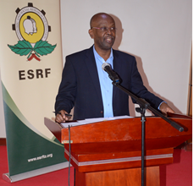
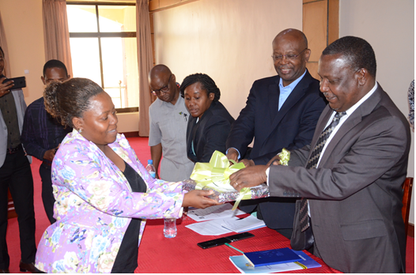
Country Case Study
Challenges Encountered
Frequent changes in political office holders e.g., Ministers, P.S. slows down implementation
Policy and regulatory reforms are necessary slow and could take many years to complete
Implementation of the project involve coalitions of partners in government and the civil society. Managing and satisfying competing priorities of different partners is a challenge
Outcomes
Minister formally lifted export ban vide budget speech. However, that decision needs to be anchored in law to make it permanent
More work is needed to remove export trade barriers, especially the NTBs
Government keen to remove export bans
Dialogue with policy decision makers key to solving policy and regulatory bottlenecks

Slide 66
AGRA Institutional Results Framework and theory of change

Slide 67
AGRA Strategy Results Framework
CAADP Framework | Sustainable Development Goals
Goal: Catalyze and Sustain an Inclusive Agricultural Transformation in Africa to increase incomes and improve food security
Objective 1:
Increased staple crop productivity for smallholder farmers
Objective 2:
Strengthened and expanded access to output markets
Objective 3:
Increased capacity of small holder farming households and agricultural systems to better prepare for and adapt to shocks and stresses
Objective 4:
Strengthened continental, regional and government multi-sectoral coordination, and mutual accountability in the agricultural sector
Objectives
Primary Outcomes
Outcome 1: Strengthened agricultural input systems, technology development and supply chain
Outcome 2: Increased adoption of Agriculture productivity enhancing technologies
Outcome 3: Reduced post-harvest losses
Outcome 4:
Increased agricultural employment and entrepreneur-ship
Outcome 5:
Increased use of structured markets
Outcome 6: Strengthened and expanded business development, financial and risk management services in agriculture value chain
Outcome 7:
Reduced impact of agricultural volatility
Outcome 8: Strengthened national and regional level agriculture sector system functioning
Cross-cutting outcomes
9. Strengthened regional and national agricultural enabling policy environment
10. Increased women empowerment and livelihoods in agriculture
11. Increased youth empowerment and livelihoods in agriculture
12. Strengthened capacity for farmers and other focus agricultural value chain actors
13. Strengthened Public and Private Partnerships in agriculture

Slide 68
Policy and State Capability Theory of Change
Increased incomes and improved food security
AGRA’s Strategic Goals
Increased productivity (more productive small holder farming units and SMEs )
Increased regional trade (intra-Africa trade) in agricultural commodities and inputs
Increased resilience (more adaptive and resilient households to shocks)
Outcomes
The public sector
Increased public sector investments in agriculture
Public sector investments are generating priority and sufficient public goods that de-risk the sector
Appropriate policies providing incentives for private sector investments including public private partnerships in place and operational
Mutual accountability systems and platforms that are aligned to the continental scorecard in place and operational
Non-state actors
Increased private sector investment along the value chain (input production and delivery, farm production, distribution, processing and retail)
Increased private sector participation in cross-border and domestic trade
Non-state actors actively engaged in the accountability processes
Functioning systems
Increased private sector investment along the value chain (input production and delivery, farm production, distribution, processing and retail)
Appropriate regulatory framework for the agricultural sector in place and operational
Reduction and elimination of barriers to domestic and regional trade
Partnerships
Work with partners at all levels to:
Crowd in private capital in support of small-holder agricultural development
Derive synergies and reduce duplication of effort likelihood of transformation within
Derive synergies in order to increase the reach of AGRA’s investments (impact at scale)
So that the target population, institution or resource change
Public Sector / governments have
Sector strategies defining priority areas for investment and policy reform
Mobilized public sector, development partners and non-state actors to invest in /implement priority programs that drive agricultural transformation and facilitate regional trade
Better coordinated sector investment programs
Is championing the necessary policy reforms to drive agricultural transformation and facilitate regional trade
Accountability systems that sustain commitment, encourage results focus and ensure delivery
Investment areas
Develop appropriate sector strategies and investment plans for agricultural transformation
Formulate appropriate policies that catalyze and sustain agricultural transformation and promote regional trade
Implement sector plans and policies in order to generate sufficient public goods that de-risk the sector, attract private capital investment and facilitate regional trade
What AGRA does

Slide 69
Farmer and Systems development Theory of Change
Increased incomes and improved food security
AGRA’s Strategic Goals
Increased productivity (More productive small holder farming units and SMEs)
Increased resilience (more adaptive and resilient households to shocks)
Outcomes
State capacity and policy
Develop state capability to:
Develop appropriate sector strategies and investment plans for agricultural transformation
Formulate appropriate policies that catalyze and sustain agricultural transformation and promote regional trade
Implement sector plans and policies in order to generate sufficient public goods that de-risk the sector, attract private capital investment and facilitate regional trade
Farmers using
Improved production, management technologies and practices
Agricultural credit and financial services
Improved post harvest management technologies and practices
Early warning weather and market intelligence information
Non-state actors
Large, MSMEs producing and delivering inputs, extension, services to farmers in response to demand from farmers
Bank and non-bank institutions providing financial and credit services to MSMEs and farmers
Large, MSMEs providing off-taking, warehousing and processing services
So that the target population, institution or resource change
Farmers and other value chain actors have improved access to
Inputs (fertilizer, seeds); Extension services (knowledge and information); Credit and financial services, stable and remunerative markets, early warning and market intelligence information
Investment areas
Strengthening agricultural input systems, technology development and supply chain
Developing and strengthening extension and advisory services
Developing and strengthening early warning weather and market information systems
Developing and strengthening responsive agricultural finance and credit systems
Developing and strengthening stable reliable and remunerative output markets
Partnerships
Work with partners at all levels to:
Crowd in private capital in support of small-holder agricultural development
Derive synergies and reduce duplication of effort likelihood of transformation within
Derive synergies in order to increase the reach of AGRA’s investments (impact at scale)
What AGRA does

Slide 70
Partnerships development Theory of Change
Increased incomes and improved food security
AGRA’s Strategic Goals
Increased productivity (More productive small holder farming units and SMEs)
Increased resilience (more adaptive and resilient households to shocks)
Outcomes
Partnerships for implementation
Increased reach of AGRA systems grants
Reduced /elimination of duplication of efforts and wastage
Faster progress towards and achievement of intended outcomes and impacts
Increased likelihood of achieving the desired outcomes and impacts
Partnerships for scaling up
Increased public private partnerships
Increased access to technologies knowledge and information
Increased private sector investments at scale
Increased transboundary trade
State capacity and policy
Develop state capability to:
Develop appropriate sector strategies and investment plans for agricultural transformation
Formulate appropriate policies that catalyze and sustain agricultural transformation and promote regional trade
Implement sector plans and policies in order to generate sufficient public goods that de-risk the sector, attract private capital investment and facilitate regional trade
So that the target population, institution or resource change
Partnerships have then following catalytic effect
Systems grants consortia addressing priority bottlenecks in specific geographies
Partnerships for policy advocacy influencing policy formulation and implementation
Development partners investment programs and projects are aligned to derive synergies and avoid duplication
Mutual accountability platforms and processes are defined by partnership objectives
AGRF serving as the premier partnership platform for shaping agricultural development agenda in Africa
Investment areas
Mobilizing inclusive investments in Agriculture
Creating a private-sector led leadership agenda
Build partnerships with leading private sector champions to leverage entire ecosystem and build partnerships around knowledge and intelligence sharing
What AGRA does

Slide 71
References
Agriculture Climate Resilience Plan 2014-2019
http://www.tzdpg.or.tz/fileadmin/documents/external/national_development_frameworks/ASDP2_Final_Document_20_May._2016__after_edit__1_.pdf
http://www.tzdpg.or.tz/fileadmin/documents/external/national_development_frameworks/ASDP2_Final_Document_20_May._2016__after_edit__1_.pdf
https://datacatalog.worldbank.org
https://datacatalog.worldbank.org | 2. www.fao.org/faostat | 3. http://www.fao.org/tanzania/fao-in-tanzania/tanzania-at-a-glance/en
https://www.swedenabroad.se/en/about-sweden-non-swedish-citizens/tanzania/development-cooperation-with-Tanzania/private-sector-development-and-agricultural-markets/
National Survey and Segmentation of Smallholder Households in Tanzania:https://www.cgap.org/sites/default/files/Working-Paper-Smallholder-Survey-Tanzania-May-2016.pdf
Tanzania Ministry of Industry and Trade. Small and Medium Enterprise Policy. 2003.
The economic lives of smallholder farmers: http://www.fao.org/3/a-i5251e.pdf
World Bank Enterprise Surveys. Tanzania Country Profile 2013
www.fao.org/faostat

