Slide 1
AGRA Mali Operational Plan
Revised, June 2019

Slide 2
Table of contents
 | Section | Page Number
1 | Executive Summary | 3
2 | Mali Agricultural Context | 6
2 | AGRA 2017 – 2021 | 19
4 | AGRA Mali strategy | 22
5 | Results Framework and Targets | 31
6 | Portfolio to date, lessons and opportunities | 35
7 | The Team | 41
8 | Annexes | 43

Slide 3
Executive Summary

Slide 4
Executive Summary (1 of 2)
Agriculture is the cornerstone of Mali’s economy and holds great potential for driving economic growth, despite the fact that only the southern part of the country is suitable for farming. The sector employs 80% of the Malian population (with 58% of agriculture labor force being male) and contributes up to 40% to Gross Domestic Product (GDP). The Malian Government is committed to the sector and have consistently allocated ~13% to the sector the past five years surpassing the Comprehensive African Agriculture Development Program (CAADP) Target of at least 10% allocation and leading to sector growth of ~7%. Investments into agriculture are articulated in the Agriculture Development Policy (PDA) and its implementation and investment plan PNISA (2015-2025).
However, despite this commitment by Government, challenges abound in the ag sector largely due to variable and extreme weather patterns. The basic staple crops include: Millet, sorghum, maize, and rice which are produced by 90% of farmers for subsistence; crop yields depend almost entirely on the weather (rain) and are much lower than optimal with maize estimated at ~2.7 MT/HA against 8 MT/HA; millet 0.83 MT/HA against 2.5MT/HA; sorghum being ~0.95MT/HA against ~3.5MT. In the past five years, the production of cereals has increased, reaching an annual average of around 7.0 million MT. However, a large part of this growth was due to bringing more land into production and an increase in the rural population, rather than improvements in crop yields or labor productivity. Fertilizer usage is slightly higher than the region at ~ 28kg/HA while post harvest losses are as high as ~25% for maize. With regard to agricultural exports, cotton and livestock dominate export revenues in Mali.
AGRA’s 2017 – 2021 strategy seeks to catalyze and sustain an inclusive agriculture transformation in 11 priority countries including Mali. The theory of change is that unlocking sustainable transformation will required a combination of {i} Policy and State Capability: working with government to strengthen execution capacity while enhancing the transparency, accountability systems and policy environment for increased public and private sector investment in agriculture; {ii} Systems Development: investments to build downstream delivery systems closer to smallholder farmers while providing support to local private sector to scale technologies and services which deliver better productivity and incomes; and Partnerships: investments to facilitate the alignment between government priorities and private sector interests; improving integration and coordination which lead to investments beneficial to smallholder farmers

Slide 5
Executive Summary (2 of 2)
AGRA has partnered with the Government of Mali to support its agropole strategy by driving sector coordination for better performance, co-developing a new agricultural investment plan, and addressing market access and production issues that constrain sector performance. In addition, AGRA has also engaged the government to address weak market linkages by reforming the input subsidy program and provide much-needed evidence to support policy making. Additional investments are to:
Address weak market linkages that prevent farmers and commodity handlers from capitalizing on the growing feed industry in Koulikoro
Improve limited processing capacity constraining structured market development in Sikasso
Improve yield gaps in food security crops due to limited access to improved inputs in Segou
By executing this strategy, AGRA expects to improve the food security and increase incomes for at least 720,000 smallholder households directly and a further 700,000 indirectly while targeting four key crops: cowpea, maize, millet and sorghum in three priority regions namely: Koulikoro, Segou and Sikasso which cover ~80% of small holder farmers in Mali. In addition, these areas have better infrastructure and a more organized landscape of agricultural stakeholders. Implementation of the strategy begun in Q4 of 2017 and to date AGRA has invested ~$7.5Million in its different bodies of work as below:
In policy and state capability, AGRA supported Government with $698,000 to improve the input subsidy program (ISP), to develop a flagship program, to strengthen coordination and M&E capacities as well as to support domestication of Regional seed and fertilizer regulation.
In farmer and systems development: AGRA set up 3 consortia to drive integrated delivery in the three target regions seeking to build maize, sorghum, Millet and Cowpea value chains from a systems development perspective.
AGRA’s private sector partners included seed companies, agro-dealers, fertilizer blenders, offtakes, processors, financial institutions and business development service providers
The strategy well aligned with the government’s priorities and contributes to the need for a strong sector with effective coordination and implementation capabilities, and strengthening delivery systems for improved productivity and marketing of produce. The strategy emphasizes gender inclusive transformation to drive equitable access to inputs, finance, agriculture education and resilience.

Slide 6
Mali Agriculture Context

Slide 7
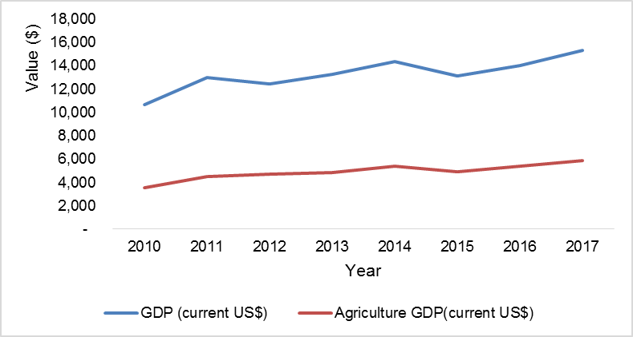
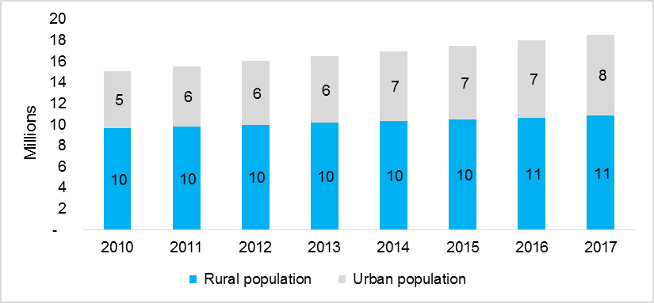
Mali’s Agriculture sector has had a slow but positive growth over the past 5 years and continues to contribute significantly to the overall economy
1. Agriculture and the Economy
Figure 1 Overall GDP Growth against Ag. GDP contribution
Mali’s GDP per capita, USD 842 is much lower than Sub-Saharan Africa’s (SSA) average with poverty headcount averaging 51% in the last 5 years;
The country experienced a slow-down in economic activity in 2015, with GDP increasing by an estimated 5.2% (compared with 5.8% in 2014) due to poor agricultural sector performance (growth of only 3.9%, down from 14.8% in 2014) and armed conflict.
Agriculture accounts for up to ~40% GDP and employs ~80% of the population with ~58% of the labor force in ag being male.
Mali’s total population is ~19M with ~58% residing in the rural areas (Figure II).
The most important export items are gold, cotton, and live animals, while imports consist largely of machinery, appliances, and transport equipment and food products. Mali's major trading partners are China and other Asian countries, neighboring countries, South Africa, and France.
The main threats of the Mali agricultural sector include:
Reliance on rain-fed agriculture;
Emergence of the Fall Army Worm;
Low mobilization of financial resources to the ag sector;
Low level of processing of agricultural products;
Poor management of inventory management and marketing of agricultural products; 5/
insufficient of human resource; 6/
low rate of agricultural equipment; 7/
insecurity in some production areas.
The Mali agricultural profession is well structured into apex/umbrella organizations taking into account gender issues (Women and young people are largely involved); in addition to the Permanent Assembly of the Chambers of Agriculture of Mali (APCAM) and the National Coordination of Farmers Organizations (CNOP), women are closely represented in; the National Federation of Rural Women of Mali (FENAFER); {ii} the National Federation of Rural Youth of Mali (FENAJER-MALI).
Figure II - Urban vs. Rural Population

Slide 8
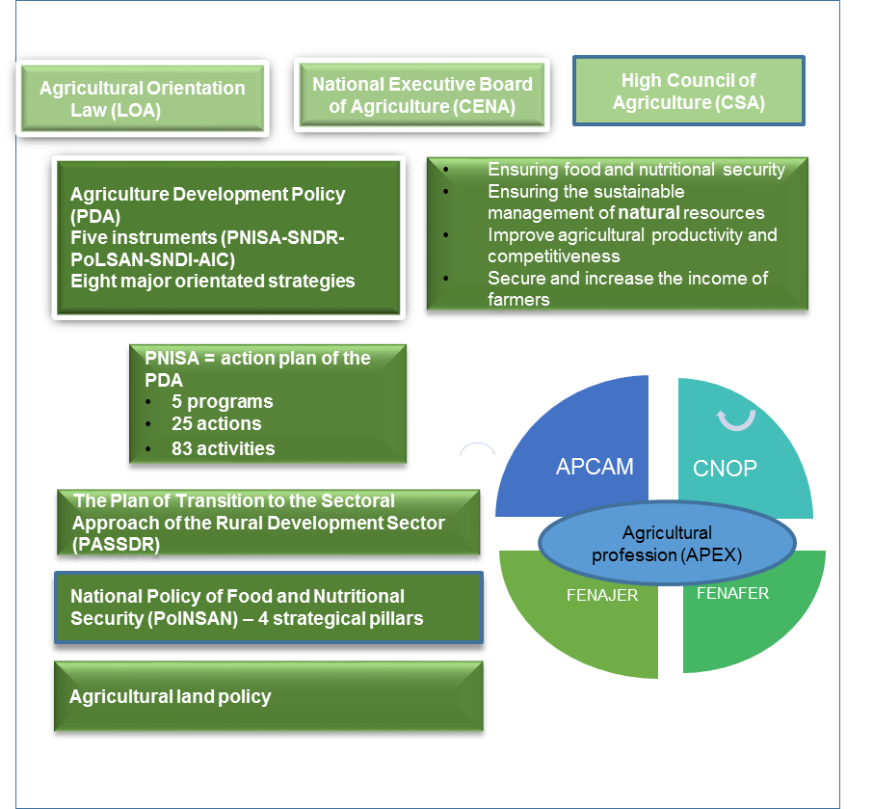
The Malian government has recommitted to Agriculture sector development through various initiatives
2. Government Priorities
Government of the Republic of Mali has developed several approaches and strategies including the Plan of Transition to the Sectorial Approach of the Rural Development Sector (PASSDR) in accordance with the principles of the ‘’Paris Declaration’’ (improving aid effectiveness) and the ‘’Sustainable Development Goals’’ (SDGs 2015-2030); These have contributed toward improving governance of the agricultural sector and in the implementation and monitoring of agricultural policies and strategies; Mali’s main objectives of fostering socio-economic development and improving food security are anchored on the following frameworks:
Agricultural Orientation Law (LOA) ,and,
Agricultural Development Policy (PDA) and the instruments for its implementation (PNISA, SNDR, PoLNSAN, SNDI, AIC)
Public spending on agriculture development is the highest in West Africa at 13% p.a. surpassing CAADP’s target of 10% while PNISA recommends a 20% allocation.
However, the government continues to face institutional capacity challenges that include:
Lack of flagship programs to guide agricultural transformation in line with PNISA priorities;
Policy weaknesses that curtail growth of the private sector
Sub-option inter and intra sector coordination; and
Weak capacity within the planning and Statistics department
Limited sectoral linkages and coordination

Slide 9
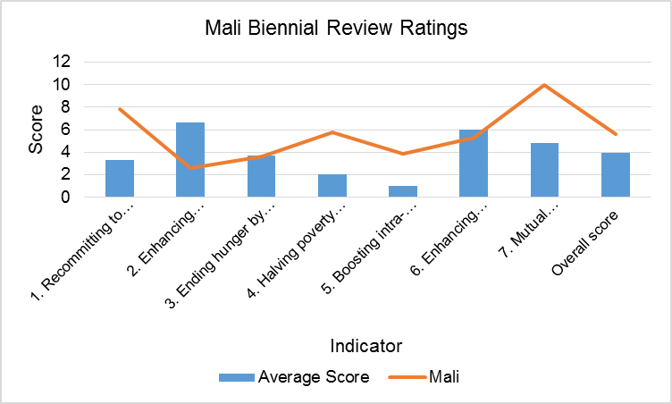
CAADP biennial review shows that the country is on-track and should emphasize access to finance and boosting trade
2. Government Priorities from BRR Review
The AU through the CAADP process using the Biennial Review Rating (BRR) is tracking each countries’ progress towards the 7 (seven) commitments. The first review conducted in 2017 and launched in 2018 rated Mali at 5.57 against a benchmark of 3.9 in 2017 - the average rating a country should score to show positive progress towards achievement of its 2025 targets. This rating means that Mali’s performance is above target on 6 of the 7 indicators assessed and Mali should boost performance on enhancing access to Finance.
Coming out of the Biennial review process in 2018, Mali commits to drive the following actions as priority for the next two years:
Commitment to inclusive and evidence based policy systems through implementation of the institutional capacity for planning, M&E and sector coordination
Improve policy reforms, including different input subsidies, seed, extension, markets, fertilizer, and mechanization and design flagship programme for implementation of inputs policy reforms
Support the diffusion of new technologies including access to agricultural equipment, extension services, supplementary irrigation systems, post-harvest equipment and management systems and statistical data collection and analysis.
Source: Biennial review Mali Action agenda

Slide 10
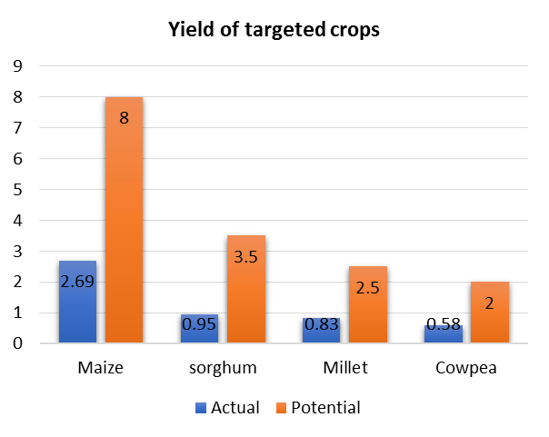
There is room to develop a more vibrant private sector if policy and other incentives are put in place for the benefit of the small holder farmer
3. The Private Sector Landscape and enabling environment
4. Profile of a Smallholder Farmer
The Government of Mali started the implementation of agricultural policy and regulatory reforms in the early 80s in order to improve the enabling business environment.
A Market Information System (OMA -1989) was put in place to improve access of farmers organizations to markets and increase the capacity of the government in the evaluation of the agricultural policy and macroeconomic reforms.
The Strategic Framework for the Fight against Poverty has led to several changes:
New seed legislation and liberalization of the seed industry for the benefit of seed companies
National Seed Committee (CNS)
National body for fertilizer control and specified conditions and modalities for registration of distributors and wholesalers required by law
Despite these efforts by Government, the cost of doing business in agriculture still remains high. The World Bank Enabling Business of Agriculture (EBA)
2017 which measures laws and regulations that impact the business environment for a sustainable and thriving agricultural sector ranked Mali 52/62 in the seed sector; 23/62 in Fertilizer; 61/62 in Machinery; 41/62 in Finance; 44/62 in Transport and 50/62 in Water. There is therefore need for follow up at the administrative and legislative processes and stages to see through implementation.
Priority policies that should be addressed and in line with the commitment for the next years BR include:
Implementation of ECOWAS harmonized rules governing quality control, certification and marketing of plant seeds, seedlings, fertilizers, grades and standards, weights and measures;
Set up regulation for operationalizing the Warrantage Act,
Develop a policy and legislative framework for agricultural mechanization
Estimates show that 23% of farmers using improved varieties of seed
On average, a farmer in Mali has to travel ~17 km to access an agro-dealer
The extension agent to farmer ratio is 1:4,702 which is much higher than the region and some countries in SSA
Fertilizer use stands at 28 kg/ha against a 50kg/ha recommendation but higher than the region and SSA
Millet, sorghum, maize, and cowpea are the basic staple crops and are produced by 90% of farmers for subsistence;
Yields of these crops are much lower than the optimal with maize at 2.7 MT/HA against 8 MT/HA; millet 0.83 MT/HA against 2.5MT/HA; sorghum 0.95 MT/HA against 3.5 MT/HA; cowpea being 0,58 MT/HA against 2MT
Target Crops Current Yields vs. Potential

Slide 11
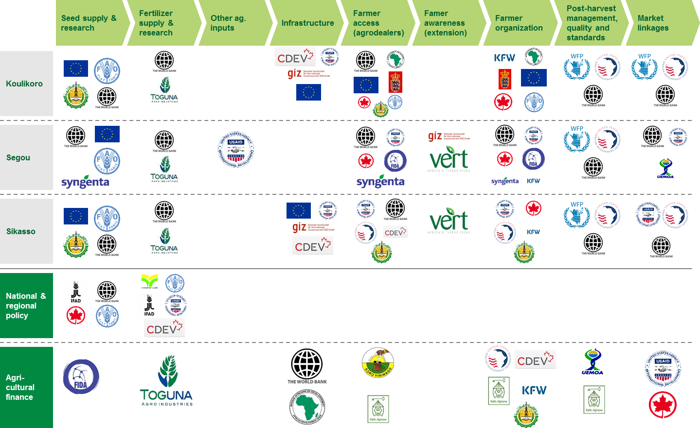
Donor funding accounts for 16% of total spend in Agriculture with 33 donors being the largest funders
5. The Donor Landscape
The World Bank is the leading multilateral financial partner of the sector with 20% of the total financing acquired at sector level followed by the African Development Bank with at 13% and the Islamic Development Bank with at 10%
Approximately 26% of Mali ODA budget of CFAF 222,657 billion goes toward the sector.
The National Fund for Agricultural Supports:
the "Agricultural Development" window
the window "Risks and Agricultural Calamities"
the "Guarantee Fund" window

Slide 12
In addition to Macro-economic analysis, AGRA also carried out analysis of specific systems to inform the strategy (1 of 4)
Seed systems
Breeding and variety release | EGS supply | Certified seed production | Awareness by farmers | Marketing and distribution | Regulation
66 Varieties developed and released between 2010 and 2018: 13 Cowpea, 18 Maize, 27 Rice, 13 Sorghum, 4 Pearl Millet) | IER is the source of early generation seed. Some private seed companies like SOPROSA, Faso Kaba, Camara Semences, Comptoir 2000 SA, DOUNKAFA produce their own foundation seed. No. of active breeders: 2 maize, 2 Sorghum, 1 Millet, 1 Cowpea. | 7 active seed companies producing certified seed for the key food crops – maize, rice, sorghum, pearl millet and cowpea. Seed sales in 2018, 427 MT of sorghum, 96 MT of millet, 254 MT of cowpea | Low level of utilization of improved seeds (incl. hybrids) by farmers. ASSEMA is a relatively vibrant seed association providing seeds through the informal seed sector. EUCORD trained 600 VBAs to provide extension services and improved seeds to 28,000 smallholder farmers. Mission Sahel trained 300 VBAs to provide extension services and improved seeds to 39,400 smallholder farmers. AMDD trained 300 VBAs to provide extension services and improved seeds to 43598 smallholder farmers Faso Jigi trained 385 VBAs to provide extension services and improved seeds to 33,755 smallholder farmers | MALIMARK trained 300 agro dealers Investments have reduced the distance covered by the agro-dealers from the base of 20.2 km to average of 17.8 km to access agro inputs. | Seed adulteration still a challenge in Mali. ECOWAS harmonized seed regulations yet to be domesticated and implemented in Mali.
Very long variety release process: seed companies dissatisfied with the duration of the process Need for more drought tolerant and short maturing varieties | Shortage of quality foundation seed for most crops particularly maize hybrids | Low volumes of production and sales for certified seed for all key food crops | Insufficient private sector engagement in raising awareness of improved varieties among farmers. Limited use of climate information by farmers in the use of appropriate seed for specific climatic regions | Under-developed agro-dealer network: insufficient number and capacity Limited storage/ warehousing facilities for agro-dealers | LABOSEM in charge of seed inspection and certification woefully under-resourced leading to the incidence of fake seeds.
Status
Gaps

Slide 13
Systems Analysis - Soil health and fertilizer systems (2 of 4)
Soil Mapping and Testing | Product development | Fertilizer blends production | Awareness by farmers | Commercialization and distribution | Regulation
Almost inexistent soil analysis; some 1000 georeferenced soil samples in the Segou region with some extending to Sikasso and Mopti done by Toguna and OCP. Some investments in soils mapping are planned for 2020 under an Islamic Development Bank loan | Fertilizer developed (Yara and Toguna) Trials done by IER/Toguna for Maize, Sorghum, cowpea and millet blends 3 blending plants operating | Low production of blends | Mali is one of the countries where the rate of fertilizer use is high compare to its neighbors, 28kg/ha Ongoing subsidy program includes farmers awareness | Trained agro-dealers operating in the country Distance still long from a farmer to an agro-dealer. | The legal framework for fertilizer regulation exists as well as regulations guiding labeling and quality control based on the regional regulation.
Lack of soils information Limited use of agroforestry as an integrated management technology | Trials to validate some fertilizer formulations Stakeholders (blenders and researchers) capacity in balanced crop nutrition and requirement for blending. | Low demand of the blends Limited technical capacity of blenders and researchers | Inefficient extension program Low involvement of private sector in extension Insufficient use of climate smart technologies in extension | Too many small ADs (<300mt/yr) Lack of working capital Distribution competence – marketing, accounting, planning… | Difficult enforcement of the regulations nutrients are not systematically tested borders are fairly porous
Status
Gaps

Slide 14
Systems analysis (3 of 4)
Extension
Agro-dealer networks
Current state of play | Ineffective extension service: 1:4,702 SHF to extension agent. The approach is based on the decentralization of agricultural extension. Private extension is weak and only some NGOs and some private companies (seed, agro-dealers,…) are investing in extension. The current investments in the country through projects are around $103 Million. Challenges and limitations of the extension is mainly the limited number of extension agent and their capacities as well as lack of resources. There is a weak link between the extension and research. In the Northern part of the country, insecurity continues to hamper operations Limited content as it relates climate smart technologies
Opportunities | Seed companies and agro-dealers are interested in building supply chains that include extension DNA recognizes that the number of public extension agent is insufficient to reach all farmers. Thus the Government is interested in other approaches The extension system is decentralized and therefore, local government are willing to implement innovative approaches to reach farmers. AGRA’s VBAs approach is an opportunity for youth and women employment in extension and agro-dealership. From the biennial review, Mali has committed to facilitate women access to financial services. Climate smart approaches to be integrated in extension curricular
Enablers | Some pilot projects have been implemented by IER-IRD and Orange-Mali on E-extension. There is a national strategy on extension. Some development partners are willing to support the Government to improve its extension
Current state of play | 220 agro dealers have been trained over the past 14 months to provide services to 262,500 farmers under the AGRA-funded projects in the three geographical operational areas in Mali. This has reduced the distance covered by these farmers from the base of 20.2 km to average of 17.8 km to access agro inputs. About 1,610 agro dealers must be recruited to reduce the distance covered from over 17 km to less than 10 km
Opportunities | The uptake of improved crop production technology by the AGRA-funded projects is an opportunity for investment in agro dealership to enhance access to agro inputs by smallholder farmers. Some partners are investing in agro-dealers (AFAP, IFDC, AfDB through TAAT) Some of the VBAs have shown interest and initiated process to invest in agro input distribution to facilitate prospective reduction in distance covered by smallholder farmers to access agro inputs. The interest of some aggregators to investment in backward integration will also enhance demand for agro inputs Building resilience into agro-dealer network (smart inputs, advisory services on practices, market information)
Enablers | Some partners have developed geo-referenced agro-dealers data base; The development of Mali agriculture flagship in maize, sorghum, cowpea and millet will facilitate investment in agro input distribution as well as mechanization and irrigation systems Some private companies (seed and fertilizer) are willing to support the supply chain

Slide 15
Systems analysis (4 of 4)
Output Markets
Access to Finance
Current state of play | Millet and sorghum are leading food security crops particularly among low income households. However, their low commercial value creates a disincentive for investment consigning them to subsistence crops. The total production of maize, sorghum and millet presently satisfies the total demand despite current high levels of post harvest losses.
Opportunities | Rapid urbanization (over 4.5% growth rate per year) is increasing demand for the cereal crop food staples produced by Malian farmers. This is an opportunity for private sector work with farmers to produce and market more food. Opportunity to support the government to operationalize the agro pole strategy in upgrading crop value chains. Export market to the neighboring countries (Mauritania, Niger, Burkina Faso, Senegal,…). Implementation of new private processing plants PNISA oriented to improving competitiveness of agriculture and agro-industry products
Enablers | Improving inclusive financial services and MIS [digital platform linking value chain actors] will strengthen competitiveness of Malian commodities. Improved road infrastructure will reduce long average times to access markets (average 5 to 24 hours) north of Mopti. Enforcement of regulation on local taxes will reduce cost of local food trade
Key partners | Grands Moulins du Mali, Off takers, M3, Bara Muso, Danaya Cereales, OPAM and WFP.
Current state of play | 5% lending to agriculture sector mainly small holders farmers in cotton Interest rates 8%-24% Financial products available: Short term production and trade credit. Equipment finance (Mali tractor)
Opportunities | Opportunity to support the government and operationalize the National Fund of Agriculture Development Opportunity to leverage public-private fund for bank capacity development. The government and Canadian cooperation has started this initiatives with FARM project Possibility to set up a multi stakeholder task force to develop agri-finance strategy (WB IFAD,EU… ) Scaling risk sharing facilities to access input and equipment Scaling digital access to input through existing lay-away platform
Enablers | A supportive regulatory environment for WRS and equipment finance Important donors fund from AFD and KfW as credit line for agriculture finance
Key partners | BNDA, BMS, Orabank, Kafo jiginew, Soroyiriwasso, FGSP, ABC fund, FARM project, Agriprofocus

Slide 16
AGRA 2017 – 2021 Strategy

Slide 17
AGRA’s Vision and Headline goals 2017 - 2021
AGRA’s vision
To catalyze and sustain inclusive agriculture transformation in Africa by increasing incomes and improving food security for 30 million smallholder households in Africa and to support countries on a pathway to attain and sustain an agriculture transformation.
AGRA’s headline goals
Increase the incomes and improve food security for 9 million farm households through the direct result of activities of AGRA, grantees, and partners to increase productivity and access to markets and finance
Contribute to increasing the incomes and improving food security of another 21 million farm households through support to strengthening capacities of governments and private sector and through the contributions of AGRA, grantees, and partners to policies, programs, and partnerships that increase productivity and access to markets and finance
Support 11 focus countries on a pathway to attain and sustain an agricultural transformation

Slide 18
AGRA’s 2017 – 2021 Strategy
Results Framework: AGRA is executing a 5 year strategy to catalyze agriculture transformation to increase incomes and improve food security…
…through three main bodies of work
Headlines goals and objectives
Increase the incomes and food security for 9M households reached directly and for 21M reached indirectly through AGRA activities; support 11 countries on a path to sustained agriculture transformation
Policy and State Capability | Working with government to strengthen execution capacity while enhancing accountability systems and enabling environment for increased public and private sector investment
Systems Development | Building downstream delivery systems for smallholder farmers while providing support to local private sector to scale technologies and services to farmers
Partnerships | Facilitating linkages between private sector and smallholder farmers resulting in increased incomes and sustainable sector investments
Increased staple crop productivity
Expanded access to markets
Increased resilience (capacity to respond to shocks and stresses)
Improved govt coordination and mutual accountability
Outcomes
Improved Input Markets
Increased tech adoption
Reduced Post Harvest losses
Increased Employment
Increase Market access
Increase access to Finance + BDS
Reduced Volatility
Improve Institutional capacity
Cross Cutting Outcomes
Enabling policy environment
Gender and Youth empowerment
Capacity development (SME’s ,SHF’s, Govt’s)
Strengthened public private partnerships
*Source: AGRA Strategy and Business Plan 2017- 2021

Slide 19
AGRA Mali Strategy

Slide 20
AGRA’s Strategy for Mali
AGRA’s strategy and business plan for Mali seeks to help catalyze and sustain an inclusive agricultural transformation by contributing to the government’s need for a strong agriculture sector with effective coordination and implementation capabilities, and strengthening the agriculture sector delivery systems for improved productivity and marketing of produce to impact incomes and improve food security for at least 720,000 farmers directly and about 700,000 smallholder households indirectly through the three areas of work.
Policy and State Capability
Systems Development
Partnerships
AGRA’s plans in Mali, in relation to policy and building of state capacity include:
National Agricultural Investment Plan (NAIP)/Flagship development
Rationalize and roll out of the existing Input Subsidy Program
Domesticate the ECOWAS seed and fertilizer regulation
Improve planning, implementation, coordination capacity of the Ministry of Ag. for efficient service delivery
Support MoA to prepare for the next BR review
The interventions planned to drive key system level change in Mali include:
Extension services
Market systems
Fertilizer systems
Resilience
Inclusive finance
Women Economic Empowerment
Partnership development plans for Mali include:
Developing synergies with World Bank for policy enabling environment, Input Subsidy program reform and technology transfer.
Systems development / USAID,
New fertilizers blending / TOGUNA AGRO-INDUSTRIES-IER
M&E and statistics / EU
The overarching principles of the Mali strategy will include approach to scale and sustainability, partnerships,
government and private sector engagement.

Slide 21
AGRA’s Approach in Mali is Aligned to the National Agriculture Strategy…
AGRA’s strategy in Mali is built on past successes and learnings where AGRA invested US$ ~20M in Input and Output Markets Systems Development, Innovative Finance, Research, Capacity Building and Policy & Advocacy. The current strategy has renewed emphasis on policy and state capability with additional investments in enhancing systems and farmer level development. Mali and AGRA’s vision for Agriculture are in alignment in addition to AGRA’s overall strategy to work more closely with governments
Mali’s Vision for Agriculture Development
The Government of Mali through its Agriculture Development Policy (PDA) aims to promote sustainable, modern and competitive agriculture. PNISA (NAIP) strives to promote a competitive and sustainable agriculture that ensures food and nutritional security and incomes. PNISA is structured in five components, including four structural components and a cyclical component.
Enabling institutional development and capacity building of actors
Development of investments in the agricultural sector
Improving the competitiveness of agricultural and agro-industrial products
Developing an agricultural research and advisory system
Contribute to assure food and nutritional security of the populations
AGRA’s goals in Mali
AGRA’s objective in Mali is to increase incomes, improve food security and reduce shocks and stresses for at least 720K smallholder households directly and 700K indirectly in four value chains namely cowpea, maize, millet and sorghum
AGRA Mali focus areas:
Flagship development
Enabling policy environment
Extension systems
Inclusive Finance
Fertilizer systems
Resilience
Women’s Economic Empowerment
Delivery Areas of work:
Policy and State Capability
Partnerships
Systems Development.
Mali Government Vison and AGRA Goal Alignment
Mali/AGRA Collaboration
Mali agriculture Transformation
Improved Livelihoods for SHF’s

Slide 22
Mali Theory of Change
AGRA’s Strategic Country Goals
Country Goal: Increased resilience, productivity, incomes and food security
Cross Cutting areas
Outcomes
Farmers using
Improved production, management technologies and practices
Agricultural credit and financial services
Improved post harvest management technologies and practices
Early warning weather and market intelligence information
Other value chain actors
SMEs becoming more efficient in producing and delivering inputs, extension, services to farmers
Bank and non-bank institutions providing financial services to MSMEs and farmers
Large, MSMEs providing off-taking, warehousing and processing services
Better coordination of business among value chain actors.
State capacity and policy
Develop state capability to:
Rationalize and roll out of the existing Input Subsidy Program
Domesticate the ECOWAS seed and fertilizer regulation.
Cascade the PNISA (NAIP) to the subnational level and develop regional investment plans
Strengthen the M&E system of the Ministry of Agriculture through the CPS/SDR
So that the target population, institution or resource change
Farmers and other value chain actors have improved access to
Inputs (fertilizer, seeds); Extension services (knowledge and information); Credit and financial services, stable and remunerative markets, early warning and market intelligence information
Partnerships
Work with partners at all levels to:
Crowd in private and public investment to develop two flagship programs (ISP & NAIP)
Derive synergies to reduce duplication of effort
increase the reach of AGRA’s investments (impact at scale)
What AGRA does
Country Investment areas
Developing and strengthening input systems (seed and fertilizer)
Developing and strengthening extension and advisory services (VBAs, E-extension…)
Developing and strengthening responsive agricultural finance and credit systems based on risk sharing mechanism between value chain actors
Developing and strengthening stable reliable and remunerative output markets
Building the capacity of various value chain actors, farmer level, private and public sector
Developing and strengthening systems for climate smart agriculture practices at farmer and systems level

Slide 23
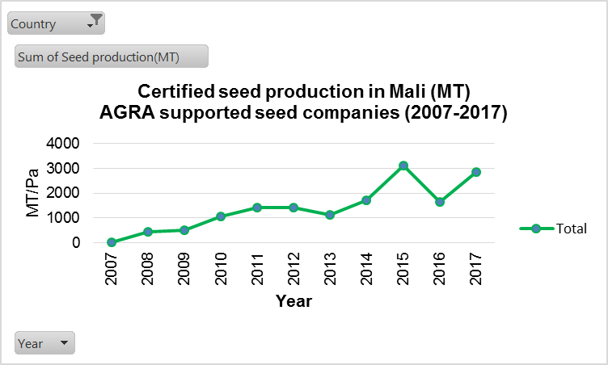
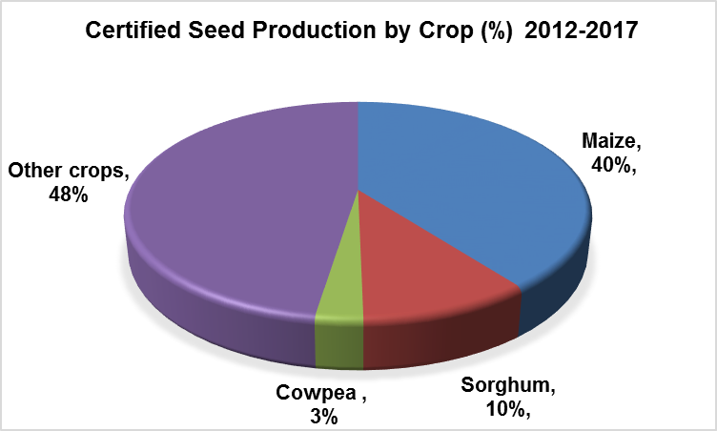
AGRA’s Strategy continues to build off of past work done in Mali to drive for scale and sustainability
Over the last decade, AGRA has invested $20.24million in Mali and contributed to sector development. Through these investments, AGRA made progress that we continue to build off of in the new strategy:
7 PhDs and 33 MScs trained
7 seed companies supported who increased their certified seed production from less than 100Mt to over 10,796 Mt cumulatively since 2007). Supported the development and release of 75 varieties out of which 28 were commercialized
AGRA supported 4,689 agro-dealers through whom distances the farmer had to travel to access inputs reduced from about 26 to 20 km
AGRA trained thousands of farmers on ISFM (3,441 lead farmers), quality storage and structured trade (over 35,763 farmers) as well as farmer organizations on governance, group dynamics and leadership and assisted beneficiary farmers to aggregate 37,283 MT commodity valued at US$14.1 million
2 financial services providers supported. 3 financial products developed
Contributed to the development, validation, and submission of legislation on Warehouse Receipt System (WRS) for approval by relevant government authorities. It also contributed to the mapping and identification of post-harvest facilities and sites for the construction of new silos.
Supported the Government in developing regulatory framework for the implementation of the fertilizer quality control

Slide 24
Mali has also mapped the main partners in the country and their current / Potential relationship with AGRA
Intervention Area | Name of Implementing partner | Type of Institution | Current engagement (grantee, contractor, other partners) | Operational level (national, regional, international) | Location of HQ in Mali | Type of engagement (Off-taker/processor, input supplier, mechanization, quality/PHH, financing, etc
Policy coordination, M&E and Statistics, agricultural regulations, extension | Ministry of Agriculture | Public |  | National | Bamako | Agricultural policy
 | Consortium Koulikoro
Seed company | FASO KABA | Private | Grantee | Regional | Bamako | Seed supplier
Seed company | CAMARA SEMENCES | Private | Grantee | Regional | Bamako | Seed supplier
NGO / Market linkage | AMASSA AFRIQUE VERTE | Private | Grantee | National | Bamako | Quality, PHH, market linkage
NGO / Extension | AMDD | Private | Grantee | Regional | Bamako | Extension
NGO / Extension | MISSION SAHEL | Private | Grantee | Regional | Bamako | Extension
NGO / AGRODEALER | MALIMARK | Private | Grantee | Regional | Bamako | Agro dealership
Agricultural research | IER | Public | Grantee | Regional | Bamako | Agricultural research
Agricultural sector | DNA | Public | Grantee | Regional |  | Facilitation, extension, policy regulations implementation
 | Consortium of Sikasso
Seed company | AGRIPLUS | Private | Grantee | Regional | Sikasso | Seed supplier
Seed company | SODIAF | Private | Grantee | Regional | Sikasso | Seed supplier
Seed company | SOPROSA | Private | Grantee | Regional | Sikasso | Seed supplier
Seed company | SOPROSEK | Private | Grantee | Regional | Sikasso | Seed supplier
Seed company | ZAMOHO | Private | Grantee | Regional | Koutiala | Seed supplier
NGO / Market linkage | AMASSA AFRIQUE VERTE | Private | Grantee | Regional |  | Quality, PHH, market linkage
NGO / Extension | EUCORD | Private | Grantee | Regional | Bamako | Extension
NGO / Market & Aggregation | AMEDD | Private | Grantee | Regional | Koutiala | Quality, PHH, aggregation, market linkage
Agricultural sector | DRA | Public | Grantee | Regional | Sikasso | Facilitation, extension, policy regulations implementation
Public / Agricultural research | IER | Public | Grantee | Regional
 | Consortium Segou |  | Grantee
Seed company | COMPTOIR 2000 SA | Private | Grantee | Regional | Bamako | Seed supplier
Seed company | DOUN KA FA | Private | Grantee | Regional | Bamako | Seed supplier
NGO / Market | AMASSA AFRIQUE VERTE | Private | Grantee | Regional |  | Quality, PHH, market linkage
Apex FO / Extension | FASO JIGI | Private | Grantee | Regional | Segou | Extension
NGO / AGRODEALER | MALI MARK | Private | Grantee | Regional |  | Agro dealership
Agricultural research | IER | Public | Grantee | Regional |  | Agricultural research
Agricultural sector | DNA | Public | Grantee | Regional |  | Facilitation, extension, policy regulations implementation

Slide 25
AGRA has prioritized three regions in Mali based on impact potential and ease of delivery
To prioritize interventions, regions were assessed based on:
Possible impact
Ease of delivery
Mali
Segou
200K farmers focusing on millet, sorghum and cowpea
Highest density of farmer household in the country (33/km²)
Strong transport infrastructure for crop commercialization
Largest irrigation schemes
Fertilizer subsidy strong on rice
High production volume despite traditional farming techniques, with a marketable surplus of 165 K MT
High yield gaps and post-harvest losses create inconsistency in production and drive food security challenges
Key markets include government (through OPAM), WFP, and private grain traders
Koulikoro
320K farmers focusing on maize and sorghum, with cowpea intercropped
Six rivers feeding irrigation facilities
Key buyers include government (through OPAM), WFP, and private grain traders/exporters for industry
High potential as a supplier to feed processing industry in nearby Bamako
Food processing industry also developing
Low quality of processed grains limits market opportunities
Under-developed FOs, with significant technical and organizational capacity gaps
Limited aggregation services
Marketable surplus: 544K MT
Sikasso
200K farmers focusing on maize, sorghum and cowpea
Marketable surplus: 680 K MT (30% of national production)
Sikasso Breadbasket Strategy, promoted by AGRA, was suspended due to national security issues, but is currently very high on government agenda
Cotton industry facilitates fertilizer availability, which benefits increased maize production
More agrodealers than rest of country, but small scale agro-processing
High level of mechanization
Key markets include government (through OPAM), WFP, and private grain traders, but demand is unpredictable
Close proximity to Burkina Faso and Guinea could support exports when national surpluses are available
Poor processing capacity and limited value addition services
Weak farmer support and extension services leads to low agronomic knowledge and poor PHH techniques
Crop
Acreage, 000 ha
Farmers, 000
Maize
189
463
Sorghum
92
234
Millet
100
241
Cowpea
80
938
Rice is will be included as a market transition crop with the opportunity to improve the processing industry to meet quality requirement for domestic and export markets. Rice will be promoted in Segou region which has a large irrigation scheme

Slide 26
Working with public and private entities, AGRA aims to influence funding to the most impactful projects
AGRA recognizes the existence of other donors in Mali focusing on the same value chains in the same areas and will complement and leverage the work of other funders to trigger a transformation.
Projected expenditure and investments¹
AGRA
<1%
Government of Mali²
~$ 900M
Donors³
~4.5B
AGRA’s strategic vision in Mali can only be achieved through strong partnerships with other players in Mali
AGRA will prioritize interventions that catalyze and complement funding committed by the Government, private sector, and donors
AGRA is committed to:
Alignment with Government priorities and programs
Boosting government capacity for strategic planning and implementation
Participating in and supporting government coordinating mechanisms and effort to mobilize public and private investments
Catalytic system investments to scale up proven models and technologies
1: Figure not drawn to scale; 2014 values extrapolated for government and donor funding
2: ReSAKKS, 2014 data extrapolated over 5 years
2014 Official Development Assistance (ODA) flows, Other Official Flows (OOFs) and Private Grant/Flows reported by donor countries, multinational organizations and private entities to OECD DAC Directorate for all purposes related to agriculture except forestry and general environment protection extrapolated over 5 years
3: SOURCE: World Bank (accessed via ReSAKKS); UN FAOSTAT (with data originating from OECD DAC)

Slide 27
Results Framework and Targets

Slide 28
Mali Country Results Framework
Expected outcomes | Country Result area | Key interventions
Outcome 1: Strengthened national level agricultural sector system and Strengthened agricultural enabling policy environment | Evidence based planning and accountability mechanisms strengthened | Rationalize and roll out of the existing Input Subsidy Program
 |  | Domesticate the ECOWAS seed and fertilizer regulation
 |  | Cascade the PNISA (NAIP) to the subnational level and develop regional investment plans
 |  | Strengthen the M&E system of the Ministry of Agriculture through the CPS/SDR
Outcome 2: Strengthened agricultural input systems, technology development and supply chain | Increased availability and use of seeds and fertilizer for small holder farmers | Support the production of early generation seed, and scale up seed production.
 |  | Support and strengthen seed certification and fertilizer quality control system
 |  | Support formulation and production of crop and soil specific fertilizer blends
 |  | Conduct extension and capacity building activities to increase the use of seeds of improved and climate smart varieties, adapted fertilizer blends, water and soils conservation technics by farmers.
 |  | Strengthen agro-dealership to bring agri-inputs close to farmers.
Outcome 3: Increased use of structured markets | Increased quality of produce by small holder farmers | Support farm level aggregation centers with warehouses Develop youth-led PH processing interventions to provide services to SH Facilitate access to PHH training, basic commodity handling equipment, enhanced management and linkages to output off-takers and input dealers
 |  | Build capacity of farmers on grain standards and post-harvest loss reduction
 | Increased capacity of SMEs and FOs to participate in structured markets | Develop integrated value chain system; including forward contracting, pricing, quantity projections, transportation
Outcome 4: Strengthened and expanded business development, financial and risk management services in agriculture value chain | Increased supply and demand of sustainable financial services | Developing and strengthening responsive agricultural finance and credit systems based on risk sharing mechanisms.
Outcome 5: Strengthened Public and Private Partnerships in agriculture | Increased public private partnerships and investments in agriculture from private sector | Build partnerships with leading private sector champions to leverage entire ecosystem and build partnerships around knowledge and intelligence sharing
 |  | Mobilizing inclusive investments in Agriculture to develop a rice flagship program.

Slide 29
Key Country Indicators and Targets
AGRA is tracking 73 indicators across its strategy and at country level, but a version of the following dashboard will be tracked for ongoing management and summary reports:
INDICATORS | Baseline 2017 | 2018 Target | 2019 Target | 2020 Target | 2021 Target
Goal Level Impact Indicators
Average number of months of adequate household food provision | 10.9 |  | 11.2 |  | 11.4
Improved food security: Household dietary diversity index) | 5 |  | 5.5 |  | 6.5
Objective Level Outcome Indicators
Average yield (MT/ha) of Maize | 2.2 | 2.3 | 2.9 | 3.5 | 4.5
Average yield (MT/ha) of Sorghum | 1.1 | 1.4 | 1.7 | 1.9 | 2.2
Average yield (MT/ha) of Cowpea | 0.2 | 0.25 | 0.3 | 0.4 | 0.5
Average yield (MT/ha) of Millet | 0.9 | 1.1 | 1.4 | 1.6 | 1.8
Primary Level Outcome Indicators
Adoption rate of target improved productivity technologies or management practices at farmer level) | 42.3% |  | 50% |  | 67%
Percent of crop losses ( After harvest, threshing and storage levels):
Maize | 35% | 33% | 30% | 23% | 18%
Sorghum | 33% | 33% | 30% | 23% | 17%
Cowpea | 32% | 27% | 23% | 15% | 12%
Millet | 30% | 30% | 28% | 25% | 15%
Number of new people employed by SMEs receiving AGRA support along the focus value chains) | 0 | 330 | 260 | 124 | 0
Percent of total household produce sold through structured market facilities/arrangements) | 35% | 40% | 45% | 50% | 60%
Percent of loan/risk facilities directed to agricultural activities/SMEs in target financial/risk providers | 5% | 6% | 7% | 8% | 10%

Slide 30
Key Country Indicators and Targets
 | Baseline 2017 | 2018 Target | 2019 Target | 2020 Target | 2021 Target
Quantity (MT) of fertilizer blends produced by local fertilizer producers supported by AGRA | 0 | 0 | 0 | 3,000 | 3,000
Percent of households using target certified seed of improved varieties, fertilizer blends and other improved productivity technologies or management practices | 42.3% |  | 50% |  | 67%
Cubic meter of storage space developed or refurbished /rehabilitated |  | 3,000 | 350 | 0 | 0
Average fertilizer use (Kg/Ha) | 28 | 29 | 30 | 32 | 32
Number of farming households using post-harvest technologies/facilities |  | 76,980 | 118,020 | 21,000 | 20,000
Percent of target SMEs along focus value chains operating profitably
Percent of farmers using structured trading facilities/arrangements |  | 30% | 30% | 30% | 30%
Quantity (MT) of target crops sold through structured markets
Percent target farmers using financial/risk management services of engaged institutions |  | 12,060 | 147,525 | 208,530 | 222,432
Percent of farmers and other stakeholders accessing early warning information to use for value chain planning | 0 | 5% | 10% | 15% | 15%
Number of post-harvest technologies sold/distributed to farmers | 0 | 1 | 2 | 0 | 0

Slide 31
Portfolio to date, lessons and opportunities

Slide 32
AGRA’s Current Portfolio summary (2017 - 2019)
Policy and State Capability
Farmer and Systems
Strategic Partnerships
Investment of USD698,000 for Institutional Capacity Strengthening for Sustainable Transformation of Agriculture Sector in Mali (ICS-SAT)
Institutional coordination of the Ministry of Agriculture
Support to the Ministry in the rationalization and roll out of the existing Input Subsidy Program
Domestication of Regional (ECOWAS) seed and fertilizer regulation.
Support Government to Develop a country flagship program
Assisting the Government to cascade the PNISA (NAIP) to the subnational level and develop regional investment plans
Strengthen the M&E system of the Ministry of Agriculture through the CPS/SDR
$ 7,518,313; Targeting 720,000SHFs
Koulikoro Inclusive and Competitive Agricultural Market Systems for Smallholders. Target 320,000 SHFs. Goal: inclusive productivity & market access for maize, millet, sorghum & cowpea value chains.
Improving Smallholder Farmers’ Incomes and Food Security Through Enhancing Productivity and Market Access in Sikasso Region. Target: 200,000 SHFs. Goal: To increase income, food security and livelihood among smallholder farmers for Maize, Sorghum and Cowpea Value Chains .
Enhancing crop production and access to profitable markets for smallholder farmers in the region of Segou. Target 200,000. Goal: Promote inclusive sector growth for sorghum, millet and cowpea value chains in the region of Segou.
Alignment to leverage expertise and resources on improved ISP implementation and resilience.
CPS/SDR capacity building in M&E
Provide input to USAID Mali’s new country strategic plan and ensure buy in.
Pursue ongoing dialogue with CRS and LWR to co-create project on resilience to be funded by the Global Environment Fund
Synergies in seed system development and FAW control
Financial institutions Banque Nationale de Developpement (BNDA), Kafo Jiginew & Soroyiriwa so
Collaborate closely with financial to develop tailored financial products for SMEs and farmers and develop their capacities in agricultural finance.

Slide 33
Since strategy inception in 2017, AGRA has made a number of investments in Mali
5
6°0'0"W
3°0'0"W
0°0'0"
Grant Type: Consortium
Grant Title: Improving incomes and food security of smallholder farmers through establishment of functional market systems for maize, sorghum and cowpea value chains
Coverage: Boucle du Mouhoun, Centre-Ouest
1
Grant Type: Standalone
Grant Title Strengthening the planning, coordination and delivery capabilities of the Ministry of Agriculture to drive a Sustainable Transformation of the Agriculture Sector
Coverage: National
Sahel
Grant Type: Standalone
Grant Title: Strengthening Extension services to improve maize and cowpea value chains.
Coverage: Centre- Ouest and Boucle du Mouhoun, Haut Bassins and Cascades Regions
2
14°0'0"N
Nord
Centre-Nord
Grant Type: Consortium
Grant Title: Inclusive Rice Value Chain Development: Marketing and Production Systems Enhancement
Coverage: Boucle du Mouhoun, Cascades, Hauts-Bassins Regions
Boucle du Mouhoun
Centre
Plateau-Central
3
Est
12°0'0"N
12°0'0"N
12°0'0"N
Grants
Centre-Ouest
Inclusive Finance
4
Haut-Bassins
Centre-Sud
Agrodealer
Grant Type: Consortium
Grant Title: Scaling Up Maize and Cowpea Value Chains for Improved Incomes and Food Security for Smallholder Farmers
Coverage: Cascades and Hauts Bassins Regions
Centre-Est
Extension
Markets
6
Seeds
Sud-Ouest
Grant Type: Consortium
Grant Title: Selling quality rice for a better income – Consortium Bagré
Coverage: Center-East Regions
Inclusive Finance
All investments have a component of resilience
Cascades
10°0'0"N
AGRA Selected Regions
6°0'0"W
3°0'0"W
6°0'0"W
3°0'0"W
0
60
120
240
360
Kilometers
Other Regions
480

Slide 34
Details of Existing Portfolio of Investments in Mali
Description
Partners
Crops/Value Chain
Policy & Advocacy
Seed, fertilizer
Domestication of Regional (ECOWAS) seed and fertilizer regulation.
CPS/SDR, DNA, ECOWAS
State Capability
Strengthen the M&E system of the Ministry of Agriculture through the CPS/SDR
Ministry of Agriculture (CPS/SDR, DNA), EU
Support Government to Develop a country flagship program
Ministry of Agriculture, ASWG, private sector, NGOs, Agricultural professions
Institutional coordination of the Ministry of Agriculture
Ministry of Agriculture, ASWG
Support to the Ministry in the rationalization and roll out of the existing Input Subsidy Program
Ministry of Agriculture, WB, EU, USAID
Assisting the Government to cascade the PNISA (NAIP) to the subnational level and develop regional investment plans
Ministry of Agriculture, ASWG, private sector, NGOs, Agricultural professions
Systems Development
Koulikoro Inclusive and Competitive Agricultural Market Systems for Smallholders
Faso Kaba, AMASSA, Camara semences, Malimark, Mission Sahel, AMDD, DNA, IER
320,000 SHFs; maize, millet, sorghum & cowpea
Improving Smallholder Farmers’ Incomes and Food Security Through Enhancing Productivity and Market Access in Sikasso Region
DRA, IER, AMEDD, Eucord, AMASSA, SOPROSA, SOPROSEK, AGRI-PLUS, ZAMOHO, SODIAF
200,000 SHFs; Maize, Sorghum and Cowpea
Enhancing crop production and access to profitable markets for smallholder farmers in the region of Segou
DNA, IER, AMASSA, Faso Jigi, MALIMARK, Comptoir 2000 SA, Doun Ka Fa,
200,000 SHFs; sorghum, millet and cowpea

Slide 35
Mapping the Strategy to outcomes in the theory of change
Change area (outcomes) | Activities | Current investments | Gaps for future investments | Potential partners
Strengthened planning, coordination and implementation of agricultural sector investment plans Enabling policy environment developed | Organization of regional workshops for PNSIA-2 declination and dissemination Establishment and organization of steering committee meetings for the consolidation of regional plans into national plan held Value chains analysis to inform areas of investment with regards to emerging value chains in Mali Development of a flagship programs Support to the Ministry of Agriculture in the rationalization and roll out of the existing input subsidy program in Mali Identification and reform of key policy challenges in inputs (seeds and fertilizer) and markets systems. Strengthening the Monitoring and Evaluation system of the Ministry of Agriculture/CPS/SDR in line with PNSIA-II implementation. | ICS-SAT ML 005 project | Policy reforms Centralization of seed certification process: existence of only one LAB – LABOSEM – in Bamako, servicing all the agricultural regions | MOA (DNA, CPS/SDR, IER, CNRA, OPV), World Bank, EU, USAID, IsDB, FAO, GIZ, AfDB, Trade Associations, Statistical Services (INSTAT), input suppliers (Elephant Vert, CropLife, DPA, TOGUNA AGRO-INDUSTRIES..) Processing enterprises (M3, Bara Mousso, GMM)

Slide 36
Mapping the Strategy to outcomes in the theory of change (2/3)
Change area (outcomes) | Activities | Current investments | Gaps for future investments | Potential partners
Enabling policy environment developed | Undertake policy reforms under specific issues to be identified | Harmonized ECOWAS seed and fertilizer regulations Domesticate seed regulations Fertilizer subsidy targeting | Support the passage of legislation on Plant Breeders Right in Mali | World Bank, USAID, GIZ, Global Affairs of Canada
Systems for increasing access to seeds, fertilizer and extension services strengthened | Work with IER and seed companies to increase availability of EGS Work with seed companies to increase availability of certified seeds for maize (hybrid), millet, sorghum and cowpea within the consortia Engage agro-dealers hub agro dealers to increase farmer access to inputs in the consortia | Consortium investments in the three regions (Sikasso, Koulikoro and Segou) Implementation of new approach of extension (VBA model) to increase awareness and improve adoption of technologies | Fertilizer blends development Improve public extension approach | IER, Seed companies, Apex organizations, UNRIA, DNA, Toguna
Systems for increasing access to financial and credit services strengthened | Technical Assistance (TA) and Business Development Services (BDS) to: Financial Service Providers (FSPs) to develop Value Chain Finance (VCF) for mechanization support schemes Catalyze credit lines and guarantee fund SMEs capacity strengthening through access to improved post harvest technologies thanks participation in challenge funds/incentives and attract matching grants |  | Support Risk sharing mechanism to access agricultural inputs for smallholder farmers through insurance incentive mechanisms, CSA ( climate smart agriculture). | BNDA, SORO Yiriwaso, KAFO JIGINEW, AMASSA Afrique Verte, AMEDD

Slide 37
Mapping the Strategy to outcomes in the theory of change (3/3)
Change area (outcomes) | Activities | Current investments | Gaps for future investments | Potential partners
Systems for increasing access to output markets strengthened | Develop integrated value chain models for key crops (production, aggregation, processing and mechanization) within Koulikoro, Sikasso and Segou consortia: Engage market players to determine demand Engage seed companies and agro dealers to enhance input supply Engage SHFs to ensure quality and quantity produced meets market demand Facilitate convening of all value chain actors for Business to Business (B2B) exchanges | Consortium investments in the three regions (Sikasso, Koulikoro and Segou) | Weakness in access and use of market information system Support Risk sharing mechanism to facilitate access to financial product. | AMASSA Afrique Verte, AMEDD, M3, GMM, PATAM BNDA, SORO Yiriwaso, KAFO JIGINEW, AMASSA Afrique Verte, AMEDD
Partnerships | CPS/SDR capacity building in M&E with European Union (EU) | AGRA investment is around $ 124,000 to leverage $1.2million from European Union | Equipment for the M&E operationalization | EU, Ministry of Agriculture

Slide 38
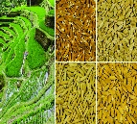
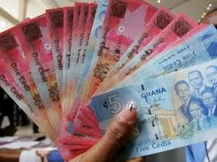
Early Results from investments made in Mali are outlined below…..
180,000 farmers
AGRA aims to reach 720 K HHs directly and a further 700 K HHs indirectly. So far, 100% have been committed and 25% (180K) reached.
3,428 MT of Seed
AGRA aims to produce 32 K MT of seed over the life of strategy. To date, 3,428 MT has been produced and sold to farmers for US$ 3.26M
US$ 5.72 M leveraged
AGRA’s work in connection with the implementation the current consortia project led to mobilization of US$ 5.72M toward the program from the Lux-Development, USAID, SUISSE CONTACT, PACEPEP (Danmark), Lux-Development ICRISAT-HOPE-2, IITA, MCNIGHT Foundation
5 Policies
AGRA has prioritized five policies in Mali which include the Warehouse Receipt System, ECOWAS seed domestication, ECOWAS fertilizer domestication, ECOWAS standards domestication and Mechanization policy. All the five policies are at legislation stage

Slide 39
Emerging Lessons
Lesson | Adaptive Response
Lesson 1: Providing evidence-based information is key in the Government support | Key intervention areas supported by analytical priority studies has created confidence for the engagements / commitment by the government officials, as well as in-country development partners. It has led to the opportunities for leveraging resources and expertise for high impact of agricultural transformation in Mali.
Lesson 2: System Development is the way to impact and sustainability | The rapid acceptance of this new extension approach is mainly due to the engagement of the grantees on the one hand and on the other hand to the interest of the beneficiary farmers. Many farmers well understood the profit from the new technology and decided to implement it in a large scale of their farms. These VBAs played a fruitful role by providing required seeds and fertilizers, training support in linkage with 3,610 Mother and 161,530 Baby Demos implemented. In addition, strengthening capacity of the partners grantees in charge of aggregation, market linkage resulted in a strong network of partnership between SHF organization and off-takers that increases the volume of grain sold;
Lesson 3: Partnership development is a long process but key to increase investment in agricultural sector. | Being an active member of the Agricultural Sector Working Group (ASWG) and the Joint Agricultural Sector Review (JASR) has given AGRA the right visibility and continues to create a platform for meaningful interactions with stakeholders. The continuity of the engagement with World Bank, European Union, USAID, FAO to support AGRA’s efforts in improving the Input Subsidy Program (ISP), seed and extension program.

Slide 40
Emerging Opportunities for Mali
Opportunity | Implication for Mali
The Government willingness to set up the agricultural sector as a high priority despite the security context. For example the planning of the cropping campaign with emphasis on maize production and processing | AGRA will continue to contribute to the capacity building of the Government for better implementation, coordination and accountability according to the weaknesses jointly identified. AGRA will align with the Government decision to produce 11 Millions MT of cereals in 2019-2020 and contribute through the consortia investment.
The Government of Mali has launched a new 6 years’ Inclusive Finance project for private sector co-funded by the Malian Government, IFAD, Canadian and Denmark cooperation. | AGRA will continue to develop and strengthen its efforts in the inclusive finance, market and agro dealership systems development. To create linkage between farmers, aggregators, off-tackers and banks / MFIs - this will be linked to Government initiative for leveraging.
Government has undertaken the harmonization of extension approaches / systems in view to maximize and bring synergies within public and private partners. | AGRA will continue strengthening the VBA’s approach for the promotion of new technologies involving key areas in value chains (seed, fertilizer, market, mechanization, resilience…) and the creation of new employment for youth and women through agro dealership, staple crop market, post harvest handling…In addition, AGRA will continue its broker role to support the Government to mobilize resources
Government commitment to rationalize the 15% budget allocated to agricultural sector by taking into account new emergent value chains | AGRA will pursue the support to the Government by providing needed evidence based data (several studies on value chains, input subsidy, etc.)
World Bank is open to partner with AGRA to support the improvement of Input Subsidy Program and Technologies’ transfer. | Partnerships with World Bank and other partners will accelerate AGRA’s leveraging capacity for better impact in Mali.

Slide 41
The Team

Slide 42
Country organogram and support structure
Regional Head, West Africa
West Africa-based Technical Support
HQ- based Technical Support
HQ Administrative
Country Manager
Head of Input Distribution & Agro-dealer development
PIATA Chief of Party
Head of Grants Management
PIATA Deputy Chief of Party
Chief Finance Officer
Grants Officer-
Associate Program Officer
Program Officer, Soil Fertilizer & Fertilizer Systems,
Head of Country Support
Head of Procurement
Head of Policy and Advocacy
Head of Communications
M & E Officer
Associate Program Officer,
Regional Program Officer, Markets,
Head of Seed Research & Systems Development
Human Resources Director
Finance Administrator:
Program Coordinator
Head of Inclusive Finance
Head of Development Cooperation
Program Officer, Regional Food Trade
Head of Soil Fertility & Fertilizer Systems
General Counsel
Head of Extension & Capacity Building
Program Officer, Partnerships
Head of Gender
Key
Head of Partnerships
Based in country and Hired
Head of M&E and Knowledge Management
Based in Nairobi
Head of Strategy and Analytics
Based in country
Compliance Officer
Shared Resource
Based in Burkina

Slide 43
Annexes

Slide 44
AGRA Institutional Results Framework and theory of change

Slide 45
AGRA Strategy Results Framework
CAADP Framework | Sustainable Development Goals
Goal: Catalyze and Sustain an Inclusive Agricultural Transformation in Africa to increase incomes and improve food security
Objective 1:
Increased staple crop productivity for smallholder farmers
Objective 2:
Strengthened and expanded access to output markets
Objective 3:
Increased capacity of small holder farming households and agricultural systems to better prepare for and adapt to shocks and stresses
Objective 4:
Strengthened continental, regional and government multi-sectoral coordination, and mutual accountability in the agricultural sector
Objectives
Primary Outcomes
Outcome 1: Strengthened agricultural input systems, technology development and supply chain
Outcome 2: Increased adoption of Agriculture productivity enhancing technologies
Outcome 3: Reduced post-harvest losses
Outcome 4:
Increased agricultural employment and entrepreneurship
Outcome 5:
Increased use of structured markets
Outcome 6: Strengthened and expanded business development, financial and risk management services in agriculture value chain
Outcome 7:
Reduced impact of agricultural volatility
Outcome 8: Strengthened national and regional level agriculture sector system functioning
Cross-cutting outcomes
9. Strengthened regional and national agricultural enabling policy environment
10. Increased women empowerment and livelihoods in agriculture
11. Increased youth empowerment and livelihoods in agriculture
12. Strengthened capacity for farmers and other focus agricultural value chain actors
13. Strengthened Public and Private Partnerships in agriculture

Slide 46
Policy and State Capability Theory of Change
Increased incomes and improved food security
AGRA’s Strategic Goals
Increased productivity (more productive small holder farming units and SMEs )
Increased regional trade (intra-Africa trade) in agricultural commodities and inputs
Increased resilience (more adaptive and resilient households to shocks)
Outcomes
The public sector
Increased public sector investments in agriculture
Public sector investments are generating priority and sufficient public goods that de-risk the sector
Appropriate policies providing incentives for private sector investments including public private partnerships in place and operational
Mutual accountability systems and platforms that are aligned to the continental scorecard in place and operational
Non-state actors
Increased private sector investment along the value chain (input production and delivery, farm production, distribution, processing and retail)
Increased private sector participation in cross-border and domestic trade
Non-state actors actively engaged in the accountability processes
Functioning systems
Increased private sector investment along the value chain (input production and delivery, farm production, distribution, processing and retail)
Appropriate regulatory framework for the agricultural sector in place and operational
Reduction and elimination of barriers to domestic and regional trade
Partnerships
Work with partners at all levels to:
Crowd in private capital in support of small-holder agricultural development
Derive synergies and reduce duplication of effort likelihood of transformation within
Derive synergies in order to increase the reach of AGRA’s investments (impact at scale)
So that the target population, institution or resource change
Public Sector / governments have
Sector strategies defining priority areas for investment and policy reform
Mobilized public sector, development partners and non-state actors to invest in /implement priority programs that drive agricultural transformation and facilitate regional trade
Better coordinated sector investment programs
Is championing the necessary policy reforms to drive agricultural transformation and facilitate regional trade
Accountability systems that sustain commitment, encourage results focus and ensure delivery
Investment areas
Develop appropriate sector strategies and investment plans for agricultural transformation
Formulate appropriate policies that catalyze and sustain agricultural transformation and promote regional trade
Implement sector plans and policies in order to generate sufficient public goods that de-risk the sector, attract private capital investment and facilitate regional trade
What AGRA does

Slide 47
Farmer and Systems development Theory of Change
Increased incomes and improved food security
AGRA’s Strategic Goals
Increased productivity (More productive small holder farming units and SMEs)
Increased resilience (more adaptive and resilient households to shocks)
Outcomes
State capacity and policy
Develop state capability to:
Develop appropriate sector strategies and investment plans for agricultural transformation
Formulate appropriate policies that catalyze and sustain agricultural transformation and promote regional trade
Implement sector plans and policies in order to generate sufficient public goods that de-risk the sector, attract private capital investment and facilitate regional trade
Farmers using
Improved production, management technologies and practices
Agricultural credit and financial services
Improved post harvest management technologies and practices
Early warning weather and market intelligence information
Non-state actors
Large, MSMEs producing and delivering inputs, extension, services to farmers in response to demand from farmers
Bank and non-bank institutions providing financial and credit services to MSMEs and farmers
Large, MSMEs providing off-taking, warehousing and processing services
So that the target population, institution or resource change
Farmers and other value chain actors have improved access to
Inputs (fertilizer, seeds); Extension services (knowledge and information); Credit and financial services, stable and remunerative markets, early warning and market intelligence information
Investment areas
Strengthening agricultural input systems, technology development and supply chain
Developing and strengthening extension and advisory services
Developing and strengthening early warning weather and market information systems
Developing and strengthening responsive agricultural finance and credit systems
Developing and strengthening stable reliable and remunerative output markets
Partnerships
Work with partners at all levels to:
Crowd in private capital in support of small-holder agricultural development
Derive synergies and reduce duplication of effort likelihood of transformation within
Derive synergies in order to increase the reach of AGRA’s investments (impact at scale)
What AGRA does

Slide 48
Partnerships development Theory of Change
Increased incomes and improved food security
AGRA’s Strategic Goals
Increased productivity (More productive small holder farming units and SMEs)
Increased resilience (more adaptive and resilient households to shocks)
Outcomes
Partnerships for implementation
Increased reach of AGRA systems grants
Reduced /elimination of duplication of efforts and wastage
Faster progress towards and achievement of intended outcomes and impacts
Increased likelihood of achieving the desired outcomes and impacts
Partnerships for scaling up
Increased public private partnerships
Increased access to technologies knowledge and information
Increased private sector investments at scale
Increased transboundary trade
State capacity and policy
Develop state capability to:
Develop appropriate sector strategies and investment plans for agricultural transformation
Formulate appropriate policies that catalyze and sustain agricultural transformation and promote regional trade
Implement sector plans and policies in order to generate sufficient public goods that de-risk the sector, attract private capital investment and facilitate regional trade
So that the target population, institution or resource change
Partnerships have then following catalytic effect
Systems grants consortia addressing priority bottlenecks in specific geographies
Partnerships for policy advocacy influencing policy formulation and implementation
Development partners investment programs and projects are aligned to derive synergies and avoid duplication
Mutual accountability platforms and processes are defined by partnership objectives
AGRF serving as the premier partnership platform for shaping agricultural development agenda in Africa
Investment areas
Mobilizing inclusive investments in Agriculture
Creating a private-sector led leadership agenda
Build partnerships with leading private sector champions to leverage entire ecosystem and build partnerships around knowledge and intelligence sharing
What AGRA does

Slide 49
Donor Funding of Rural Sector Development in Mali

Slide 50
DONORS’ FUNDING OF RURAL SECTORIAL DEVELOPMENT IN MALI

Slide 51
Mali Cropping Seasons

Slide 52
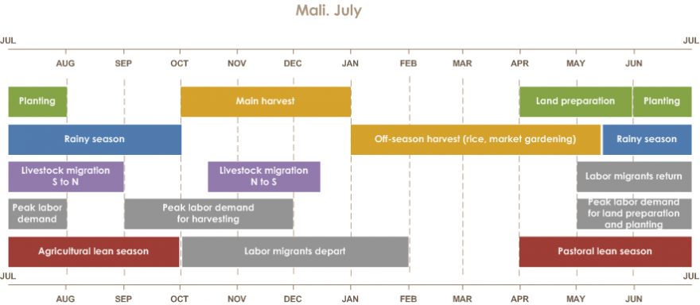
Cropping Seasons

Slide 53
Acronyms

Slide 54
Acronyms
AfDB | African Development Bank
AGRA | Alliance for a Green Revolution in Africa
APCAM | Assemblée Permanente des Chambres d'Agriculture du Mali
ASDP | Agriculture Sector Development Plan
ASWG | Agriculture Sector Working Group
AEZ | Agro-economic zones
CAADP | Comprehensive Africa Agriculture Development Program
CPS/SDR | Cellule de Planification et de Statistiques du Secteur du Développement Rural
CREDD | Cadre Stratégique de Relance Economique et de Développement Durable
CSA | Commissariat a la Sécurité Alimentaire
CSCRP | Cadre stratégique pour la Croissance et la réduction de la pauvreté
DNA | Direction Nationale d’Agriculture (National Department for Agricultural Development)
FAO | Food and Agricultural Organization of the United Nations
FDI | Foreign Direct Investment
GMM | Grands Moulins du Mali
IFAD | International Fund for Agricultural Development
IsDB | Islamic Development Bank
LABOSEM | Laboratoire des Semences
M3 | Moulins Modernes du Mali
MoA | Ministry of Agriculture
NAIP | National Agriculture Investment Plan
NVA | Nouveaux Villages Agricoles
OPAM | Office des Produits Agricoles du Mali
PATAM | Projet d’Appui a la Transformation de l’Agriculture au Mali
PCDA | Programme Compétitivité et Diversification Agricole
PDA | Politique de Developpement Agricole
PNISA | Programme National d’Investissement du Secteur Agricole
PTF | Partenaires Techniques et Financiers
ReSSAKS | Regional Strategic Analysis and Knowledge Support System
SDDR | Schéma Directeur du Développement Rural
UE | Union Europeenne
USAID | United States Agency for International Development
VBA | Village Based Advisor
WADB | West African Development Bank

Slide 55
References

Slide 56
References
AGRA Strategy and Business Plan 2017- 2021
Biennial review Mali Action agenda, 2017
Mali rural Development sectorial review 9th , 2019
Official Development Assistance (ODA) 2014, flows, Other Official Flows (OOFs) and Private Grant/Flows reported by donor countries, multinational organizations and private entities to OECD DAC Directorate for all purposes related to agriculture except forestry and general environment protection extrapolated over 5 years
ReSAKKS, 2014 data extrapolated over 5 years, www.ressaks.org
UN FAOSTAT (with data originating from OECD DAC)
UN World Population Prospects, 2015
World Bank June 2017 (accessed via ReSAKKS) http://worldbank.org

