Slide 1
AGRA Burkina Faso Operational Plan
Revised, June 2019

Slide 2
Table of contents
 | Section | Page Number
1 | Executive Summary | 3
2 | Burkina Faso Agricultural Context | 6
3 | 2017 – 2021 Strategy | 16
4 | AGRA Burkina Faso Strategy | 19
5 | Results Framework and Targets | 27
6 | Portfolio to date, lessons and opportunities | 35
7 | The Team | 46
8 | Annexes | 48

Slide 3
Executive Summary

Slide 4
Executive Summary
Burkina Faso’s economy relies heavily on agriculture with close to 85% of the active labor force employed in the agricultural sector. The country is landlocked with a population of ~19M of which 70% are in the rural areas. Overall GDP growth over the past six years has been at 5.2% and sector growth is estimated at 3.1% pa over the same period. The Government of Burkina Faso (GoBF) is committed to the Agriculture sector and this is reflected in the National Agriculture Investment Plan, phase II (PNSR II). Planned major investments include the creation and operationalization of Bagre, Sourou and Samendani growth poles that are geared towards mobilizing private sector investments and enhancing the competitiveness of the agricultural sector. Key sector challenges include:
High yield gaps (<25% of potential yields) in most staples;
Lack of access to markets and high post-harvest losses in most staples (>25%)
Low use of inputs, e.g. 12% famers use certified seeds; fertilizer use at 14kg/ha vs. the target of 50 kg/ha
Limited lending to the agriculture sector (5% of the total lending)
Limited capacity of resource mobilization and spending; limited capacity of planning and coordination
Huge impact of climate change due to erratic rain patterns in the Sahelian region.
AGRA’s 2017 – 2021 strategy seeks to catalyze and sustain an inclusive agriculture transformation in 11 priority countries including Burkina Faso. AGRA’s Theory of change is that unlocking sustainable transformation will require a combination of {i} Policy and State Capability: working with government to strengthen execution capacity while enhancing the transparency, accountability systems and policy environment for increased public and private sector investment in agriculture; {ii} Systems Development: investments to build downstream delivery systems closer to smallholder farmers while providing support to local private sector to scale technologies and services which deliver better productivity and incomes; and Partnerships: investments to facilitate the alignment between government priorities and private sector interests; improving integration and coordination which lead to investments beneficial to smallholder farmers

Slide 5
Executive Summary
AGRA will therefore focus on:
Implementation of the PNSR-II and the ongoing decentralized planning process for this National Agricultural Investment Plan (NAIP), particularly strengthening capabilities to attract foreign direct investment and enhance accountability systems. Medium and long-term country support interventions may include support to the government to roll out an e-extension program, develop a national resilience plan, reform the existing input subsidy program,
Enhance off-taker partnerships between processors, traders and producers that lead to assured markets and sustained adoption of inputs along the cotton belt
Improve seed system and fertilizer supply chains that enable farmers to have access to affordable and quality input as well as extension services in a timely manner in Centre-Est and Centre-Ouest
By executing this strategy, AGRA expects to improve the food security and increase incomes for at least (1.3M¹) smallholder households over the next 5 years, while indirectly impacting another 0.9M farmers. targeting four key crops: cowpea, maize, rice and sorghum in five different regions namely: Haut Bassins, Boucle de Mouhoun, Cascades, Centre-Est and Centre-Ouest. Implementation of this strategy begun in Q4 of 2017 and to date AGRA has invested ~$ 17M in the different bodies of work:
In policy and state capability, $3,4 M to strengthen the delivery capabilities of the Ministry of Agriculture in planning coordination, execution and strong M&E system for evidence based decision making;
In farmer and systems development ~ US$ 14M to set up 6 consortia in all the target areas and crops to drive integrated delivery
In the Partnerships body of work, AGRA is leveraging on GiZ projects CARI (Competitive African Rice Initiative), PROCIV (Green Innovation Center Project) and ABC Fund ( Agribusiness Capital Fund) to unlock bottlenecks in systems development. AGRA’s private sector partners included seed companies, fertilizer producers and importers, processors and equipment manufacturers
The strategy is well aligned with the government’s priorities and contributes to the need for a strong sector with effective coordination and implementation capabilities, and strengthening delivery systems for improved productivity and marketing to drive equitable access to inputs, finance, agriculture education and resilience. Finally, The strategy emphasizes gender inclusive transformation development.
Ongoing discussions on target revisions based on:
Current grant commitments
Assumes no further investments in BF
The 3 zones being targeted are already over saturated and any further numbers would have to be from different regions

Slide 6
Burkina Faso Agricultural Context

Slide 7
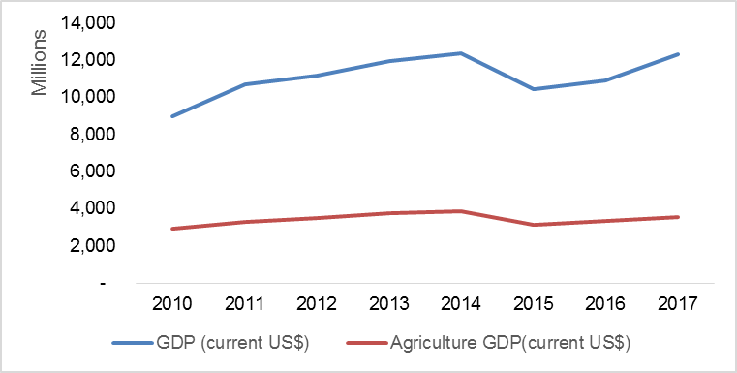
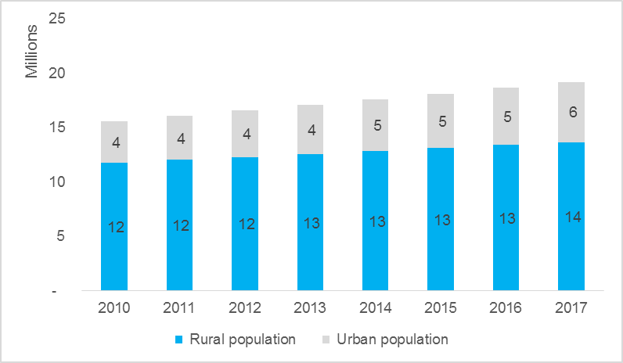
Burkina Faso’s Agriculture sector has experienced slow growth over the past five years
1. Agriculture and the Economy
GDP Growth vs. Ag. GDP contribution
Burkina Faso’s GDP per capita, USD 640 is way below Sub-Saharan Africa’s (SSA) average with poverty headcount averaging ~44% in the last 5 years¹;
Agriculture contributed 32% to GDP during the period 2005-2015.
The total population is 19M with a male to female ratio of 48%:52% and 70% of the population resides in the rural, Annual population growth rate is ~ 3% p.a.
Burkina Faso’s main exports are gold (70% of total exports) and cotton (13%) while the country has a huge import bill arising from fuel and drought prone climate which leads to huge commodity price fluctuations and subsequently a negative balance of trade.
Burkina Faso has a large area of arable land, estimated at 9M HA of which only 46% is currently being used.
Similarly, irrigable land is estimated at 233,500 hectares, but only ~ 13 is being used.
From 2003 to 2013, crop production slightly exceeded national food requirements, except in 2007/08 and 2011/12. In 2012/13, total crop production was about 4.2 million MT, which is approximately 666,000 MT (19%) above the food requirements of the country.
Urban vs. Rural Population
Rural Vs. Urban Population

Slide 8
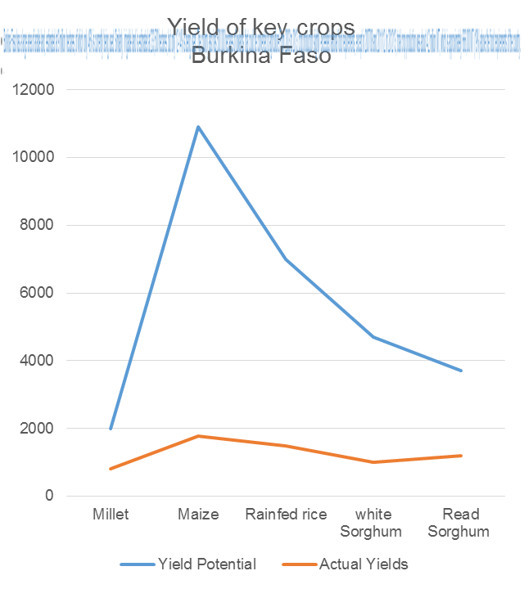
The Burkina Faso government has recommitted to Agriculture sector development through various initiatives
2. Government Priorities
3. Profile of a Smallholder Farmer
The rural investment plan (PNSR II) has been developed and is linked to the rural development strategy, SDR (Strategie de Developpement Rural 2016-2025) that includes an agriculture strategy. This strategy aims to improve sustainable food security through increased agricultural, pastoral, fisheries, forestry and wildlife production; based on improved productivity, increased incomes due to greater integration to market and diversification of activities in rural areas. PNSR II has four main components that include;
Improvement of food security and sovereignty
Sustainable development of rural resources
Improvement of access to drinking water and living environment
Establishment of partnerships between stakeholders
On average, a farmer in Burkina Faso has to travel 21 km to access an agro-dealer;
The extension agent to farmer ratio is 1:3,500
Fertilizer use stands at 14kg/ha which is way below the 50kg/ha recommendation
Only 12% use certified seed
Major staple food crops, including maize, rice, sorghum, and millet. None of these crops attain the optimal yield as shown below.

Slide 9
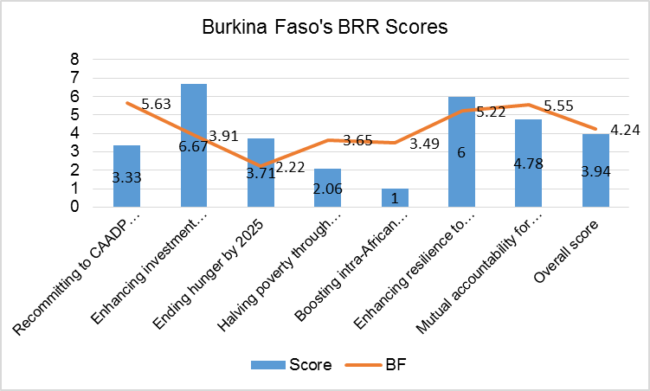
CAADP biennial review shows that the country is on-track and should emphasize ending hunger and boosting trade
2. Government Priorities from BRR Review
The AU through the CAADP process using the Biennial Review Rating (BRR) is tracking each countries’ progress towards the 7 (seven) commitments. The first review conducted in 2017 and launched in 2018 rated Burkina Faso at 4.24 against a benchmark of 3.9 in 2017 - the average rating a country should score to show positive progress towards achievement of its 2025 targets. This rating means that Burkina Faso’s performance is above target on more than 50% of the indicators and it is hoped this performance will be sustained or surpassed during the next review scheduled for 2020⁹.
The overall recommendations for Burkina Faso coming out of the Biennial review process in 2018 include:
Increase the area under sustainable land management practice to strengthen resilience to climate related risks;
Increase and sustain its funding allocation to agricultural research and development as one of the strategies to enhance productivity, and allocate budget to fully response to spending needs on social protection for vulnerable social groups; and
Put in place policies that would facilitate and promote intra-regional African trade in agricultural commodities and services.
Source: Biennial review Burkina Faso Action agenda

Slide 10
There is room to develop a more vibrant private sector if policy and other incentives are put in place
3. The Private Sector Landscape and enabling environment
Foreign Direct Investment (FDI) to Burkina Faso has averaged US$ 486 M the last five years of which 10% goes to the ag sector while cross border trade averaged ~ US$ 221 M pa¹²
Since 2000 economic growth increased by an average of about 5.2% pa largely because of policy reforms that favor entrepreneurship, as well as growth of the mining industry and improvements in the agriculture sector
Burkina Faso ranks 151 in the World Bank’s Doing Business Index while Sub Sahara’s Africa’s average is 79 making the business environment quite unfriendly.
2013
2014
2015
2016
2017
11. FAO Private sector agribusiness investment in sub-Saharan Africa (2011) 12. www.reSSakS.org 13 World Bank Doing Business (2019)

Slide 11
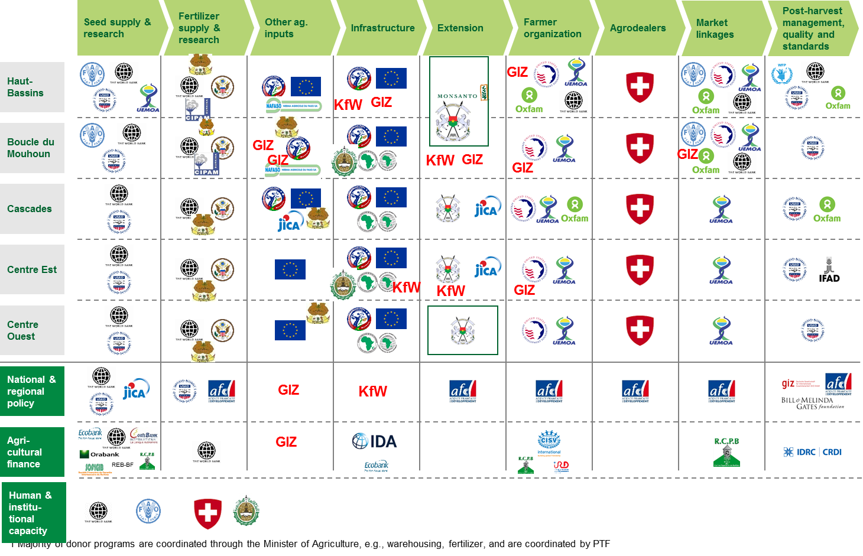
A number of major donors and private sector companies are focused on the Western and Centre East regions

Slide 12
In addition to Macro-economic analysis, AGRA also carried out analysis of specific systems to inform the strategy
Seed systems
Breeding and variety release | EGS supply | Certified seed production | Awareness by farmers | Marketing and distribution | Regulation
Shortage of breeders Insufficient infrastructure and irregular funds for variety development Number of varieties of various crops including those supported by AGRA developed but pending release Long variety release process | Research institutions retain the monopoly of EGS production and sale. In very few cases research institutions can contract a seed company to produce under their supervision. Hybrid parental lines are exclusively produced by research institute Challenges in sourcing for foundation seeds from neighboring countries despite ECOWAS harmonized rules | 15 active seed companies (ANES-BF members) & numerous seed producers (members of UNPS) are involved in certified seed production of key food crops: maize, rice, sorghum & cowpea. Only 4 are involved in hybrid seed production. Only one hybrid maize variety is under production. Seed production shows an increasing trend since 2016. Cereal certified seed sector is dominated by OPV despite availability of hybrid varieties. | Low levels of awareness leading to low seed demand including hybrids Some progress are being observed with the consortium approach | Poor access to improved seed by smallholder farmers Government is the major seed buyer for distribution under subsidy program. Very few seed companies offer direct sales to farmers / low volumes of seeds are sold directly to farmers. Large volume of carry-overs experienced if no demand is received from Government | Seeds sector regulatory frameworks well structured but still have some ‘’antiquated’’ provisions. Inadequate capacity to implement the regulatory systems. 4 seed labs available (1 central and 3 regional) Informal seed system without quality assurance dominant leading to poor seeds being sold at lower price thus reducing the demand for certified seed
Insufficient/lack of financial support from the govt Policies which do not facilitate release/licensing of publicly bred varieties by private seed companies | EGS Supply is still a challenge, particularly for maize hybrid parental lines due to lack of private stand-alone Foundation Seed Production company, lack of capacity (technical, operational and infrastructure) in most seed companies to produce foundation seed and inability to pay royalties. | Parental lines of outstanding public hybrids not available to seed companies and no provision in seed law to solve the issue Weak/absent internal seed quality control system | Insufficient investment of private sector in promotional activities of improved varieties Weak public-private sector interface for maintaining and rolling out new varieties. Weak public extension services | Very weak or absence of marketing strategies in seed companies Under-developed agro-dealer network: (insufficient number and capacity) Inconsistent production of new popular crop varieties Weak linkage between agro-dealers, seed companies and extension agents. | Insufficient number of seed inspectors and lack of resources Lack of review of seed law and policy reforms No strong system in place to reduce % of adulterated seeds in the market No legal provisions in place for introducing quality assurance to the dominant informal seeds. Policies restrict private companies to produce EGS of public varieties
Status
Gaps

Slide 13
Systems analysis (2 of 5)
Soil health and fertilizer systems
Soil Mapping and Testing | Product development | Fertilizer blends production | Awareness by farmers | Commercialization and distribution | Regulation
The National Soil Institute (BUNASOLS) has soil morphology and classification for 5 regions OCP mobile laboratory in partnership with BUNASOLS began operation in May 2018, 1300 soil samples to be taken in 4 regions Mapping under AfSIS planned in 2019 with the support of the Islamic Development Bank. | Fertilizer blend available, containing S and B and another one from Yara containing Mg and Zn Cotton and Vegetables blends from the fertilizer blending company (Compagnie Industrielle de Production Agricole et Marchande ,CIPAM) | 2 blending companies; country capacity about 300,000 Mt (with CIPAM and IFCA) | Low level of awareness and low rate of fertilizer use in general Extension system based on public extension agent with a ratio of 15,000 3,500 farmers to 1 agent. | Supply chain developed through Agro-dealers network 2 main agro-dealers association with about 2,500 members Hub-dealers being strengthened in regions (from AFAP and AGRA grants) | Since 2017, fertilizer quality control regulations passed into law. These regulations are in compliance with the fertilizer quality control regulations of ECOWAS. The National Committee for Fertilizer Control (CONACE) set up
Soil mapping and analysis Limited capacity of the Soil Institute (BUNASOL) | Some best-bet trials Stakeholders (blenders and researchers) capacity in balanced crop nutrition and requirement for blending. | Low demand of the blends Limited technical capacity of blenders and researchers | Scaling existing fertilizers blends through demonstrations Inefficient extension system | Lack of working capital Dependent on wholesaler Lack of management and technical competence In some regions agro-dealers are almost non-existent | Limited number of fertilizer inspectors (only 50 trained) Limited capacity in terms of resources for the regulation implementation
Status
Gaps

Slide 14
Systems analysis (3 of 5)
Extension
Agro-dealer networks
Current state of play | Burkina Faso Government does not have enough Extension Agents to teach farmers Extension Agent/Farmer ratio > 1:3,500 Extension Agents do not have sufficient resources to visit and train farmers. Private sector Extension poorly developed
Opportunities | Reduce Extension worker: farmer ratio by creating self-employment opportunities for Extension workers (Village-based Advisors (VBAs)) including women and youth to rapidly create demand for yield-enhancing inputs whilst teaching farmers good agricultural practices Seed and fertilizer companies supply inputs to VBAs for demonstration and sale to farmers at the Village level Enhance Extension Service delivery policies at national and regional levels Catalyse Systemic Change to improve delivery of Extension Services in Burkina Faso
Enablers | Partner with Government to revise policy to include private extension, and to involve in selection, training and certification of VBAs Partner with Seed and Fertilizer Companies provide seed and fertilizer for demonstrations Partner with Agro-dealers and Offtakers to endure linkage with VBAs
Current state of play | Whereas the national average number of farmers per agro input dealer is about 4,762, there are approximately 600 farmers to an agro dealer in the geographical areas that consortia are implementing AGRA-funded projects. These “project farmers” cover 13 km (average) , which is about 8 km less than other farmers, to access an agro dealer’s products and services.
Opportunities | There is tremendous interest to catalyze uptake of improved crop production technologies. There is an opportunity to increase number of agro dealers by about 800 so as to reduce the distance to less than 10 km in “project areas”. VBAs can graduate to become Agro-dealers or agents of Agro-dealers to enhance farmers’ last mile access to inputs There is an investment opportunity to support interested agro dealers to pre-finance smallholder farmers and, aggregate their produce at harvest for onward sale to downstream value chain actors
Enablers | Partner governments and other development organizations to facilitate identification and development of agro dealers to reduce distances covered by farmers outside the project areas Partner with governments and other development organizations to build the capacity of VBAs to become Agrodealers or Agents of Agro-dealers Enhance the use of mobile money and digital procurement platforms in agro input distribution to facilitate easy access by retail agro dealers and, consequently smallholder farmers Work with Government to enact laws to effectively regulate the industry

Slide 15
Systems analysis (4 of 5)
Output Markets
Access to Finance
Current state of play | • Commodity trade flow patterns and price co-movements indicate that local markets are well integrated. Prices for locally produced staple foods are highly seasonal across Burkina Faso, driven in part by producer marketing behavior (selling stocks to pay household expenses) & post-harvest handling and storage practices. Imported rice prices are far more stable across time and space. Transactions are mostly cash based, even though banks, mobile money operators, and microfinance institutions exist.
Opportunities | The Government has prioritized the improvement and dissemination of ICT services in the country. Leverage already wide mobile coverage to improve extension of services to farmers.
Enablers | Improved road infrastructure would reduce the high transport costs & long travel times to markets, particularly in the eastern Region. A policy that addresses fees levied on sellers at local markets would unlock commodity trade at the commune level.
Key partners | Within existing consortia Other – USAID RISE II, WAAP
Current state of play | 4% lending to agriculture sector in 2018 Interest rates: 8%-18% Financial products available : Input and equipment finance, Working capital loan, Warrantage, Savings products
Opportunities | Creation of the Agricultural development Bank of Burkina Development and promotion of a national agricultural insurance program by the ministry of agric and MAMDA (marocain insurance company) Opportunities to leverage on others donors(AFD, KfW, WB and Enabel) funds interest to improve SMEs access to finance with WHR project Scaling risk sharing facilities to access input and equipment Opportunities to work with government on involving the banks and private sectors in the input subsidy program
Enablers | Development and adoption of the rural investment code Development of a national strategy on warrantage activities Progress on mobile money transfer
Key partners | Banks: BADF, CORIS BANK, RCPB, BOA Insurance companies: Yelen assurance, Planet Guarantee Investment fund: ABC, PACTE Guarantee fund: SOFIGIB, PCESA, DCA

Slide 16
2017 – 2021 Strategy

Slide 17
AGRA’s Vision and Headline goals 2017 - 2021
AGRA’s vision
To catalyze and sustain inclusive agriculture transformation in Africa by increasing incomes and improving food security for 30 million smallholder households in Africa and to support countries on a pathway to attain and sustain an agriculture transformation.
AGRA’s headline goals
Increase the incomes and improve food security for 9 million farm households through the direct result of activities of AGRA, grantees, and partners to increase productivity and access to markets and finance
Contribute to increasing the incomes and improving food security of another 21 million farm households through support to strengthening capacities of governments and private sector and through the contributions of AGRA, grantees, and partners to policies, programs, and partnerships that increase productivity and access to markets and finance
Support 11 focus countries on a pathway to attain and sustain an agricultural transformation

Slide 18
AGRA’s global 2017 – 2021 Strategy
Results Framework: AGRA is executing a 5 years strategy to catalyze agriculture transformation to increase incomes and improve food security…
…through three main bodies of work
Headlines goals and objectives
Increase the incomes and food security for 9M households reached directly and for 21M reached indirectly through AGRA activities; support 11 countries on a path to sustained agriculture transformation
Policy and State Capability | Working with government to strengthen execution capacity while enhancing accountability systems and enabling environment for increased public and private sector investment
Systems Development | Building downstream delivery systems for smallholder farmers while providing support to local private sector to scale technologies and services to farmers
Partnerships | Facilitating linkages between private sector and smallholder farmers resulting in increased incomes and sustainable sector investments
Increased staple crop productivity
Expanded access to markets
Increased resilience (capacity to respond to shocks and stresses)
Improved govt coordination and mutual accountability
Outcomes
Improved Input Markets
Increased tech adoption
Reduced Post Harvest losses
Increased Employment
Increase Market access
Increase access to Finance + BDS
Reduced Volatility
Improve Institutional capacity
Cross Cutting Outcomes
Enabling policy environment
Gender and Youth empowerment
Capacity development (SME’s ,SHF’s, Govt’s)
Strengthened public private partnerships
*Source: AGRA Strategy and Business Plan 2017- 2021

Slide 19
AGRA Burkina Faso Strategy

Slide 20
AGRA’s Strategy for Burkina Faso
AGRA’s 2017 – 2021 strategy seeks to catalyze and sustain an inclusive agriculture transformation in 11 priority countries including Burkina Faso. Our theory of change is that unlocking sustainable transformation will required a combination of {i} Policy and State Capability: working with government to strengthen execution capacity {ii} Systems Development: investments to build downstream delivery systems closer to smallholder farmers and Partnerships: investments to facilitate the alignment between government priorities and private sector interests.
Policy and State Capability
Systems Development
Partnerships
AGRA’s plans in Burkina Faso on the component include:
Supporting conducive policy development for the sector (work on inputs policies, markets, etc.)
Institutional capacity support to enhance delivery and coordination in the sector
The interventions planned to drive key system level change in Burkina Faso include:
Maize and cowpea value chain upgrading
Improving Fertilizer systems
Strengthen extension services
Increase financial inclusion
Partnership development plans for Burkina Faso include:
Leveraging synergies with the German cooperation (GIZ, KfW) on our joint projects
Engaging with private corporates (Seedco, Olam) on supply chain, input distribution
Cooperation with IFAD on the ABC fund (portfolio pipeline development)

Slide 21
AGRA’s Approach in Burkina Faso is aligned to the National Agriculture Strategy
AGRA’s strategy in Burkina Faso is built on past successes and learnings in Burkina Faso where AGRA invested US$ 21.5M in Input and Output Markets Systems Development, Innovative Finance, Research, Capacity Building and Policy & Advocacy. The current strategy has renewed emphasis on policy and state capability with additional investments in enhancing systems and farmer level development. Burkina Faso and AGRA’s vision for Agriculture are in alignment in addition to AGRA’s overall strategy to work more closely with governments
Burkina Faso’s Vision for Agriculture Development
The Government of Burkina Faso want to transform his agriculture "By 2025, make it modern, competitive, sustainable and the engine of economic growth, based on family farms and efficient agricultural enterprises and ensuring all Burkinabe access to the necessary food for a healthy and active life ".
AGRA’s goals Burkina Faso
AGRA’s objective in Burkina Faso is to increase incomes, improve food security and reduce shocks and stresses for at least 1.3M smallholder households directly and 0.9M indirectly in four value chains namely cowpeas, maize, rice and sorghum
AGRA Burkina Faso focus areas:
Seeds / input systems
Fertilizer /soil systems
Extension services
Market systems
Inclusive finance
Delivery Areas of work:
Policy and State Capability
Partnerships
Systems Development.
Burkina Faso Government Vison and AGRA Goal Alignment
Burkina Faso/AGRA Collaboration
Burkina Faso Agriculture Transformation
Improved Livelihoods for SHF’s

Slide 22
Burkina Faso Theory of Change
AGRA’s Strategic Country Goals
Country Goal: Increased resilience, productivity, incomes and food security
Cross Cutting areas
Outcomes
Farmers using
Improved production, management technologies and practices
Agricultural credit and financial services
Improved post harvest management technologies and practices
Early warning weather and market intelligence information
Other value chain actors
SMEs becoming more efficient in producing and delivering inputs, extension, services to farmers
Bank and non-bank institutions providing financial services to MSMEs and farmers
Large, MSMEs providing off-taking, warehousing and processing services
Better coordination of business among value chain actors.
State capacity and policy
Develop state capability to:
Support the institutional transition to the result based programming and budgeting while enhancing the M&E, accountability and coordination mechanisms
Formulate appropriate policies that catalyze and sustain agricultural transformation and promote business and trade
Implement sector plans and policies in order to generate sufficient public goods that de-risk the sector, attract private capital investment and facilitate regional trade
So that the target population, institution or resource change
Farmers and other value chain actors have improved access to
Inputs (fertilizer, seeds); Extension services (knowledge and information); Credit and financial services, stable and remunerative markets, early warning and market intelligence information
Partnerships
Work with partners at all levels to:
Crowd in private and public investment to develop a 50,000 ha rice flagship program
Derive synergies to reduce duplication of effort
increase the reach of AGRA’s investments (impact at scale)
What AGRA does
Country Investment areas
Developing and strengthening input systems (seed and fertilizer)
Developing and strengthening extension and advisory services (VBAs, E-extension…)
Developing and strengthening responsive agricultural finance and credit systems based on risk sharing mechanism between value chain actors
Developing and strengthening stable reliable and remunerative output markets
Building the capacity of various value chain actors, farmer level, private and public sector

Slide 23
AGRA’s Strategy continues to build off of past work done in Burkina Faso to drive for scale and sustainability
In the first ten years (2006 – 2016), AGRA’s work in Burkina Faso was in the following programs: Seed systems, Soil Health, Policy, Market access and inclusive finance. Through these investments, AGRA made progress that we continue to build off of in the new strategy:
11 PhDs and 27 MScs trained
05 seed companies supported who increased their certified seed production from less than 100Mt to over 7,000 Mt annually.
Supported the development and release of 17 varieties out of which 06 were commercialized.
AGRA supported 1,379 agro-dealers and seeking to reduce distance from 21km currently to 10km
AGRA trained thousands of farmers on ISFM (413,587 farmers), quality storage and structured trade (over 19,258 farmers) as well as farmer organizations on governance, group dynamics and leadership
Strong partnerships with financial services providers supported and innovative value chains financing models with promising results introduced
Contributed to the development of the regulation text on the control of fertilizers. As a result all institutional orders are sampled and checked on delivery.

Slide 24
Burkina Faso has also mapped the main partners in the country and their current / Potential relationship with AGRA
Burkina Implementing Partners (May, 2019)
Intervention Area | Organization Name | Type of Institution | Current Engagement | Operational level | Location
Markets - Extension | Groupe de Recherche et d’Actions pour le Développement (GRAD) | Private partner | Lead grantee | Regional | Ouagadougou
Market supply chain coordination- Inclusive finance | SICAREX | Private partner | Lead grantee | National | Ouagadougou
Seed Production - Breeder | Institut de l'Environnement et de Recherches Agricoles (INERA) | Public partner | Grantee | National | Ouagadougou
Extension | L’Union Nationale des Producteurs de Riz du Burkina Faso | Private partner/FO | Sub-Grantee | National | Ouagadougou
Mechanization | Association Centre Ecologique Albert Schweitzer du Burkina Faso | Private partner | Sub-Grantee | National | Ouagadougou
Markets extension | Union des Groupement pour la Commercialisation des produits Agricoles de la Boucle du Mouhoun | Private partner/FO | Grantee | National | Dedougou
Extension | Direction Regionale de l’Agriculture et des Amenagements du Centre Ouest | Public partner | Sub-Grantee | Local | Dedougou
Extension | Direction Regionale de l’Agriculture et des Amenagements Hydrauliques de Boucle du Mouhoun (DRAAH-BM) | Public partner | Sub-Grantee | Local | Koudougou
Extension, input quality control | Direction Génerale des Production Végétales | Public partner | Grantee | National | Ouagadougou
Seed company | Neema Agricole Du Faso | Private partner | Sub-Grantee | Regional | Bobo Dioulasso
Seed company | Faso Agriculture et Intrants | Private partner | Sub-Grantee | National | Ouagadougou
Markets- Inclusive finance | Agence pour la Promotion de la Petite et moyenne entreprise. Agriculture et Artisanat | Private partner | Lead grantee | National | Ouagadougou
Agrodealer, Fertilizer | Association Des Grossisteset Detaillants D'intrants Agricoles | Private partner | Sub-Grantee | National | Ouagadougou
Seed company | AGRI PROMO SARL | Private | Sub-Grantee | National | Ouagadougou
Extension, markets- Inclusive Finance | Union Provinciales des Professionnelles Agricoles du Houet | Private partner / FO | Grantee | Local | Bobo Dioulasso
Extension Services - Resilience | Association Burkinabé d’Action Communautaire | Private partner | Grantee | National | Ouagadougou
Market Access, Inclusive finance Resilience | Rikolto International | Private partner | Lead grantee | International | Ouagadougou
Market Access, Extension | Trias | Private partner | Grantee | International | Ouagadougou
Country Support | Ministry of Agriculture, Water & Fisheries Resources | Public partner | Grantee | National | Ouagadougou

Slide 25
Transformation at the farmer and system level can be driven by focusing on selected value chains in 5 regions
To prioritize interventions, regions were assessed based on:
Possible impact
Ease of delivery
Centre-Est
376,000 farmers focusing on rice, cowpea, and sorghum of which 50% is targeted and 62% to be impacted.
Largest rice producer, with access to the best organized irrigation scheme (Bagre)
3% of production is marketable surplus to be sold locally and in neighboring countries marketed
Inconsistent/unpredictable weather patterns and poor soils
Limited connectivity between private sector and SHFs to develop farmer groups
Poor input system
Crop
Acreage, ha
Farmers
Maize
1,098,000
578,000
Rice
63,500
127,000
Sorghum
607,000
337,000
Cowpea
189,600
316,000
Cash crop belt
Centre-Ouest
1.9M farmers across 3 regions: Boucle du Mouhoun (750K), Hauts-Bassins (890K), and Cascades (319K) of which 50% is targeted and 62% to be impacted.
Breadbasket for the country, with focus on rice, maize, cowpea, and sorghum
Accounts for 68% of the country’s maize production
Rice producer with one of the biggest dam/irrigation schemes in Sourou
Widespread cotton growth in Boucle du Mouhoun and Hauts-Bassins – resulted in improved cropping practices, increased use of quality inputs (seeds and fertilizer), and the highest presence of agro-dealers
Some sugar-driven growth in Cascades
Poor road infrastructure
Marketable surplus of more than 90% above regional consumption
388,000 farmers, focusing on cowpea and sorghum of which 50% is targeted and 62% to be impacted.
Use only 5% country’s improved seed volume (inputs)
Marketable surplus of more than 75% above regional consumption due to low demand in-region
Unpredictable rains and high incidence of pest
Lowest productivity and limited access to improved inputs

Slide 26
Working with public and private entities, AGRA aims to influence funding to the most impactful projects
AGRA recognizes the existence of other donors in Burkina Faso focusing on the same value chains in the same areas and will complement and leverage the work of other funders to trigger a transformation.
Proposed expenditure and investments¹
AGRA’s strategic vision in Burkina Faso can only be achieved through strong partnerships with other players in Burkina Faso
AGRA will prioritize interventions that catalyze and complement funding committed by the Government and donors
As such, AGRA is committed to:
Alignment with Government priorities and programs
Boosting government capacity for strategic planning and implementation
Participating in and supporting government coordinating mechanisms
Committing resource to catalytic system development that allow for scale known models and technologies
Donors⁴
~$2,527 million
Government of Burkina Faso³
~$1,105 million
Private sector investment⁵
(To be determined)
AGRA²
$34 million
1: Figure not drawn to scale
2: Proposed country investments for country strategy 2017 - 2021
3: FAOSTAT 2014 data flat-lined for 5 years
4: Official Development Assistance (ODA) flows, Other Official Flows (OOFs) and Private Grant/Flows reported by donor countries, multinational organizations and private entities to OECD DAC Directorate for all purposes related to agriculture except forestry and general environment protection
5: Exact estimates for private sector investment are unknown and therefore conceptual
SOURCE: FAOSTAT; ReSAKKS; AGRA analysis

Slide 27
Results Framework and Targets

Slide 28
Burkina Faso Country Results Framework
Expected outcomes | Country Result area | Key interventions
Outcome 1: Strengthened national level agricultural sector system and Strengthened agricultural enabling policy environment | Evidence based planning and accountability mechanisms strengthened | Support formulation of appropriate policies that catalyze and sustain agricultural transformation (input subsidy program, inputs and market regulations etc.)
 |  | Support government to strengthen execution capacity while enhancing the transparency, accountability systems and policy environment for increased public and private sector investment in agriculture
 |  | Support strengthening Government M&E systems and functioning of the coordination mechanism through support to SP/CPSA.
 |  | Second Technical Experts to Ministry of Agriculture
Outcome 2: Strengthened agricultural input systems, technology development and supply chain | Increased availability and use of seeds and fertilizer for small holder farmers | Support the production of early generation seed, and scale up seed production.
 |  | Support and strengthen seed certification and fertilizer quality control system
 |  | Support formulation and production of crop and soil specific fertilizer blends
 |  | Conduct extension and capacity building activities to increase the use of seeds of improved and climate smart varieties, adapted fertilizer blends, water and soils conservation technics by farmers.
 |  | Strengthen agro-dealership to bring agri-inputs close to farmers.
Outcome 3: Increased use of structured markets | Increased quality of produce by small holder farmers | Support farm level aggregation centers with warehouses Develop youth-led PH processing interventions to provide services to SH Facilitate access to PHH training, basic commodity handling equipment, enhanced management and linkages to output off-takers and input dealers
 |  | Build capacity of farmers on grain standards and post-harvest loss reduction
 | Increased capacity of SMEs and FOs to participate in structured markets | Develop integrated value chain system; including forward contracting, pricing, quantity projections, transportation
Outcome 4: Strengthened and expanded business development, financial and risk management services in agriculture value chain | Increased supply and demand of sustainable financial services | Developing and strengthening responsive agricultural finance and credit systems based on risk sharing mechanisms.
Outcome 5: Strengthened Public and Private Partnerships in agriculture | Increased public private partnerships and investments in agriculture from private sector | Build partnerships with leading private sector champions to leverage entire ecosystem and build partnerships around knowledge and intelligence sharing
 |  | Mobilizing inclusive investments in Agriculture to develop a rice flagship program.

Slide 29
Key Country Indicators and Targets
AGRA is tracking 73 indicators across its strategy and at country level, but a version of the following dashboard will be tracked for ongoing management and summary reports:
Indicator | Baseline | Year 1: 2017 | Year 2: 2018 | Year 3: 2019 | Year 4: 2020 | Year 5: 2021 | Cumulative: 2017-2021
G1. Agriculture GDP growth (increase) | 5.30% | _ | _ | _ | _ | _ | _
G2. Average number of months of inadequate household food provision (decrease) | 4 | _ | _ | 4 | _ | 2 | 2
G3. Improved food security: Household dietary diversity index (increase) | 4 | _ | _ | 5 | _ | 6 | 6
G4.Percent of population living on less than $1.90/day. (decrease) | 39.00% | _ | _ | _ | _ | _ | -
G5. Percent of population living below the national poverty line (decrease) | 40.10% | _ | _ | _ | _ | _ | _
1. Average yield (MT/ha) of focus crops (increase) | Maize 2.2 | 2.2 | 2.5 | 3 | 4 | 5 | 5
 | Rice 1.9 | 1.9 | 2.5 | 2.7 | 3.3 | 3.8 | 3.8
 | Sorghum 1.1 | 1.1 | 1.2 | 1.4 | 1..6 | 1.8 | 1.8
 | Cowpea | 1 | 1.1 | 1.3 | 1.5 | 1.5 | 1.5
2. Percent change in yield gap of focus crops (decrease) | Maize | 70% | 60% | 50% | 40% | 30% | 30%
 | Rice | 17% | 15% | 12% | 9% | 6% | 6%
 | Sorghum | 55% | 45% | 35% | 30% | 25% | 25%
 | Cowpea | 83% | 77% | 70% | 68% | 66% | 66%
5. Hectares of land under stress tolerant varieties |  | 361 | 5,411 | 9,018 | 3,247 | 3,247 | 21,283
6. Amount of funds mobilized for the agricultural sector through improved coordination efforts | 0 | 0 | 200,000 | 800,000 | 2,000,000 | 4,000,000 | 7,000,000
8. Number of crop varieties and other technologies commercialized with AGRA support | Crop varieties | 0 | 2 | 2 | 3 | 3 | 10
 | Fertilizer | 0 | 0 | 2 | 0 | 0 | 2
 | Other technologies | 0 | 2 | 1 | 0 | 0 | 3
9. Quantity (MT) of improved seeds of focus crops produced by enterprises supported by AGRA | Total | 0 | 7,800 | 5,000 | 7,500 | 1,500 | 21,800
10. Quantity (MT) of seeds sold as a result of AGRA support | Total | 0 | 6,240 | 4,000 | 6,000 | 1,200 | 17,440
OI.3- Value (USD) of seeds sold as a result of AGRA support |  | 0 | 7,075,040 | 8,006,689 | 10,826,463 | 3,624,821 | 29,533,013
11. Number of national soil science labs supported for optimal operations in fertilizer and soil health analysis | 0 | 0 | 0 | 1 | 0 | 0 | 1
12. Number of fertilizer blends developed as a result of AGRA support | 0 | 0 | 0 | 2 | 0 | 0 | 2
OI.4- Amount (MT) of fertilizer sold by enterprises supported by AGRA |  |  | 10,000 | 15,000 | 20,000 | 0 | 45,000
OI.5- Value (USD) of fertilizer sold by enterprises supported by AGRA |  |  | 2,678,571 | 4,017,857 | 5,357,143 | 0 | 12,053,571
13. Number of enterprises along focus input development and supply value chains operating optimally |  |  |  | 14 |  | 35 | 35
OI. BF 02-Number of agrodealers-linked to input providers through contract |  | 120 | 90 | 50 | 0 | 260 | 120
OI.BF 03-Number of farmers linked to agrodealers and accessing inputs |  | 20,000 | 50,000 | 30,000 | 0 | 100,000 | 20,000

Slide 30
Key Country Indicators and Targets
Indicator | Baseline | Year 1: 2017 | Year 2: 2018 | Year 3: 2019 | Year 4: 2020 | Year 5: 2021 | Cumulative: 2017-2021
14. Rate of application (adoption) of target improved productivity technologies or management practices at farmer level | 21% | _ | _ | 40% | _ | 67% | 67%
15. Average distance (km) from farmers to agro dealers | 18 | - | - | 14 | - | 10 | 10
16. Percent of farmers accessing Agricultural Advisory extension support services | 18% | 18% | 28% | 50% | 65% | 75% | 75%
17. Number of extension service events completed | Demo plots | 177 | 1,200 | 1,500 | 500 | 0 | 3,377
 | Inputs fairs | 0 | 1 | 1 | 1 | 0 | 3
 | Field days | 500 | 600 | 800 | 450 | 0 | 1,900
 | Radio programs | 15 | 18 | 50 | 80 | 8 | 171
 | Tv programs | 20 | 1 | 1 | 0 | 0 | 22
 | Mini-packs distributed | 0 | 133,000 | 420,000 | 247,000 | 0 | 800,000
18. Number of farmers and other value chain actors participating in AGRA supported extension services | TOTAL | 10,000 | 123,000 | 420,000 | 247,000 | 0 | 800,000
19. Number of households using targeted technologies or management practices |  | 8,000 | 48,400 | 336,000 | 197,600 | 0 | 640,000
20. Cropped area (Ha) under improved technologies or management practices | Total | 4,000 | 49,200 | 168,000 | 98,800 | 0 | 320,000
21. Average fertilizer use (Kg/Ha) | Average
22. Percent of post-harvest losses | Maize | 35% | 33% | 30% | 26% | 18% | 18%
 | Rice | 31% | 28% | 23% | 18% | 12% | 12%
 | Sorghum | 33% | 30% | 25% | 20% | 17% | 17%
 | Cowpea | 32% | 30% | 25% | 20% | 16% | 16%
23. Cubic meter of storage space developed or refurbished | 0 | 0 | 7,500 | 25,500 | 0 | 0 | 33,000
24. Number of storage facilities developed/ refurbished | 0 | 0 | 20 | 40 | 70 | 0 | 130
25. Amount of commodity handling costs ($) of produce in storage per unit (MT) per month | 2 | - | - | - | - | - | 2
26. Number of farming households using post-harvest technologies/facilities |  | 10,610 | 159,146 | 265,243 | 95,488 | 0 | 530,486
27. Number of new jobs created by SMEs receiving AGRA support along the focus value chains | 0 | 8 | 150 | 300 | 200 | 20 | 676
28. Number of enterprises supported and operating along the focus value chains as a result AGRA interventions | 0 | 2 | 161 | 349 | 190 | 0 | 902 702
29. Percent of SMEs along focus value chains operating profitably |  |  | 30% | 35% | 40% | 50% | 50%
Include all indicators as per current Target matrix

Slide 31
Portfolio to date, lessons and opportunities

Slide 32
AGRA’s Current Portfolio summary (2017 - 2019)
Policy and State Capability
Farmer and Systems
Strategic Partnerships
Institutional Support to Ministry of agriculture: AGRA contributed US$ 3,411,000.00 to Strengthen the delivery capabilities of the Ministry - Planning coordination, execution and strong M&E system for evidence based decision making
Flagship rice expansion project with the government: AGRA provided technical assistance to the Ministry to develop a flagship rice PPP - in the Western region – Aimed at developing 50,000 Ha irrigated land through PPP funding approach. Feasibility studies are ongoing
Input subsidy reform: AGRA contributed to reform Government approach to input subsidy to integrate better targeting and private sector led distribution systems
Support to the DGPER (Ministry of Agriculture) for the operationalization of the Rural Investment Code
~$17 M targeting, 800,000 SHFs
Cascades and Haut-Bassins regions Target 150K (Maize and cowpea). Scaling up to improve incomes and food security for Smallholder Farmers
Boucle du Mouhoun and Centre Ouest regions Target 184,087 SHFs (maize, sorghum and cowpea ). Improving incomes and food security of smallholder farmers through establishment of functional market systems
Boucle du Mouhoun, Cascades and Hauts-Bassins Regions Target 120 000 SHF (Rice). Improve rice farmers’ income and food security through enhanced rice production and marketing
Centre East Region, Target 50,000 SHF (Rice)
Catalyze the rice value chain transformation in Burkina Faso through a strong output market system building on the Government investments in irrigation facilities in the Bagre Growth Pole in the Centre East Region
Centre-Ouest and Boucle du Mouhoun, Haut Bassins and Cascades regions. Target 294K SHF (maize and cowpea ). Strengthening Extension services to improve productivity and stakeholders’ income
AGRA has partnered with ProCIV, a GIZ project funded by BMZ to build the capacity of the implementing partners on contract farming.
Ongoing partnership with IFC on warehouse receipt system interventions
Ongoing collaboration with the Competitive African Rice Initiative (CARI) on rice value chain development in the Hauts Bassin region
Partnership with Seedco for new maize variety and distribution through the community based advisor model

Slide 33
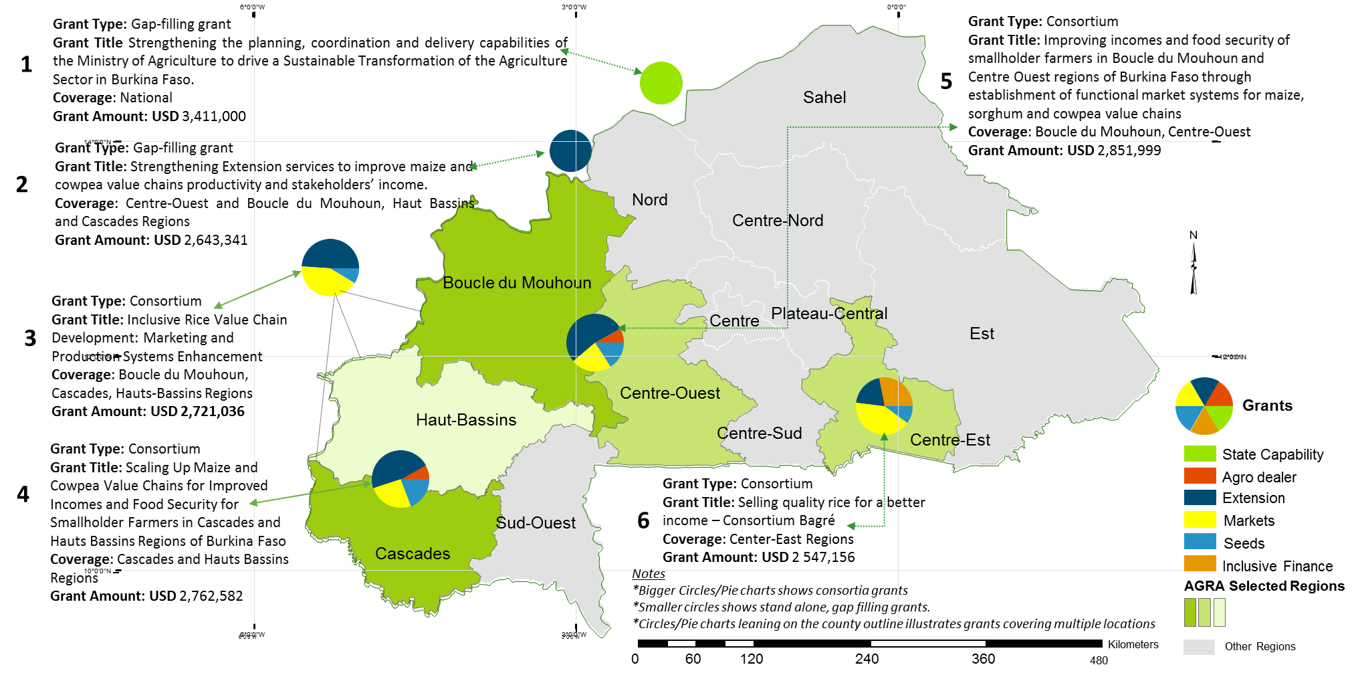
Since Strategy Inception, AGRA has made a number of Investments in Burkina Faso
Notes
*Bigger Circles/Pie charts shows consortia grants
*Smaller circles shows stand alone, gap filling grants.
*Circles/Pie charts leaning on the county outline illustrates grants covering multiple locations

Slide 34
Details of Existing Portfolio of Investments in Burkina Faso (1 of 2)
Description | Partners | Crops/Value Chain | Target
Inclusive Rice Value Chain Development: Marketing and Production Systems Enhancement | SICAREX, Groupe de Recherche et d’Actions pour le Développement (GRAD), Institut de l'Environnement et de Recherches Agricoles (INERA), L’Union Nationale des Producteurs de Riz du Burkina Faso (UNPR-B) | Rice | 120,000
Improving incomes and food security of smallholder farmers in Boucle du Mouhoun and Centre Ouest regions of Burkina Faso through establishment of functional market systems. | Groupe de Recherche et d’Actions pour le Développement, Institut de l'Environnement et de Recherches Agricoles, Association Centre Ecologique Albert Schweitzer du Burkina Faso, .Union des Groupement pour la Commercialisation des produits Agricoles de la Boucle du Mouhoun, Direction Regionale de l’Agriculture et des Amenagements, Direction Regionale de l’Agriculture et des Amenagements Hydrauliques de Boucle du Mouhoun (DRAAH-BM), 7.Association Des Grossisteset Detaillants D'intrants Agricoles, 8.Direction Génerale des Production Végétales, 9.Neema Agricole Du Faso, Agriculture et Intrants | Maize, sorghum and cowpea value chains | 184,087
Strengthening Extension services to improve maize and cowpea value chains productivity and stakeholders’ income in the Centre-Ouest and Boucle du Mouhoun, Haut Bassins and Cascades regions of Burkina Faso | Association burkinabé d’action communautaire (ABAC) KAWORO | Maize and cowpea | 294,000

Slide 35
Details of Existing Portfolio of Investments in Burkina Faso (1 of 2)
Description | Partners | Crops/Value Chain | Target
Scaling Up Maize and Cowpea Value Chains for Improved Incomes and Food Security for Smallholder Farmers in Cascades and Hauts Bassins Regions of Burkina Faso | Association pour la promotion des petites et moyennes entreprises (APME 2A), Institut de l'Environnement et de Recherches Agricoles, Association Centre Ecologique Albert, Schweitzer du Burkina Faso, Association Des Grossistes et Detaillants D'intrants, Neema Agricole Du Faso, Agriculture et Intrants, Union provincial des professionnels agricoles du Houet, Agripromo, Direction Génerale des Production Végétales, | Maize and Cowpea | 150,000
Maize and cowpea value chain upgrading with sustainable financial systems and industrial markets | ICDE | Maize cowpea | 75,000

Slide 36
Mapping the Strategy to outcomes in the theory of change
Change area (outcomes) | Activities | Current investments | Gaps for future investments | Potential partners
Strengthened planning, coordination and implementation of agricultural sector investment plans | Strengthening of the delivery capabilities of the Ministry of Agriculture - Planning coordination, execution and strong M&E system for evidence based decision making | Ministry of Agriculture( $3,411,000) Strengthen institutional capacity of the Ministry of Agriculture, in line with ongoing strategic reforms initiated by the Government in order to drive agriculture sector transformation in Burkina Faso
 | Development of the rice flagship project | Technical assistance provided to carry out the scoping and formulation for Burkina Faso rice flagship initiative | Effectively mobilize private developer able to secure needed resources to implement the project with the Government’s support | Sinohydro, China Development Bank, Exim Bank of China, IsDB, African Development Bank
Enabling policy environment developed | Input subsidy reform: AGRA contributed to reform Government approach to input subsidy to integrate better targeting and private sector led distribution systems Support to the DGPER (Ministry of Agriculture) for the operationalization of the Rural Investment Code Review of the seed law to fully domesticate ECOWAS guidelines and ensure key bottlenecks on private sector involvement in EGS are addressed | Technical assistance provided to the Ministry to review the current input subsidy model and propose reform options | Operationalize the rural investment code Implementation of the improved subsidy program ? | CORAF/WECARD, GIZ, KfW

Slide 37
Mapping the Strategy to outcomes in the theory of change
Change area (outcomes) | Activities | Current investments | Gaps for future investments | Potential partners
Strengthened agricultural input system, technology, development and supply chain | Production of foundation and breeder seeds of different varieties including hybrids Production and selling of certify seeds Implementation of mother demos Distribution of mini packs for baby demos Capacity building of agro dealers (hub and retailers) to increase fertilizers access to farmers Selling of fertilizer to the farmers trough agro dealers network Reduction of post harvest loses by promoting the using of improved technologies Facilitation of access to finances for input access | GRAD ($ 1 845 335) Increase productivity of Maize, sorghum and cowpea to contribute to improve incomes and food security of smallholder farmers in Boucle du Mouhoun and Centre-Ouest regions APME2A ($ 1,817,677) Increase productivity of Maize and cowpea to contribute to increase incomes by 25%, food security and livelihood for 150 000 smallholder farmers in the cascades and Hauts Bassins regions of Burkina Faso GRAD ($ 1499 865) Increase productivity of rice to contribute to to Improve income and food security for 109 382 rice producing farmers in Boucle du Mouhoun, Cascades, and Hauts-Bassins regions ABAC ( $ 2 643 341) Enhance Extension system in Burkina to contribute to improve the productivity on Maize and cowpea in for regions in Burkina TRIAS ($ 714 552) Increase the productivity of Rice in the Center Est region by dong demos and training VBAs and farmers INERA ($ 258 460) produce foundation and breeder seeds of rice for seeds companies | Need to improve the access to the mechanization Need to reach more farmers to achieve the objectives of AGRA Need to make available balanced fertilizer for SHFs | SONATER IsDB, INERA, Fertilizer blenders

Slide 38
Mapping the Strategy to outcomes in the theory of change
Change area (outcomes) | Activities | Current investments | Gaps for future investments | Potential partners
Increased use of structured markets | Facilitate financial negotiation for FOs and SMEs (ICDE) Capitalize and expand the pilot experience of developing a franchise business model for cowpea (ICDE) Promote the creation and/or development of 100 jobs for young people along value chains (ICDE) Provide incubator and accelerator services to 15 existing and new mechanization service providers and rice processors(SICAREX) Facilitate the development of sustainable business relationships between processors and traders (SICAREX) Support processors to master their production costs (SICAREX) Facilitate access to financing for stakeholders in the rice value chains (SICAREX) Facilitate building lasting business relationships among actors in rice value chains ( (RIKOLTO) Quality management support for producers, processors, parboilers (RIKOLTO) Support to MFIs and FIs to develop/adapt financial products Inform/train MFIs and FIs on the financing needs of stakeholders in agricultural value chains (RIKOLTO) Strengthen producers' capacities according to the Smart Valley approach for the development of sites for rice production (RIKOLTO) Basic repair and equip existing stores/ warehouses with basic produce handling and quality management tools (UPPA-H) Organization of maize and cowpea collection and storage (UPPA-H) Link aggregation centers to institutional markets (school feeding programs; World Food Program; national and regional reserves and traders (UPPA-H) | ICDE ($1,401,546 ) Maize and cowpea value chain upgrading with sustainable financial systems and industrial markets SICAREX ($1,134,018) Increase income for 109 382 rice smallhoder farmers in three regions through enhance rice production and marketing SICAREX ($ 509,227) Bolster and support a competitive and inclusive rice value chain which to increase incomes of 50,000 small-scale rice producers in the Centre-east region of Burkina Faso RIKOLTO ( $ 1,064,915) Develop business relation between rice value chain actors, develop a franchise business model for women rice parboilers UPPA-H ($371,021) Increase incomes for 150 000 smallholders farmers of maize and Cowpea by facilitating post harvest management and commercialization. | ?? | Banks, GIZ, KfW, IFAD, FAO, ABC Fund

Slide 39
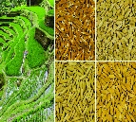
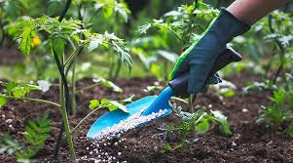
Early Results from investments made in Burkina Faso are outlined below…..
47K
AGRA aims to reach 1.3 M HHs directly and a further 0.9 M HHs indirectly. So far, 61% have been committed* and 47,000 reached.
1,799
MT of Seed
AGRA aims to produce 54,225 MT of seed over the life of strategy. To date, 1,799 MT has been produced and sold to farmers for US$ 5.16M
176 Agro dealers
AGRA aim to support development of 563 agro dealer shops over the life of strategy. Current achievement of 176.
5 Hub-agro-dealers
In partnership with the Association Des Grossistes et Detaillants D'intrants Agricoles (AGRODIA) and Groupe de Recherche et d’Actions pour le Développement (GRAD), AGRA is supporting development of hub agro-dealers using the AFAP model and has 05 hub agro dealers comprised of 483 retailers who have sold 144 K MT valued at US$ 64M
~US$ 75 M to be leveraged
AGRA’s work in development of the rice flagship will lead to the mobilization of US$ 75 M
5 policies (Agriculture Investment Code, Warehouse Receipt, Market Public Procurement, ECOWAS Seed Domestication and ECOWAS Fertilizer Domestication) have been prioritized for reforms and are all at different stages of implementation with the Agriculture Investment Code and Public Procurement Policy at execution stage
5 Policies
* No. of HHs committed under current investments

Slide 40
Emerging Lessons
Lesson | Adaptive Response
Lesson 1: Access to finance for staple food crop production and marketing can be unlocked with innovative risk sharing approaches Limited financing prevent SHF from effectively adopting at their full potential productivity enhancing technologies (e.g.. Quality input packages). New approaches to unlock finance through structured markets are offering promising results. This consist in sharing credit risks among key actors with direct interest in the value chain (farmers, input suppliers, processors/traders) | Working with financial institutions on credit facilities backed by sales arrangements but integrating risk sharing between farmers (10% of the credit to be deposited as “credit guarantee” in the bank, 10% to be deposited by the buyer and input supplier accepting a 10% discount on supplied input price. This allows the bank to secure an initial guarantee facility up to 30% the credit amount This model has been welcomed by banks and with initial facilities established by two banks for this agricultural season
Lesson 2: Adapted post harvest mechanized tools have significant impact on produce marketability and gender benefit The BREP project funded by AGRA initiated a matching grant for the acquisition of threshing machines (able after R&D, to thresh rice, maize, cowpea, sorghum and millet). Few months after implementation of the project, service providers were interested and able to acquire this machine to reduce post-harvest losses in their locality, also to create new jobs. In addition to ensuring high quality grains, the machines have for instance reduced time took by women to thresh cowpea from 18h to 1h | Following the initial success in introducing this adapted post harvest handling tool, AGRA intends to support its large scale access, particularly by women groups (which are more involved post harvest handling activities). A matching fund up to $1.5M planned to be administered by a bank to support equipment credits

Slide 41
Emerging Opportunities for Burkina Faso
Opportunity | Implication for Burkina Faso
1. Strong commitment by the Government, at the highest level, to transform the rice sector (Reach 1M metrics tons from the current 400K tons) by 2020, through a combination of PPP projects for extending areas under irrigated production and support value chains. | AGRA is playing a leading role in supporting the Ministry translate this ambition into a flagship project and ensure strong coordination of key partners (IsDB, China, etc.) supporting rice value chain development
2. Establishment of a new agricultural bank provides a strong opportunity to scale promising financing approaches | AGRA will continue closely working with the bank to roll out the risk sharing VC financing approach There is also a clear appetite from the bank to explore digital finance. Further discussions with the Gates team on potential response on this need
3. Collaborative (AGRA – BMGF) interventions to address gaps in evidence based policy making and delivery capability | Further discussions with the Gates team on tailored approach regarding the planned policy unit design work Ongoing joint discussion Gates team – AGRA - TBI on supporting the presidential delivery unit under the President's office

Slide 42
The Team

Slide 43
Country organogram and support structure
Regional Head, West Africa
West Africa-based Technical Support
HQ- based Technical Support
HQ Administrative
Country Manager
Program Coordinator
PIATA Chief of Party
Head of Grants Management
Head of Input Distribution & Agro-dealer development
PIATA Deputy Chief of Party
Chief Finance Officer
Driver
Head of Country Support
Head of Procurement
Program Officer
M&E Officer
Program Officer, Soil Fertilizer & Fertilizer Systems,
Head of Policy and Advocacy
Head of Communications
Associate Program Officer –Country Support
PDI Officer PO Inclusive Finance
Head of Seed Research & Systems Development
Regional Program Officer, Markets,
Human Resources Director
Head of Inclusive Finance
Associate Program Officer –Country Support
GST Finance Administrator
Head of Development Cooperation
Head of Soil Fertility & Fertilizer Systems
Program Officer, Regional Food Trade
General Counsel
Head of Extension & Capacity Building
Grants Officer
Key
Head of Gender
Program Officer, Partnerships
Based in country and Hired
Head of Partnerships
Head of M&E and Knowledge Management
Based in Nairobi
Program Officer, Partnerships
Head of Strategy and Analytics
Based in country and Yet to be hired
Compliance Officer
Shared Resource Based in Mali

Slide 44
Annexes: AGRA Institutional Results Framework and theory of change Burkina Faso Cropping Seasons Main Partners in Burkina Faso Acronyms

Slide 45
AGRA Strategy Results Framework
CAADP Framework | Sustainable Development Goals
Goal: Catalyze and Sustain an Inclusive Agricultural Transformation in Africa to increase incomes and improve food security
Objective 1:
Increased staple crop productivity for smallholder farmers
Objective 2:
Strengthened and expanded access to output markets
Objective 3:
Increased capacity of small holder farming households and agricultural systems to better prepare for and adapt to shocks and stresses
Objective 4:
Strengthened continental, regional and government multi-sectoral coordination, and mutual accountability in the agricultural sector
Objectives
Primary Outcomes
Outcome 1: Strengthened agricultural input systems, technology development and supply chain
Outcome 2: Increased adoption of Agriculture productivity enhancing technologies
Outcome 3: Reduced post-harvest losses
Outcome 4:
Increased agricultural employment and entrepreneurship
Outcome 5:
Increased use of structured markets
Outcome 6: Strengthened and expanded business development, financial and risk management services in agriculture value chain
Outcome 7:
Reduced impact of agricultural volatility
Outcome 8: Strengthened national and regional level agriculture sector system functioning
Cross-cutting outcomes
9. Strengthened regional and national agricultural enabling policy environment
10. Increased women empowerment and livelihoods in agriculture
11. Increased youth empowerment and livelihoods in agriculture
12. Strengthened capacity for farmers and other focus agricultural value chain actors
13. Strengthened Public and Private Partnerships in agriculture

Slide 46
Policy and State Capability Theory of Change
Increased incomes and improved food security
AGRA’s Strategic Goals
Increased productivity (more productive small holder farming units and SMEs )
Increased regional trade (intra-Africa trade) in agricultural commodities and inputs
Increased resilience (more adaptive and resilient households to shocks)
Outcomes
The public sector
Increased public sector investments in agriculture
Public sector investments are generating priority and sufficient public goods that de-risk the sector
Appropriate policies providing incentives for private sector investments including public private partnerships in place and operational
Mutual accountability systems and platforms that are aligned to the continental scorecard in place and operational
Non-state actors
Increased private sector investment along the value chain (input production and delivery, farm production, distribution, processing and retail)
Increased private sector participation in cross-border and domestic trade
Non-state actors actively engaged in the accountability processes
Functioning systems
Increased private sector investment along the value chain (input production and delivery, farm production, distribution, processing and retail)
Appropriate regulatory framework for the agricultural sector in place and operational
Reduction and elimination of barriers to domestic and regional trade
Partnerships
Work with partners at all levels to:
Crowd in private capital in support of small-holder agricultural development
Derive synergies and reduce duplication of effort likelihood of transformation within
Derive synergies in order to increase the reach of AGRA’s investments (impact at scale)
So that the target population, institution or resource change
Public Sector / governments have
Sector strategies defining priority areas for investment and policy reform
Mobilized public sector, development partners and non-state actors to invest in /implement priority programs that drive agricultural transformation and facilitate regional trade
Better coordinated sector investment programs
Is championing the necessary policy reforms to drive agricultural transformation and facilitate regional trade
Accountability systems that sustain commitment, encourage results focus and ensure delivery
Investment areas
Develop appropriate sector strategies and investment plans for agricultural transformation
Formulate appropriate policies that catalyze and sustain agricultural transformation and promote regional trade
Implement sector plans and policies in order to generate sufficient public goods that de-risk the sector, attract private capital investment and facilitate regional trade
What AGRA does

Slide 47
Farmer and Systems development Theory of Change
Increased incomes and improved food security
AGRA’s Strategic Goals
Increased productivity (More productive small holder farming units and SMEs)
Increased resilience (more adaptive and resilient households to shocks)
Outcomes
State capacity and policy
Develop state capability to:
Develop appropriate sector strategies and investment plans for agricultural transformation
Formulate appropriate policies that catalyze and sustain agricultural transformation and promote regional trade
Implement sector plans and policies in order to generate sufficient public goods that de-risk the sector, attract private capital investment and facilitate regional trade
Farmers using
Improved production, management technologies and practices
Agricultural credit and financial services
Improved post harvest management technologies and practices
Early warning weather and market intelligence information
Non-state actors
Large, MSMEs producing and delivering inputs, extension, services to farmers in response to demand from farmers
Bank and non-bank institutions providing financial and credit services to MSMEs and farmers
Large, MSMEs providing off-taking, warehousing and processing services
So that the target population, institution or resource change
Farmers and other value chain actors have improved access to
Inputs (fertilizer, seeds); Extension services (knowledge and information); Credit and financial services, stable and remunerative markets, early warning and market intelligence information
Investment areas
Strengthening agricultural input systems, technology development and supply chain
Developing and strengthening extension and advisory services
Developing and strengthening early warning weather and market information systems
Developing and strengthening responsive agricultural finance and credit systems
Developing and strengthening stable reliable and remunerative output markets
Partnerships
Work with partners at all levels to:
Crowd in private capital in support of small-holder agricultural development
Derive synergies and reduce duplication of effort likelihood of transformation within
Derive synergies in order to increase the reach of AGRA’s investments (impact at scale)
What AGRA does

Slide 48
Partnerships development Theory of Change
Increased incomes and improved food security
AGRA’s Strategic Goals
Increased productivity (More productive small holder farming units and SMEs)
Increased resilience (more adaptive and resilient households to shocks)
Outcomes
Partnerships for implementation
Increased reach of AGRA systems grants
Reduced /elimination of duplication of efforts and wastage
Faster progress towards and achievement of intended outcomes and impacts
Increased likelihood of achieving the desired outcomes and impacts
Partnerships for scaling up
Increased public private partnerships
Increased access to technologies knowledge and information
Increased private sector investments at scale
Increased transboundary trade
State capacity and policy
Develop state capability to:
Develop appropriate sector strategies and investment plans for agricultural transformation
Formulate appropriate policies that catalyze and sustain agricultural transformation and promote regional trade
Implement sector plans and policies in order to generate sufficient public goods that de-risk the sector, attract private capital investment and facilitate regional trade
So that the target population, institution or resource change
Partnerships have then following catalytic effect
Systems grants consortia addressing priority bottlenecks in specific geographies
Partnerships for policy advocacy influencing policy formulation and implementation
Development partners investment programs and projects are aligned to derive synergies and avoid duplication
Mutual accountability platforms and processes are defined by partnership objectives
AGRF serving as the premier partnership platform for shaping agricultural development agenda in Africa
Investment areas
Mobilizing inclusive investments in Agriculture
Creating a private-sector led leadership agenda
Build partnerships with leading private sector champions to leverage entire ecosystem and build partnerships around knowledge and intelligence sharing
What AGRA does

Slide 49
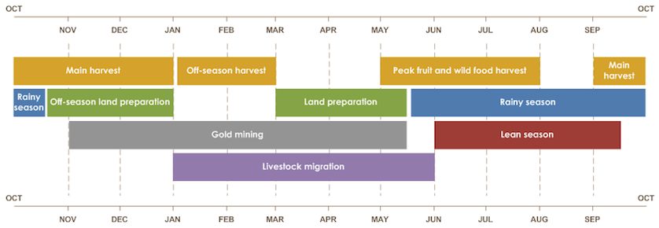
Burkina Faso
Update slide and speak about importance of timing of investments to match seasons

Slide 50
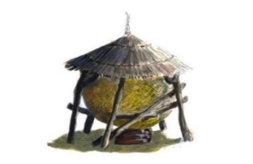
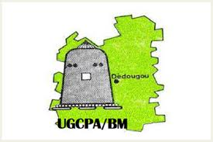
AGRA’s Main Partners in Burkina Faso
System Development
Partnerships
Policy & State Capability
Association Burkinabè
d’Action Communautaire
UPPA-Houet
Ministère de l’Agriculture et des Aménagements Hydro-Agricoles
AGRIPROMO
Direction Générale des Productions Végétales

Slide 51
ACRONYMS
ABC | Agribusiness Capital Fund
AfDB | African Development Bank
AGRA | Alliance for a Green Revolution in Africa
ASWG | Agricultural Sector Working Group
CAADP | Comprehensive Africa Agricultural Development Program
CARI | Competitive African Rice Initiative
CIPAM | (Compagnie Industrielle de Production Agricole et Marchande
EBA | Enabling Business of Agriculture
FAW | Fall Army Worm
FDI | Foreign Direct Investment
GDP | Gross Domestic Product
GoBF | Government of Burkina Faso
HA | Hectares
HH | Household
ICT | Information Communication & Technology
IFPRI | International Food Policy Research Institute
JSR | Joint Sector Review
M&E | Monitoring and Evaluation
METASIP | Medium Term Agriculture Sector Investment Plan
MAAH | Ministry of Agriculture and Water development
MoU | Memorandum of Understanding
MT | Metric Tonne
NAIP | National Agriculture Investment Plan
PNSR II | Planting for Food and Jobs
PROCIV | Green Innovation Center Project
SHF | Small holder Farmer
SIPMA | Smallholder Inclusive Productivity & Market
SMEs | Small and Medium Enterprises (SMEs)
TA | Technical Assistance Fund

