Slide 1
The secret to mobilizing funds for agri-SMEs
Webinar, March 4^{th,} 2021
Notes:
Welcome to today’s webinar “ The secret to mobilizing funds for agri-SMEs ”. We are expecting a large crowd today so we will wait a minute to get them settled.
Okay, I think we are ready to go. Thank you for joining us for today’s webinar, ““ The secret to mobilizing funds for agri-SMEs”. Today’s webinar is being hosted by AGRA and our presenters are from AGRA, the Center for Financial Inclusion and SCOPEinsight.
Before I introduce our speakers, I would like to cover a few housekeeping topics.
- Today’s webinar is being recorded. We will be able to share a link with you after the event is complete. We welcome you to revisit the content yourself and share it with colleagues.
- We also invite your comments and questions but please hold them until the end. There will be ample time to ask questions

Slide 2
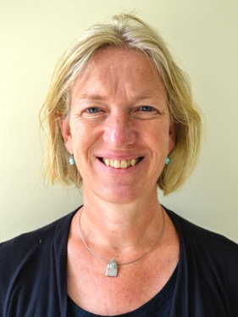
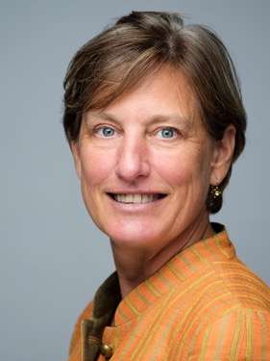
Today’s Speakers
Hedwig Siewertsen
Marise Blom
Eda Dokle
Henry Bruce
Head of Inclusive Finance
AGRA
Chief
Operating
Officer
SCOPEinsight
Research
Specialist
Center for Financial Inclusion
Director of
Research
Center for Financial Inclusion
Notes:
We have an impressive line up of speakers. First we will hear from Hedwig Sierwertsen who is the head of Inclusive finance at AGRA. Then we will hear from SCOPEinsight's Chief Operating Officer, Marise Blom. Followed by Eda Dokle who is a research specialist at the center for financial inclusion and finally from Henry brust who is CFI's Director of Research.

Slide 3
Agenda
Why would AGRA invest in bankability metrics?
Why do agri-SMEs fail to get finance?
Why do we need to speak one language?
What is the secret language?
How can the secret go viral?
Questions?
Notes:
Our presentation today is divided into seven parts. The first section will cover why AGRA invested in the metrics presented to you today. the second part will explain why agri-SMEs fail to access finance. The third part will cover why a common language is essential for access to finance. Then we will uncover what the secret langague is and what can be found in the bankability report. Then we will explain how this can become the normal and we will finished by a short Q&A session where you can type your questions into the chat.

Slide 4
Poll #1: Access to finance is the main barrier for agricultural enterprise growth: YES or NO?

Slide 5
In Africa, agriculture represents the largest opportunity to reach the SDGs by 2030. Yet, the sector remains chronically under-financed​
Investors
Three out of four agri-SMEs do not have the finance to grow​.
$65B is the estimated annual
agri-SME lending gap
Investors missing huge investment opportunity as less than 10% lending in Africa towards agriculture​
Agri-SMEs
Notes:
AGRA was created by Kofi Annan in 2006 to facilitate a uniquely African green revolution whereby millions of small scale producers are enabled to improve their yields and income in a sustainable manner. Agricultural MSMEs are key in delivering better seeds, blended fertilizer, post harvest technology and market access to small scale producers. If we cannot make these MSMEs more competitive we will fail to reach farmers with affordable products and services. Making MSMEs more competitive means they need access to finance. However, the annual lending gap in sub-Sharan Africa is estimated to be sixty five billion dollars a year. This reality translates into agri-SMEs not having the necessary finance to grow and investors missing big investment opportunities. So why do MSMEs not get access to finance?

Slide 6
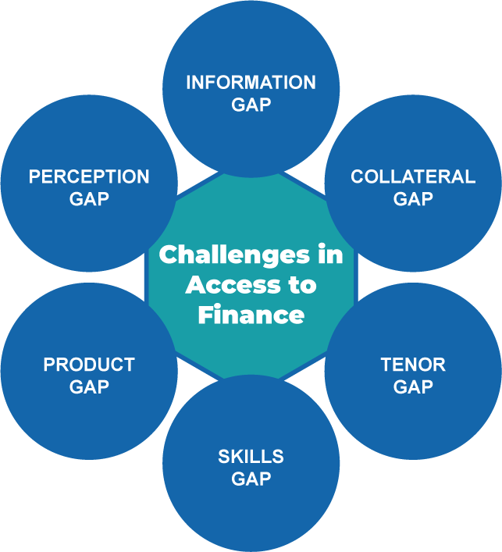
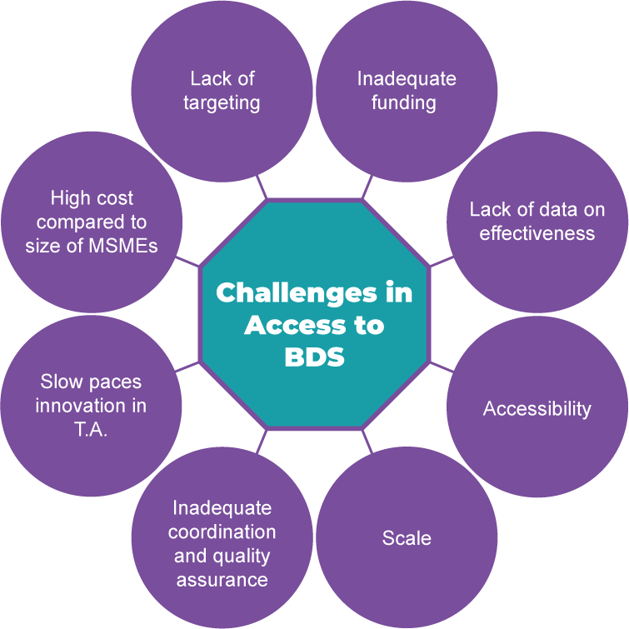
Current Barriers in MSME Growth
Access to Financial Services
Access to Business Development Services
Notes:
There are many reasons for MSMEs not getting access to finance, some are related to the MSMEs themselves and some are related to the way bankers think about MSMEs. Most MSMEs cannot easily proof to banks that they can productively use the loan and repay it. I always say that bankers are people that finance you when you can proof that you do not need the money! So how do we support MSMEs to proof in an efficient manner (because for bankers time is money) that they are an interesting client for the financier? By starting to speak the same language!

Slide 7
The need for a common language
Development of Metrics that indicate agri-SME bankability validated by 90 lenders and industry experts
Agri-SME: Am I bankable?
Bank: Is this MSMEs bankable?
Adoption of the common bankability metrics by financiers
PROBLEM
Information asymmetry
INVESTMENT
Standardized metrics
SOLUTION
More efficient deal screening
Notes:
So in order to support MSMEs and banks to speak the same language, AGRA looked at how the market for microfinance boomed in the late nineties. Microfinance institutions evolved from marginal small non professional institutions into a flourishing sector, when MFIs, funders and supporters agreed on common performance standards and started to use those standards in rating tools and during due diligence. These standards then evolved in a matchmaking platform called MIX market which became one of the largest data sharing platform for the microfinance sector, brokering millions of dollars each year. AGRA saw the analogy: what if we can develop common indicators that can be used for rating, due diligence and performance measurement of Agricultural SMEs? And see where we are today: Sharing with you version 1.0 of that common language.

Slide 8
Why do we need to speak one language?

Slide 9
Three important barriers need to be addressed to solve the access to finance challenge
1
Agri-SMEs must operate as robust businesses and must meet market requirements
Barriers for Access to Finance
Risky
2
Costly to collect data
Lenders reluctant due to bad experiences
Costly
3
Lack of standards or common language
Agri-SMEs are not aware of the requirements & lenders struggle to assess risk

Slide 10
To reduce risk for lenders, agri-SMEs must demonstrate they are well-managed and meet market requirements
Market-led Assessment
Capacity Building based on needs
Re-assessment
Digital profile with track record
The agri-SME Track Record needs to speak a language lenders understand

Slide 11
A common language leads to better informed parties and lowers cost to gather data
Am I ready to handle a loan?
Does the agri-SME fit in my portfolio??
What information do I need to provide?
Is the agri-SME a potential reliable client?
A common language increases mutual understanding and reduces costs
Which lender is right for me?
What are the specific risks I need to investigate?
Agri-SMEs
Lenders
Notes:
Note from Eda: I really liked smth from the last AGRA webinar that EXEO Capital said: We (investors and agri-SMEs) need to get ready to sit on the same table and talk the same language. Many agri-SMEs get scared from the finance language that FI use and always think that they are not ready.

Slide 12
Increased transparency and better data benefits all stakeholders and will unlock new opportunities
Targeted support for agri-SMEs by BDS providers as expectations and requirements become clearer
Decrease costs and risk for lenders through more confident and efficient pre-due diligence selection
Increase sector visibility as standard datasets can be benchmarked and tracked over time
Notes:
Note from Eda: Another comment from the AGRA webinar that may go as a voice over to the first point: Investor- we need to work with institutions that offer technical assistance to these businesses. If we are not able to invest, direct them to other partners (buyers/TA) that enable them to become investment ready. They meant (i think): let's not just shut the door to these agri-SMEs, if we don't initially finance them, but direct them to other for support/capacity building/handholding

Slide 13
When widely adopted, the common language can bridge the lending gap
Lenders search for ways to cost- effectively service agri-SMEs
Bankability metrics
Pipeline of more professional agri-SMEs
Social lenders
Local Fin Inst.
Funds
Track record/
digital profile
Re-assessment
Assessment
Capacity building/TA
Interventions
Notes:
The graduation process needs to be built on metrics that can also address info asymmetry

Slide 14
What is the secret language?
Notes:
Recap here – Missed opp for both, graduation, one language
A standardized set of bankability metrics would alleviate some of the existing barriers faced by SMEs in accessing finance by serving as a common language between agri-SMEs and lenders.
For lenders, the metrics would provide an overview of the state of an agri-SME's business that is robust enough for the lender to make an informed decision about whether to continue with due diligence.
For agri-SMEs and the service providers that support them, the metrics would clarify the expectations of lenders, so they can better prepare for the assessments and respond to the lenders’ information requests more quickly and efficiently. In a way, these metrics are a guideline to getting ready for finance.

Slide 15
Common lender behaviors hinder lending
Decreased efficiency and certainty of agri-SME assessments
Collect many generic business metrics
Request all info early on
Uncertain about relevance
Notes:
Extensive research: literature research; interviewed and surveyed over 90+ industry actors (social lenders, local financial institutions, TA/BDS providers and other supporting actors) involved in agri-SME lending; analyzed forms from different lenders; an Advisory Council of sector experts; leveraged other standard datasets and analysis of SCOPEinsight's comprehensive dataset
Common lender behaviors observed:
Uncertainty about which metrics are the most relevant at each stage of the deal flow– the information requested lacks a clear set of priorities, particularly earlier in the process, that would enable lenders to perform efficient pre-screening and initial evaluations.
Collect a large amount of generic business metrics - When lenders were asked to prioritize, their responses varied from quantitative metrics to qualitative ones.
Request everything early on in the process – given the high cost of due-diligence, lenders understandably request a lot of information but this hasn’t been optimized for pre-due diligence, so lenders end up requesting this long list of information from prospective clients from the start.
Decreased efficiency and certainty increases time/effort and risk, which hinders lending, particularly to smaller & less-formal agri-SMEs – Deciding on a clear set of metrics can save lenders time and help them evaluate risk more efficiently.

Slide 16
Poll #2: When applying for lending, an agri-SME’s management experience, staff and decision-making processes are equally as important as its financials to lenders: YES or NO?

Slide 17
Lenders wish to look beyond financials to business activity & governance
Lenders agree management capacity and governance are important
Research identified relevant areas of information
Opportunity for agri-SMEs to demonstrate their creditworthiness
Pricing, risk and compliance, governance and business planning capabilities contributing to receiving a loan
But their assessment is varied and ineffective
As an alternative to physical collateral
Lack of governance and internal management causing defaults
Notes:
Lenders agree that management capacity and governance are broadly important topics but unclear on the specifics as these metrics are challenging to quantify and verify during pre due diligence.
Our research revealed important takeaways:
From 400 metrics on 2336 agri-SMEs in the SCOPEinsight dataset - high scores in the “marketing strategies” (including pricing and market monitoring), “internal organization” (including risk and compliance), “governance”, and “business planning” dimensions increased the likelihood of an agri-SME receiving a loan, implying increased creditworthiness.
From CSAF members' portfolio and client data - governance and internal management are the primary reasons for default, making the ability of lenders to assess against these themes essential to successful lending
Opportunity for agri-SMEs to share alternative information with lenders than can support their creditworthiness, without physical collateral

Slide 18
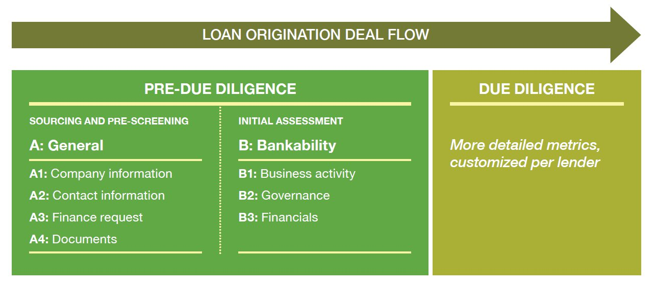
The "bankability metrics" are organized around a lender's deal flow and the bankability of the agri-SME
Notes:
This common language, the "bankability metrics", is no longer a secret! This set of straightforward data points for agri-SMEs to report to lenders is organized to align to a lender's typical deal flow: from sourcing and pre-screening, through their initial assessment to full due diligence.
General section – includes information metrics that are organized around four main areas:
Company information - Business activity, business type, registration and tax ID, organization structure, etc.
Contact information - Location, address, and primary contact details
Finance request - Loan amount requested, financing purpose, timeframe when financing is needed, and how it will be repaid
Documents - Comprehensive list of financial and legal documents
Bankability section, which we'll explore the highlights of in more detail
Business activity - information on the organization size, experience, business activity, links to markets, and level of indebtedness. (mostly quantitative)
Governance - information on the management team, their experience, dedication, and decision-making processes (highly qualitative and difficult to measure)
Financials: key balance sheet & income statement metrics, as might be expected. Lenders consider audited financials significantly more reliable.

Slide 19
Business activity metrics demonstrate core competence in a viable market
Some diversification can increase resilience
Top 3 clients (by share of sales)
Being dependent on one client indicates a limited market and detracts from pursuit of broader market opportunities
Current contracts specify pricing
"Several contracts with prices for a maize processor's flour was an indication of those clients' confidence in the business"
Top 3 commodities / products (by share of sales)
Metric in B1 Business activity
How lenders interpret the information provided
Notes:
The business activity section has 6 metrics: (in addition to the ones on the screen) year founded, number of employees, disclosure of financial obligations
Highlighting here 3 main metrics that are a clear indication of the business activity that lenders look into:
Top 3 products – information on your core business activity
Top 3 clients – information on markets
Contract and pricing – information on price stability

Slide 20
Governance and management metrics convey commitment & integrity
Recent changes in management
Metric in B2 Governance
How lenders interpret the information provided
"A revolving door of managers at a crop input provider was symptomatic of underlying operational and people issues, that detracted from running the business"
Level of commitment of the business manager to the business
A manager who spends 100% of their time with the business is dedicated to its success
Clear division of authority between management and board
A management team whose day-to-day decision-making is determined by the board is unable to operate on their own or won't succeed in the longer term
Notes:
Reiterate - ascertaining management skills and governance capacity is challenging
Proxies to measure governance, management capacity and experience

Slide 21
Poll #3: Agri-SMEs can readily report business activity and governance information: YES or NO?

Slide 22
How can the secret go viral?

Slide 23
The agri-SME finance deadlock can be broken, with benefits for all
Lower transaction costs = one less barrier for agri-SMEs to access finance
Donors can maximize their leverage by prescribing the use of these metrics in the work they support
Agri-SMEs prepare to report these metrics and get support where required
TA and BDS providers can target their support
Lenders request these metrics and use them during pre-due diligence to save time
Notes:
A shared understanding will help agri-SMEs be successful businesses and banks lend to agricultural businesses, helping to break the agri-SME finance deadlock
Stakeholders of all types should benefit:
Lenders should request these metrics from prospective agri-SMEs during the pre-screening process, saving time and making a pre-due diligence decision more confidently. They can also clarify their lending expectations by sharing the metrics with the agri-SME support providers they work with.
Agri-SMEs should prepare to report these metrics and seek support if required
TA and BDS providers should use the metrics to identify an agri-SME’s pain points and build their capacity accordingly. They can also seek minimum lending requirements from the lenders in their network, establishing a clear eligibility baseline for each lender.
Additionally, donors should maximize their leverage by prescribing the use of these metrics in the work they support
And widespread adoption could also improve the efficiency of matchmaking platforms, including the AGRF Deal Room, and the hundreds of other investment services and information solutions, like VC4Africa and AVPA
If you’d like to be involved, get in touch with the team!
In summary, lower transaction costs are one less barrier for agri-SMEs accessing the finance they need to grow and meet the food needs of the future.

Slide 24
Poll #4: When will you start adopting the bankability metrics: IN 1-3 MONTHS, IN 6-12 MONTHS, or IN 12+ MONTHS?
Notes:
How easy/hard is this? Is this short or long term? Start thinking about / starting the adoption of about applying them to your business / incorporating them into your processes

Slide 25
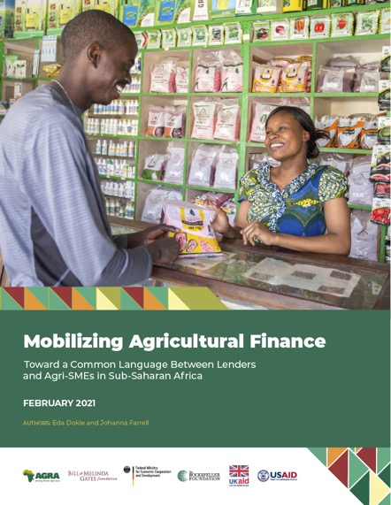
Questions?
Including:
Tables of metric names & descriptions
Link (in Appendix III) to download a data collection form in Excel
Read the full report @ bit.ly/agriSMEmetrics

Slide 26
Thank You!

